Slide 1
Indico
https://events.cels.anl.gov/
erhtjhtyhy
Samantha tezak
Executive Assistant
CPS Division
June 9, 2020

Slide 2
What is it?
Indico is web-based tool used for organizing and archiving events
It’s free & relatively simple to use
Offers a single location for archiving events and material
Offers a variety of features and you can use as many (or as few) as you choose
Why should we use it?
What’s the catch?
Unable to collect payments
An account is not necessary to view an event, but it is required to access some management features
Limited design capability

Slide 3
Overview of event types
There are 3 types of events you can create within Indico
Lecture: A lecture is a simple event that allows you to add a description or abstract, speaker(s) name and upload material.
Meeting: A meeting is a basic event that includes the features of a lecture, but it offers the additional functionality of creating an agenda/timetable and minutes.
Conference: A conference is the most robust event type. In addition to the features above, it supports abstract collection and review, participant registration, customizable menu including ability to create links and pages, badge printing, surveys, and more.
Note: Indico cannot be used for registration if there is a fee to collect. CVent must be used in this case.

Slide 4
Protection capability
Protection can be set at various levels of an event.
Category Protection: At the highest level, an entire category can be protected with an access control list.
Event Protection: If an individual event within a category needs to be protected, access can be granted with an access key or a specified access control list.
Material Protection: An individual document within an event can be protected with an access control list.
Other considerations
Use of an access control list would require that individuals have an Indico account.
Managers of a category have access to all content within the category, regardless of protection.
Event creators have access to all content, regardless of protection.

Slide 5
registration

Slide 6
features
Indico registration offers many capabilities
Create multiple registration forms
Use system registration and/or create custom fields
Set moderated registration
Limit registrants
Invite registrations via email through Indico
Customize registration emails
Customize outward facing participant list (or keep it unpublished)
Email registrants from Indico

Slide 7
Registration emails

Slide 8
customization
The menu on a conference page is customizable.
System Links: Indico comes with system links and pages by default. You can toggle these on and off. You can customize the link names.
Custom Links: You can add links in the event menu to external pages.
Custom Pages: Custom pages are created using basic word processing functions. You can also create pages using HTML.

Slide 9
Timetable views
Default View
Indico View

Slide 10
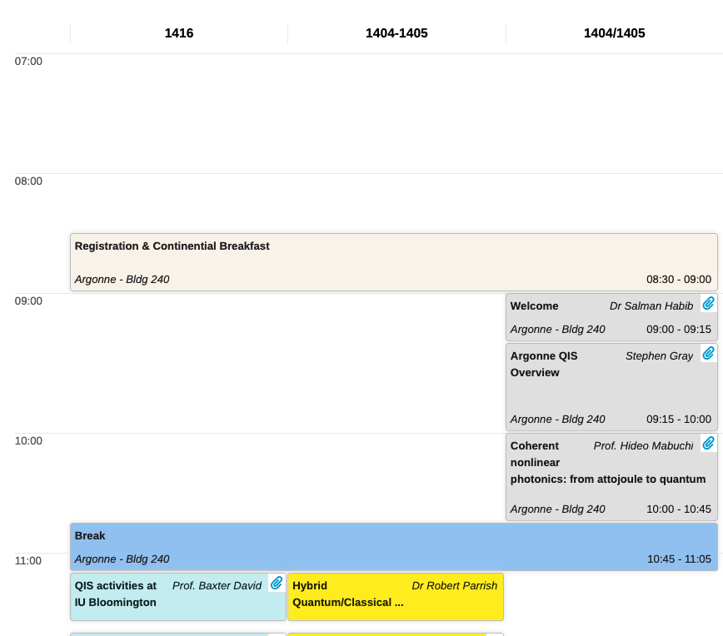
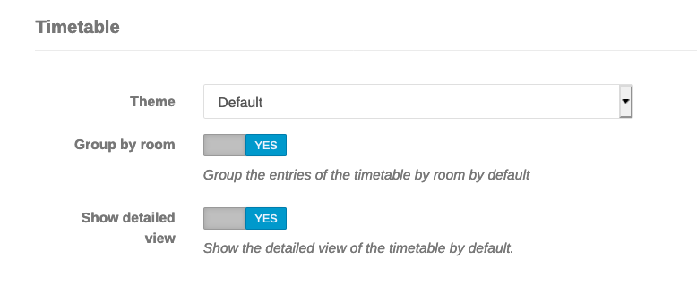
Additional Customization
Additional customization is found under the “layout” tab

Slide 11
Additional features
Clone events
Material
Reminders
Abstract submission and acceptance
Badge printing
Surveys
Calendar import link
Registration check in

Slide 12
Questions?
Indico User Guide: https://learn.getindico.io/
CELS Indico: https://events.cels.anl.gov/
HEP Indico: https://indico.fnal.gov/category/775/

