Slide 1
Writing a specific aims page
January 9, 2021

Slide 2
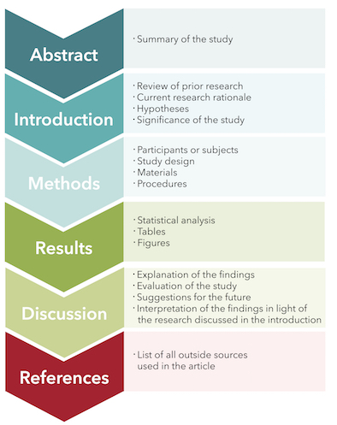
Scientific Article Format
ORDER
Abstract
Introduction
Skim Methods/Results
Discussion
Read Methods/Results
Notes:
Rely on mentors previously in program to explain expectations

Slide 3
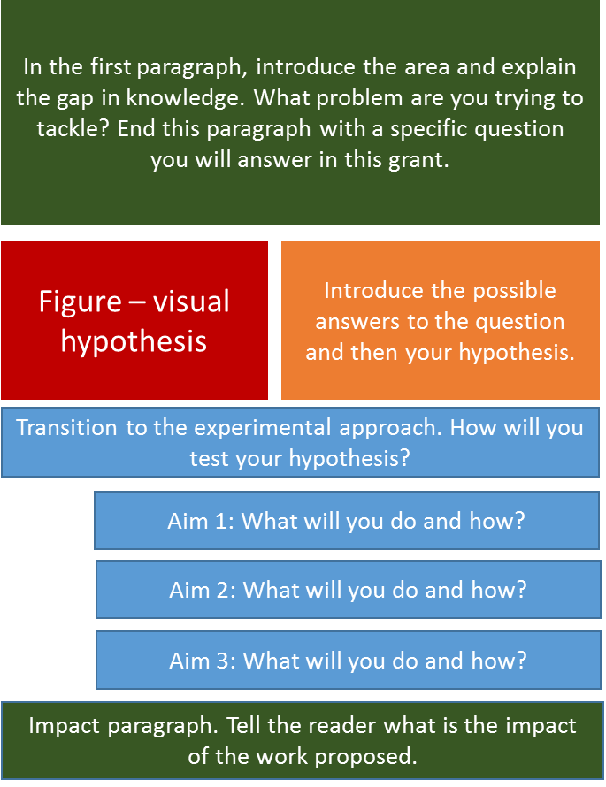

Slide 4
Why start with a specific aims page
A specific aims page is THE MOST CRITICAL part of any scientific project. It is a combination of persuasive writing and science married together in one page. A specific aims page does the following:
Demonstrates a problem, a gap in current knowledge, and suggests a solution
Aims that work toward a defended solution and reveal the impact of the proposal on the problem, the field, and future research
Creates easily understood rationale and methodology in laymen’s terms

