Slide 1
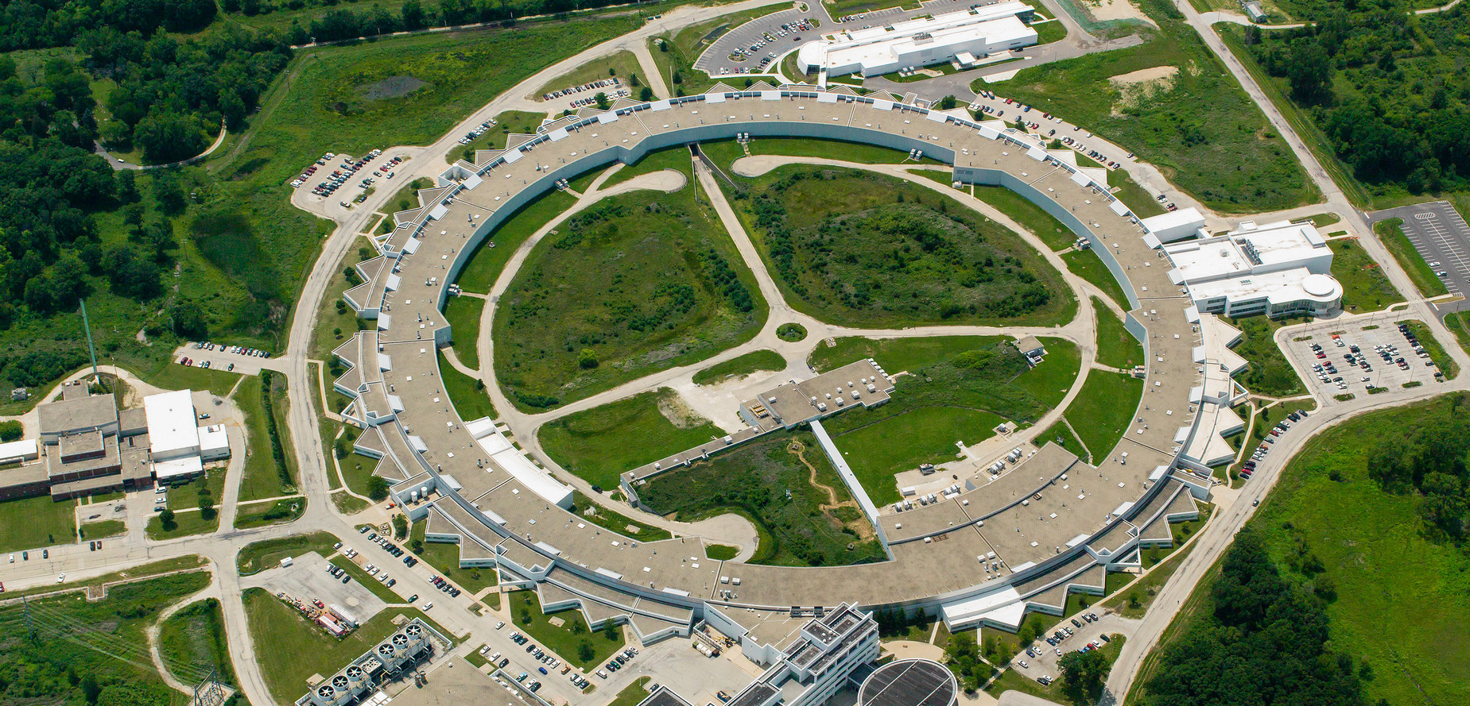
Argonne ACT-SO High
School research program (ARP)
November 7, 2020

Slide 2
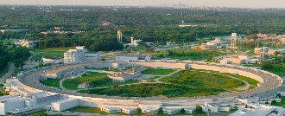
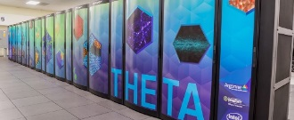
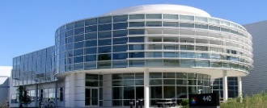
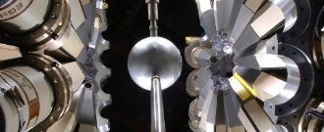
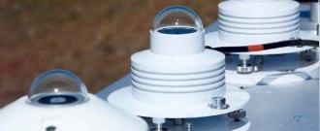
Argonne: a nexus for science and engineering
PEOPLE
MAJOR USER FACILITIES
Workforce
>1590 | scientists and engineers, including 274 joint faculty and 273 post-docs
569 | students:160 grad and 409 undergrad
>1100 visiting scientists
> 8300 users of our major facilities
Advanced Photon Source
Argonne Leadership Computing Facility
Center for Nanoscale Materials
Argonne Tandem Linear Accelerator System
Atmospheric Radiation Measurement Southern Great Plains Site

Slide 3
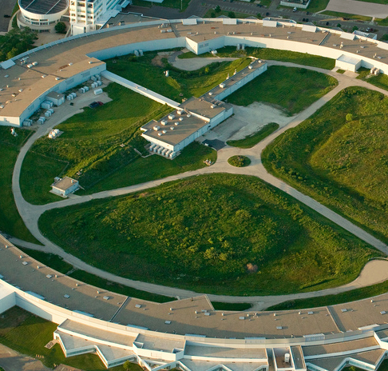
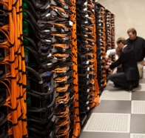

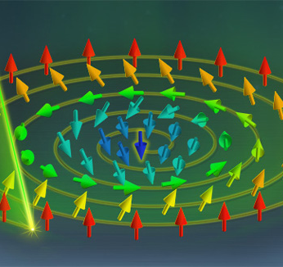
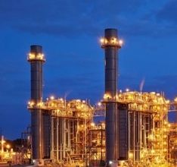
Argonne’s science and technology Strategy
Hard x-ray sciences
Advanced computing
Universe as our laboratory
Materials and chemistry
Manufacturing science and engineering
An upgraded APS
to revolutionize knowledge of materials’ structures and propel progress in science, medicine and technology
The most powerful supercomputers,
to overcome the biggest challenges in energy, materials, climate, cancer
and more
Pioneering techniques to simulate the universe and detect elementary particles, to unlock mysteries of the cosmos
Unprecedented ability to manipulate matter to optimize advanced batteries, catalysts, quantum materials and clean water systems
Breakthroughs to boost American industrial success in producing innovative materials for energy technologies of
the future

Slide 4
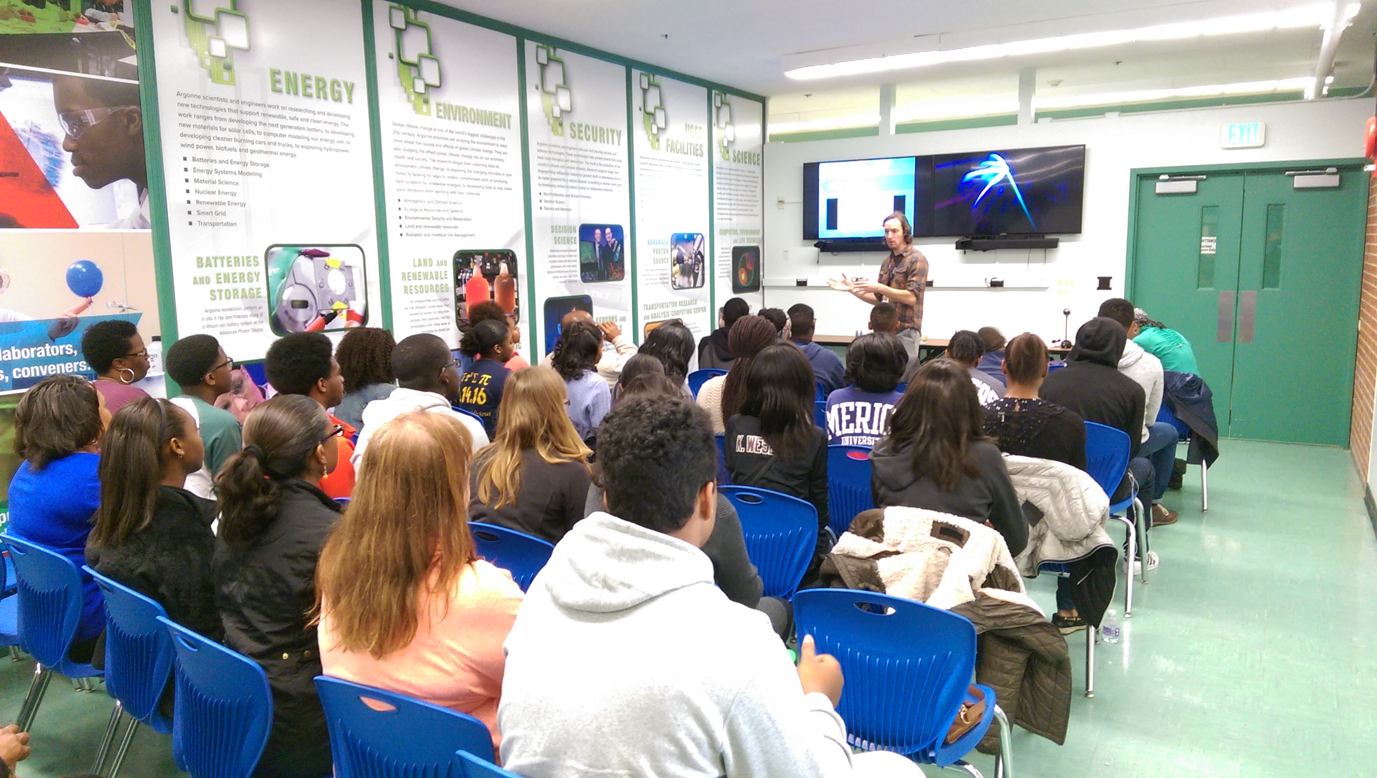
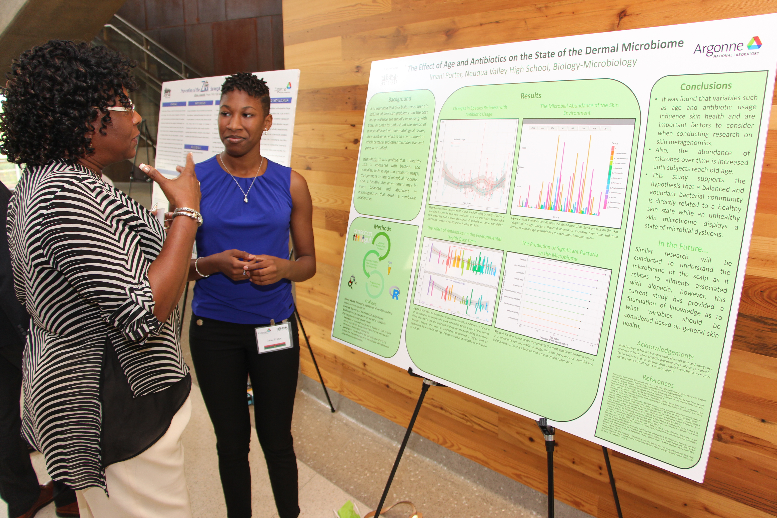
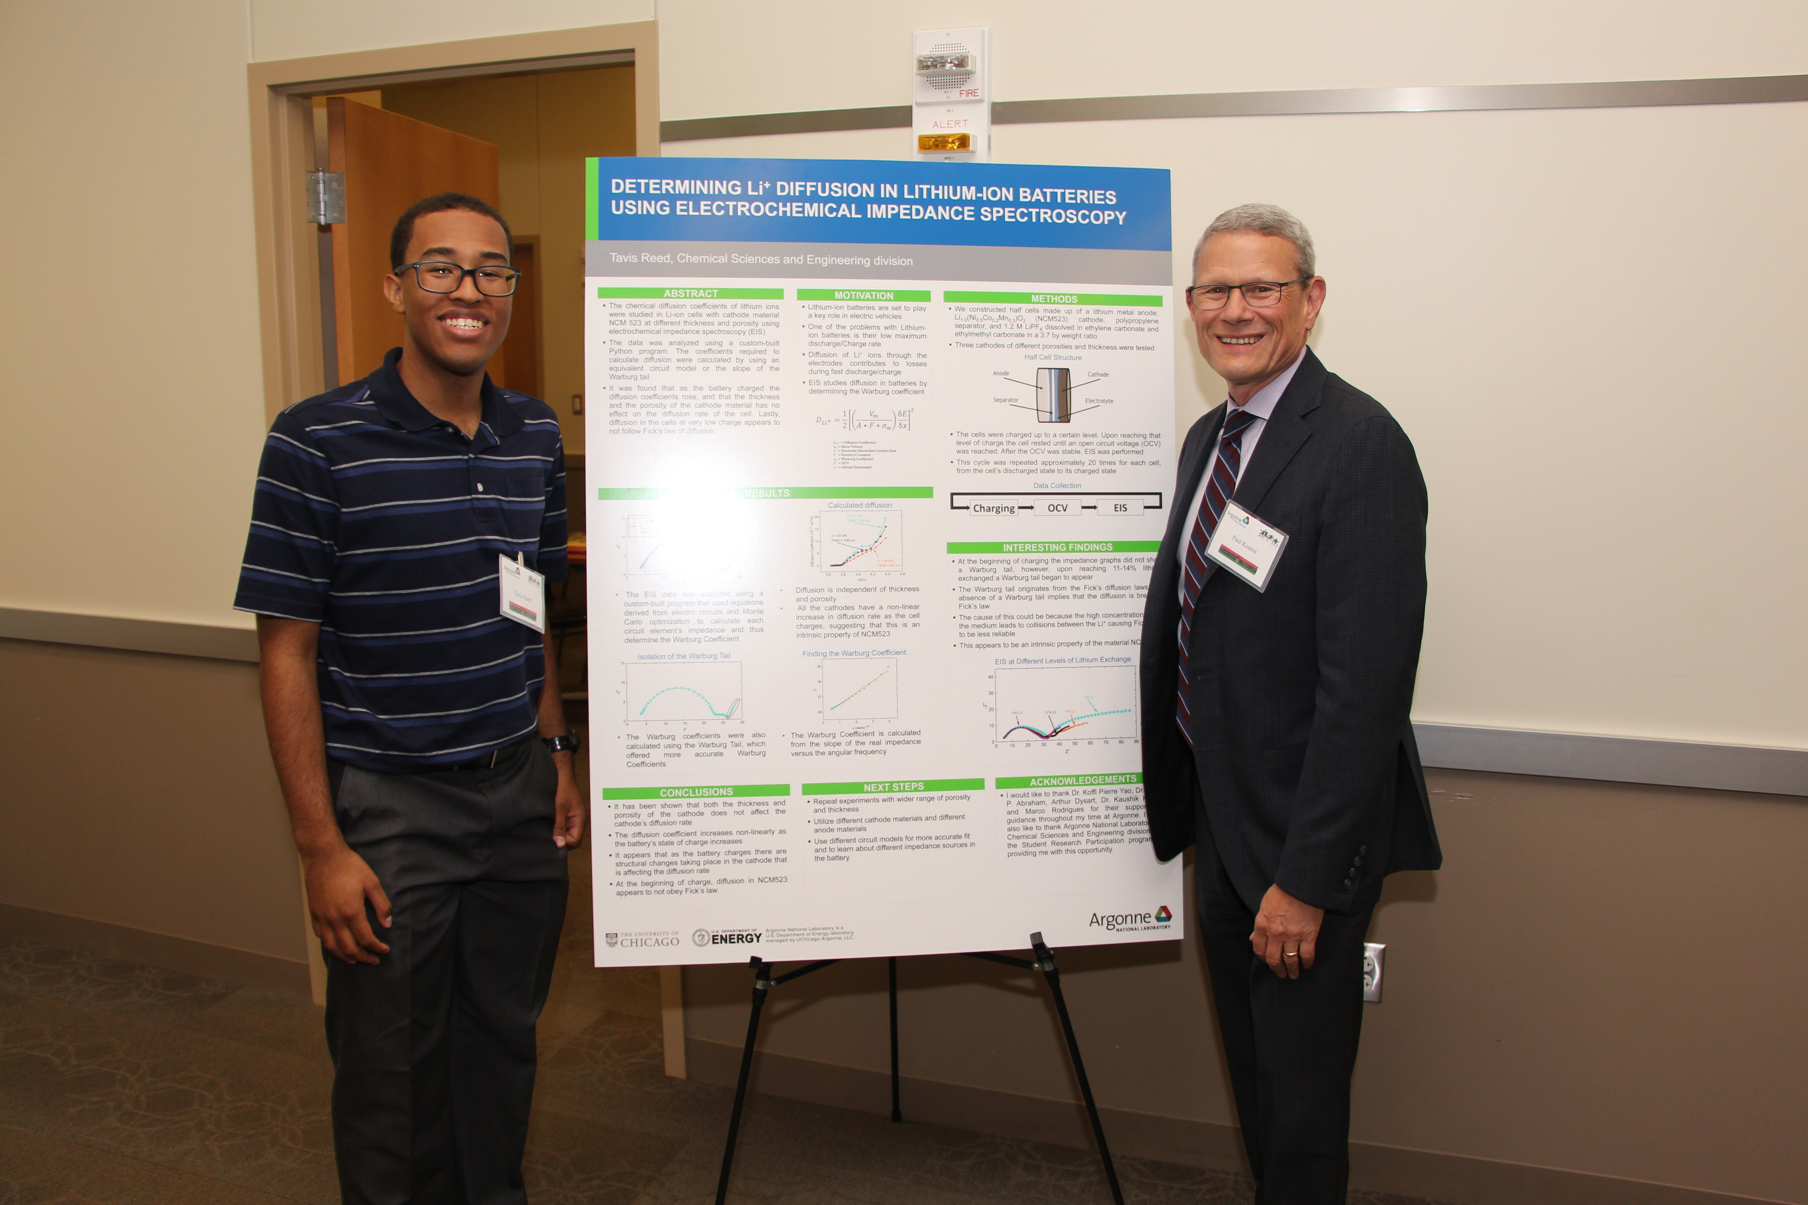
Argonne ACT-SO Mission
Mission | To provide one-on-one research opportunities for minority high school students across the Chicagoland area
Tools | We leverage the educational labs, user facilities and external collaborators to instruct students in an array of disciplines
People | Through volunteer efforts from postdoctoral and staff scientists, we focus on theoretical, experimental, and computational science

Slide 5
Argonne ACTSO by the numbers (FY20)
7
200+
150+
Program
Duration
Number of
Students
Number of Mentors
100+
30+
90%
Local
medalist
National
Medalist
students at
4-year institutions
Notes:
Non-federal research partners include SPPs and CRADAs with:
Industry
Government
Academic.

Slide 6

What is Argonne ACT-SO
An enrichment program (run and staffed by volunteers) designed to recruit, stimulate, improve and encourage high academic achievement within STEM in collaboration with DuPage County ACT-SO
Biology/Microbiology
Medicine & Health
Computer Science
Earth & Space Science
Physics
Engineering
Mathematics
Architecture*

Slide 7
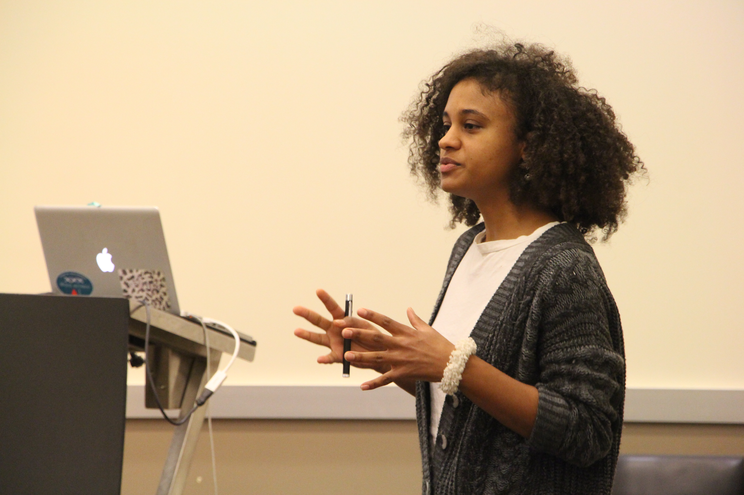
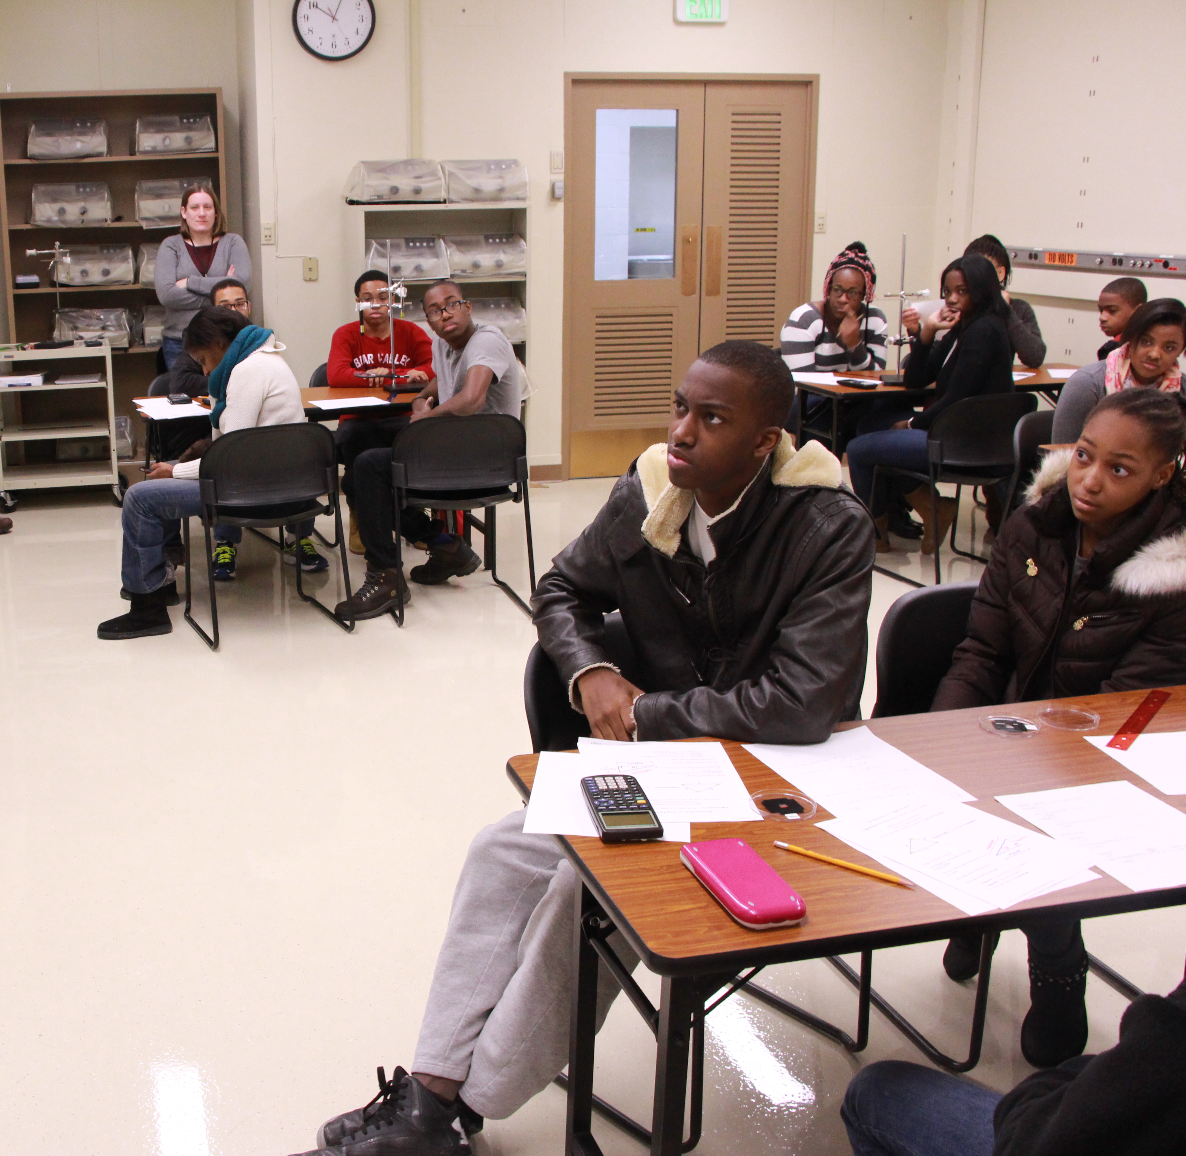
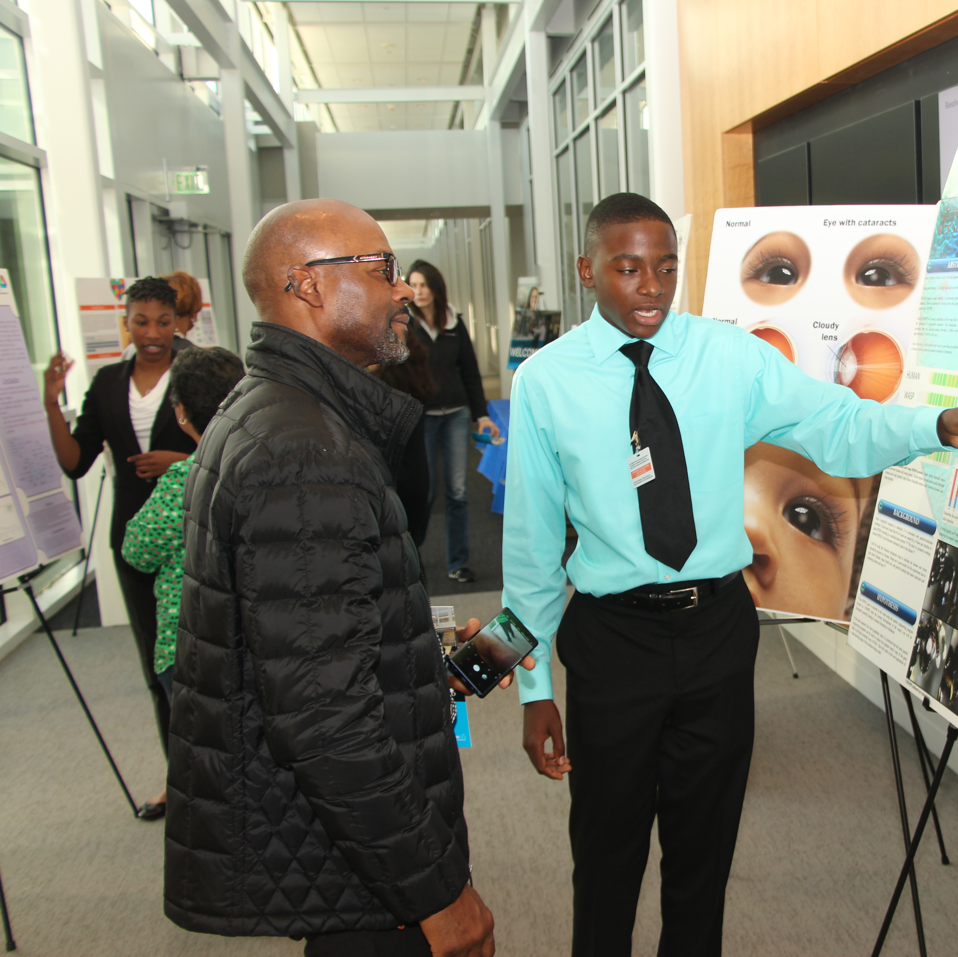
Program Structure
Argonne
Meeting
Monthly meetings
Career speakers from minority leaders in STEM
Student workshops for research skill development
Facilitate student-mentor engagement
DuPage
Meeting
College-readiness development
Professional skill development
Career speakers
Student fellowship and outreach
Mentor
Meeting
Meeting at mentor’s discretion (weekly/biweekly)
Instruction and assignment based (formal/informal)
Point-of-contact for research project
Notes:
This graphic illustrates the areas each lab works in, enabling distinct missions that still allow for collaboration.
<next slide>

Slide 8
ACT-SO Timeline
November 2020 – April 2021 (Nationals in July)
November 7th – Student/Mentor Pairing
December 5th – Coding Workshop (CEPA)
January 9th – Project Planning
February 6th – Data Collection & Analysis
March 6th – First Draft
April 3rd – Finalized Paper and Poster
  Note: If virtual, poster will be a power point presentation

Slide 9
Student Expectation
Communication is essential!
All meetings are mandatory
You are expected to lead your research project
  Note: Your mentor is your personal guide/resource
Check emails daily (and respond within the same day)
Expect to spend 2-4hr/wk
If you are unsure, ask questions.
  Note: There is nothing wrong with not knowing.

Slide 10
Program Communication
ACTSO@anl.gov
All email communications between mentor and student must have a parent and Argonne co-chairs (actso@anl.gov) on it.
Slack will be utilized for daily communications and updates
  Channels have been set up for mentors, parents, and students
  [Slack link]
Materials for Saturday meetings will be made publicly available on Indico
  Link will be provided by DuPage

Slide 11

Mentor breakout

Slide 12
Mentor expectations
ACTSO@anl.gov
Students come with an array of experience
  From never doing research to building their own plasma beams
  Traditionally students need help with literature search, scientific writing, and this year coding
Students will not be allowed on site in any capacity
  Field sites and virtual experiments are possible (we have to be creative)
Expectation is a project comparable to SULI
Mentor resource guide will be distributed to give frame of reference
Notes:
Rely on mentors previously in program to explain expectations

Slide 15
Student Breakout

Slide 16
Student expectations
ACTSO@anl.gov
Ask questions! Ask questions! Ask questions!
  For many this is new, we and your mentor are here to help you every step along the way
Manage your time to include ACT-SO
  Do not wait to the last minute, and do not underestimate the time it will take to complete an assignment
Identify the problem you want to solve not what you are interested in
Respect your mentor’s time
Notes:
Rely on mentors previously in program to explain expectations

Slide 17
Parent breakout

Slide 18
Parent expectations
ACTSO@anl.gov
You are the liaison between your child and his/her mentor
  You know your child better than mentor and most mentors will be tentative to push students beyond their comfort level
Your participation will often reflect your child’s success in the program
  Ensure your child understands the next steps/takeaways from each meeting
  Your child’s research should make sense to you as well
Coding will likely be a mandatory component
  It is becoming the Microsoft office in a person’s resume
Notes:
Rely on mentors previously in program to explain expectations

