Slide 1


JADE, a robust and expandable platform for neutronics V&V
D. Laghi^{1*}, A. Bittesnich¹, A. Valentine², S.C. Bradnam², M. Fabbri¹, M. Campos¹, M. Di Giacomo¹, A. Milocco¹
(1) F4E, Josep Pla 2 B3, Barcelona 08019, Spain
(2) UKAEA, Culham Campus, Abingdon, OX14 3DB, United Kingdom
OpenMC Application to Tokamak Neutronics Analysis Meeting 30/05/2025

Slide 2
Outline
JADE: Why, What, When
The JADE ecosystem
JADE v4 and OpenMC
How to implement a new benchmark, a practical example
Future plans and conclusions

Slide 3
Why?, What?, When?

Slide 4
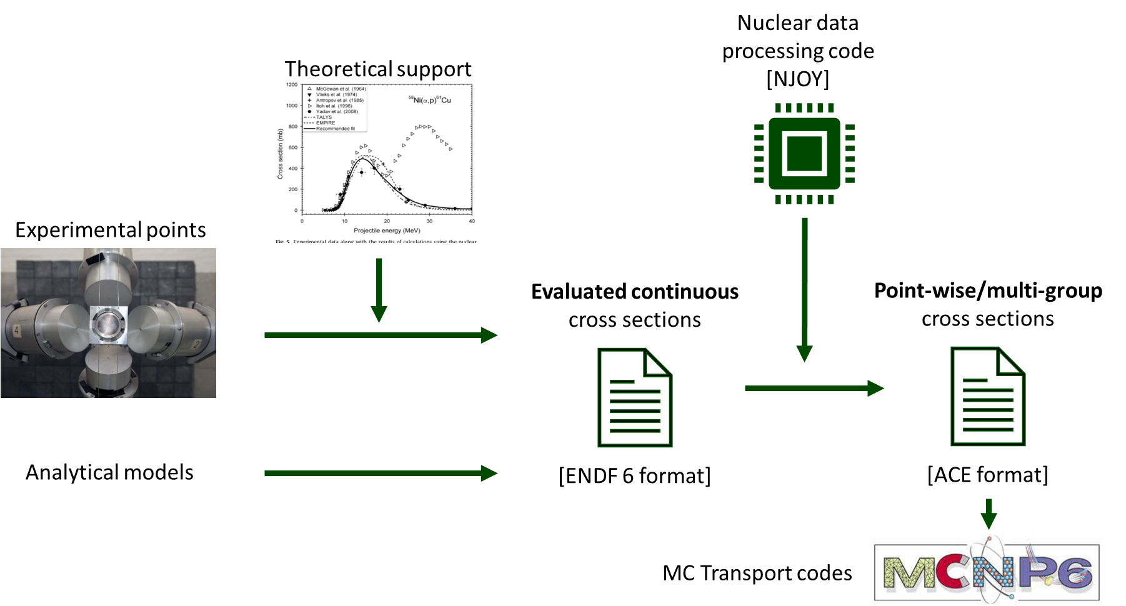
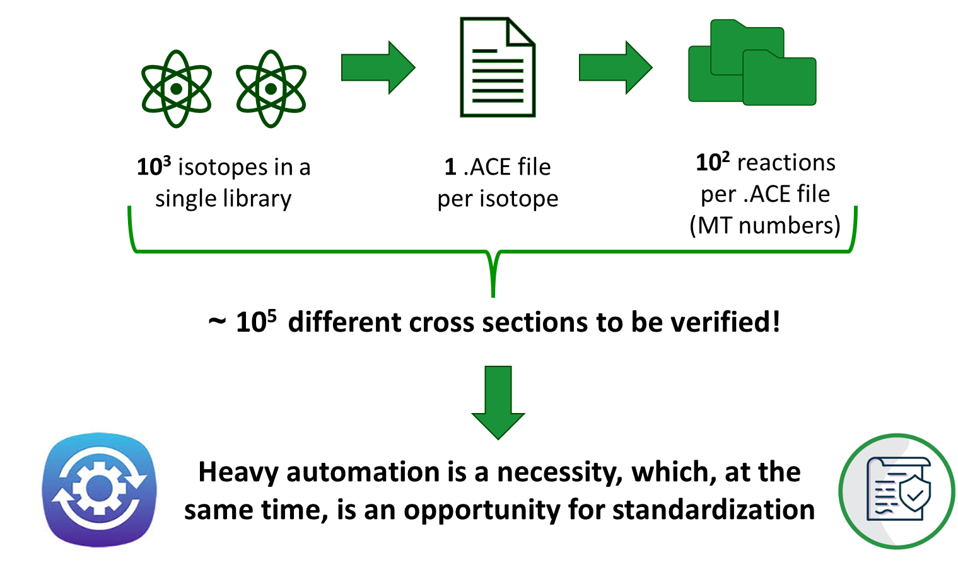
WHY JADE development started
Nuclear data production is a complex procedure that require extensive Verification and Validation (V&V)

Slide 5


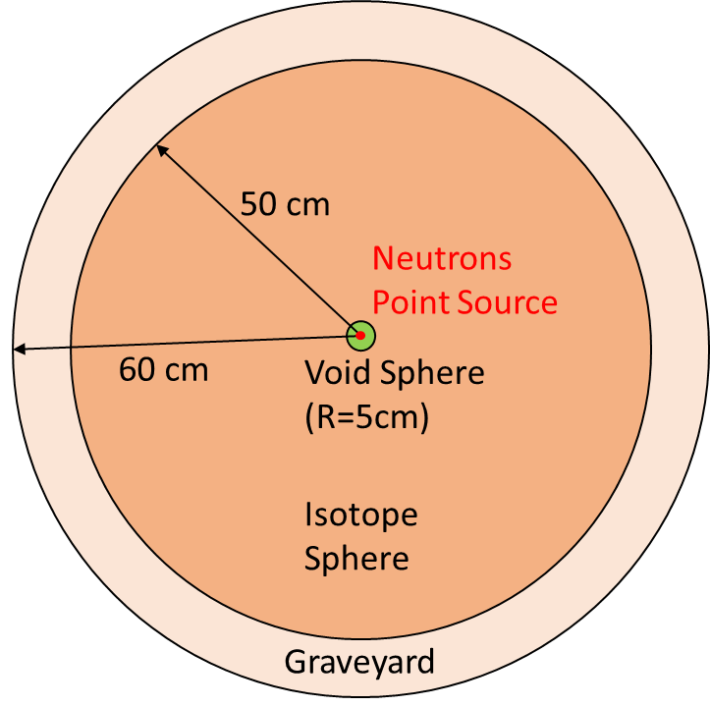

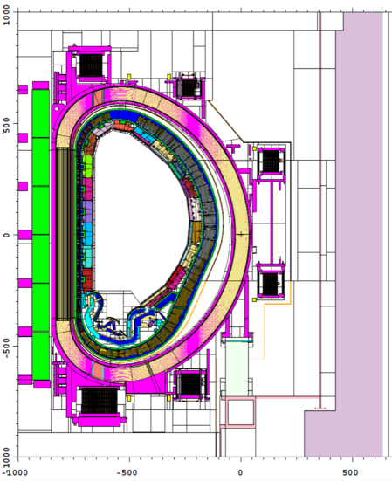
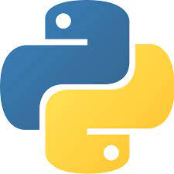



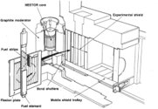


WHAT is JADE
Great number of benchmark to be automatically generated and run
VERIFICATION
“Brute Force” ideally scanning all reactions and isotopes
Run of MC transport codes
Computational benchmarks to assess impact of changes in “real-life” applications of interest
Higher physical relevance
More XS/quantities tested
Vast amounts of outputs are produced
Experimental benchmarks to help with validation of XS and codes
Meaningful automatic post-processing
VALIDATION

Slide 6
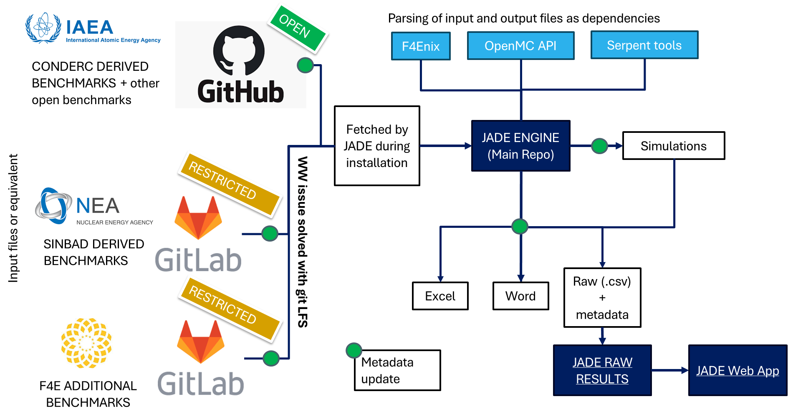
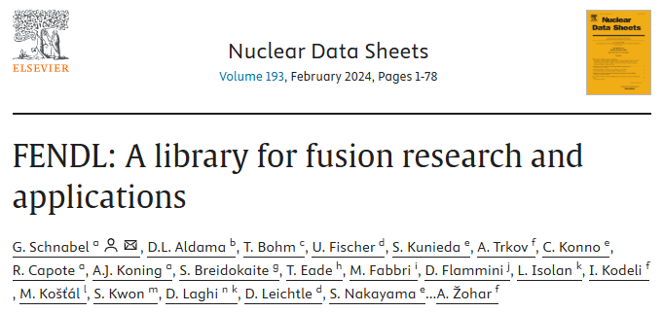



WHEN: Historical recap
10/2018
U. Fisher highlight the needs for more automated V&V in FENDL
01/2021
First JADE major release (v1.0.0)
02/2024
JADE applied with success to FENDL 3.2b V&V campaign (endorsement from IAEA NDS)
11/2024
Creation of the JADE V&V ecosystem with v3.1.0
05/2025
Restoring of all v3 benchmarks + bug corrections with v4.1.0
10/2019
Work on JADE starts as D. Laghi Ph.D. project
11/2022
UKAEA joins the project to port JADE to linux and introduce code2code capabilities
03/2024
v3.0.0 is released. Porting to linux is completed and limited OpenMC capabilities are introduced
04/2025
JADE v4.0.0

Slide 7
The JADE ecosystem

Slide 8
JADE V&V ecosystem
External dependencies
JADE V&V repos
https://github.com/JADE-V-V
https://github.com/IAEA-NDS/open-benchmarks

Slide 9
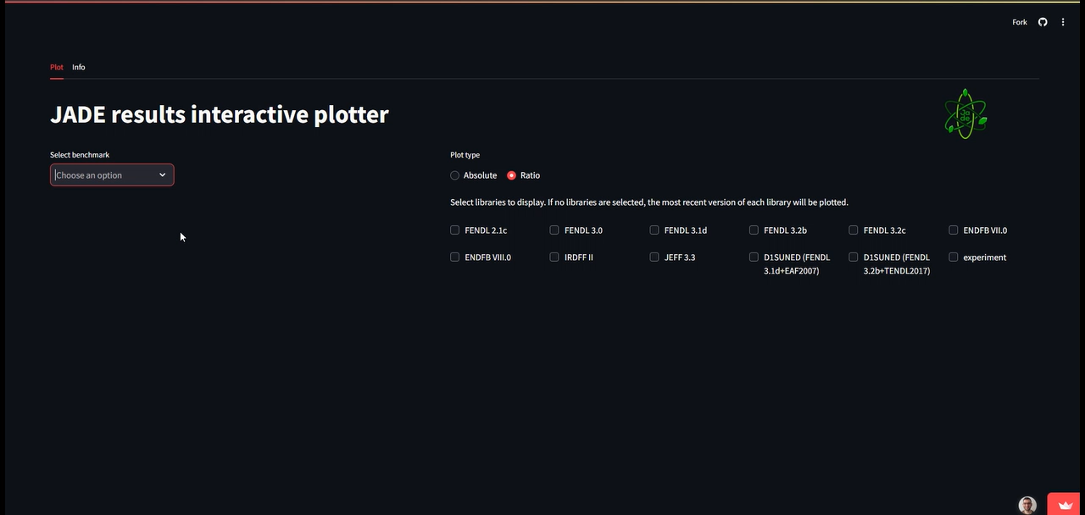
JADE WebApp

Slide 10
A few numbers
OpenMC
4
3
Papers featuring JADE
Different inputs
25
149
32
Citations
400+
Unique benchmarks implemented
Commits in the last 12 months
Unique contributors so far
11

Slide 11
JADE v4 and OpenMC

Slide 12
Main achievements of v4.0.0
Re-think JADE to be a code-lib 2 code-lib comparison. Not code2code or lib2lib.
Full implementation of OpenMC (for the available benchmark inputs)
Implement a structure that clearly isolates (by inheritance of specific abstract classes) the extra python code needed to support an additional transport code.
No additional programming for new benchmarks (including experimental). Everything is handled by ad hoc YAML configuration files.
Raw data (csv files) are now a stronger interface. They are the end point of transport code-dependent processing and the starting point of the JADE plotting and excel. This facilitates the integration with 3rd party post-processors like the WebApp.
Software design best practices were applied during refactoring.
The codebase (number of lines) has been reduced to only 1/3 with respect to v3.1.0 one.

Slide 13



Tallies comparison -> Results comparisons
Simulation output parsing
Tally MODIFIERS:
Scale
To lethargy
Add column
Replace values
…
MODIFIED TALLY
COMB
TALLY RESULT
Tally COMBINATORS:
No actions
Sum
Concatenate
…
MOD1
MOD2
MODn
MODIFIED TALLY
For each tally a standard pandas DataFrame is produced (for all transport codes).
Column headers are tally binnings. Names are standardized.
…
COMB
MODIFIED TALLY
END of transport code dependent processing
RESULT

Slide 14
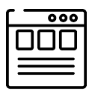





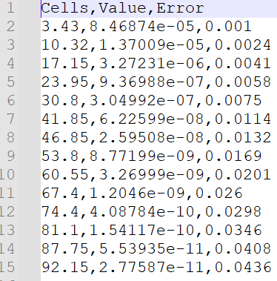


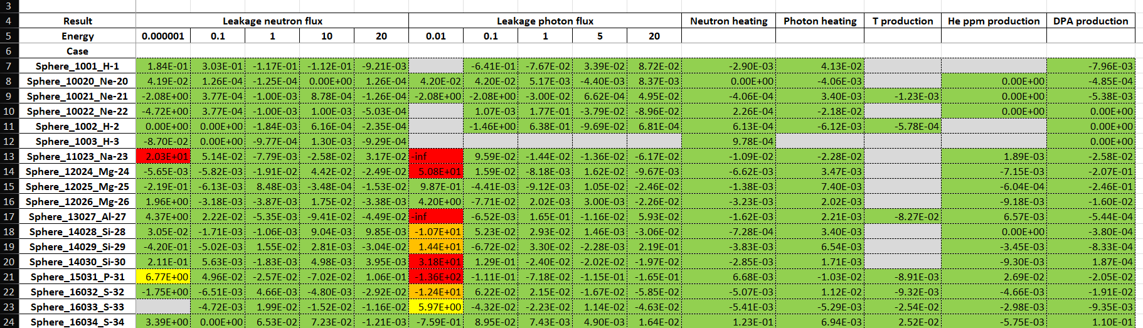

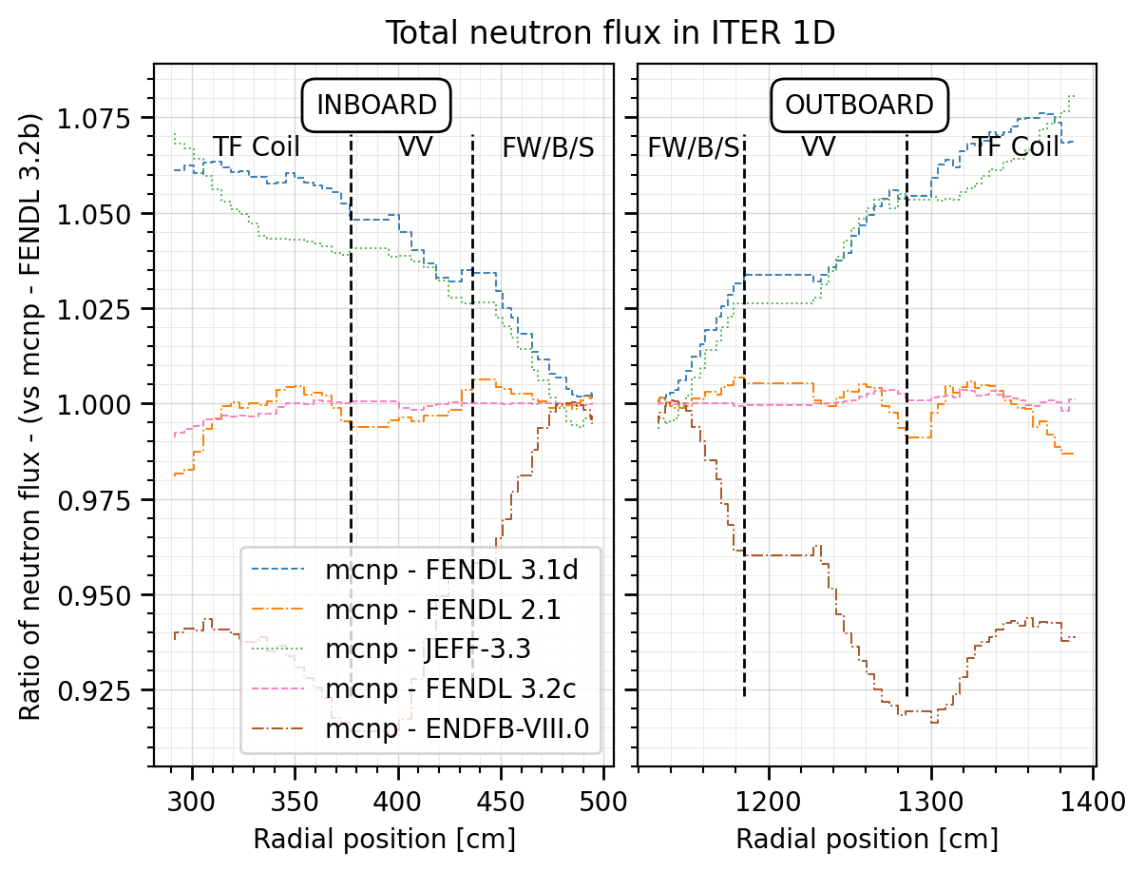

High level structure of JADE Engine
GUI
Run and PP
Benchmarks configuration files
DEVELOPERS
CMD
pip install jadevv
USER
CLUSTER
LOCAL
Environmental
variables

Slide 15
A practical example: TUD-W

Slide 16
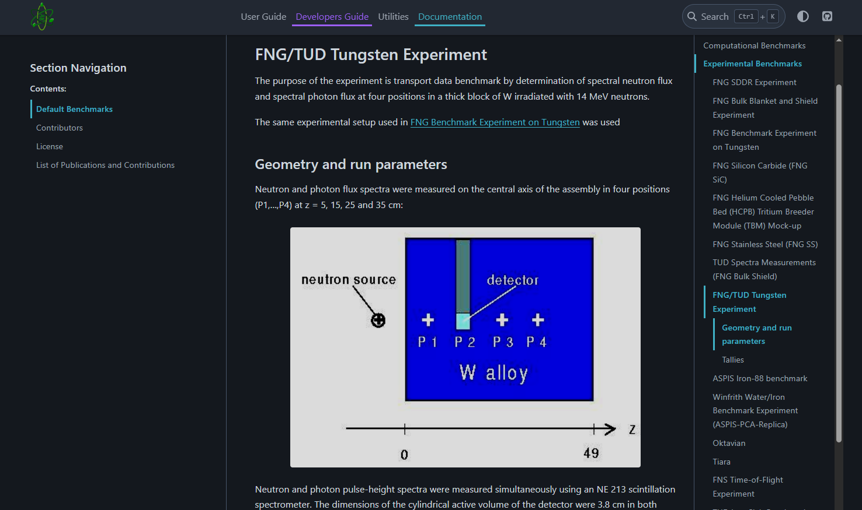
Brief description of the experiment
More details in A. Kolsek presentation later today

Slide 17
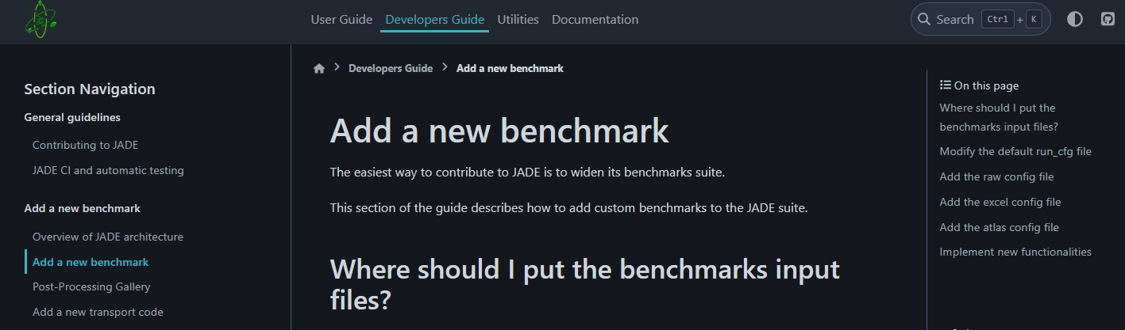
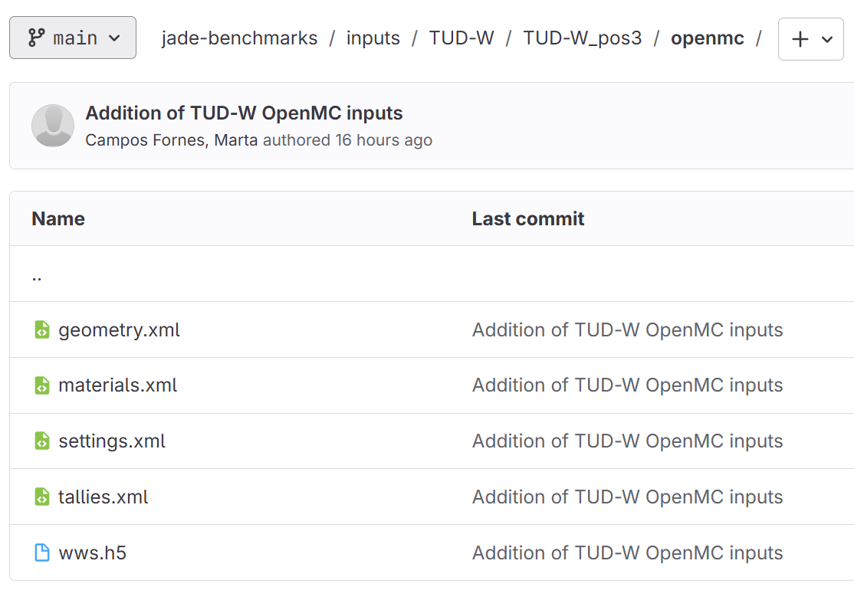
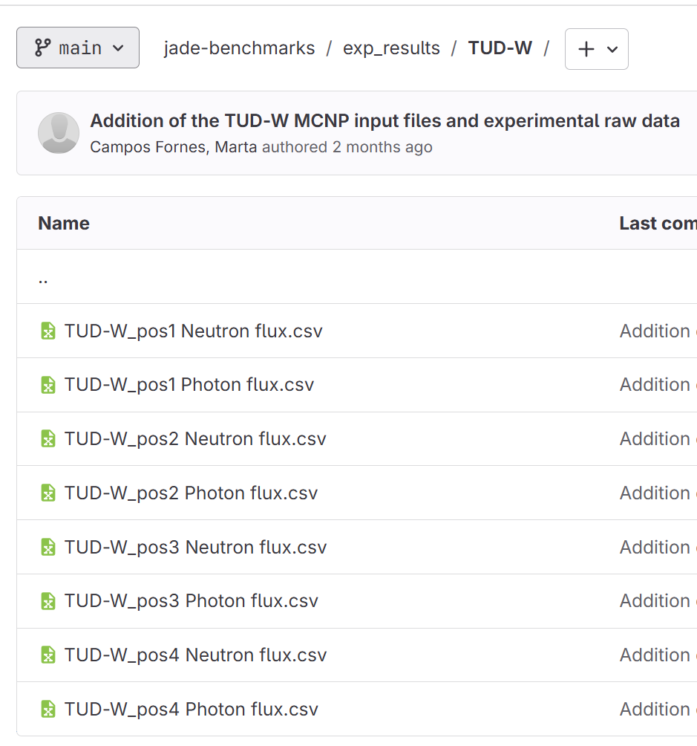
Prepare inputs for the new benchmark
INPUTS
EXP ERSULTS

Slide 18
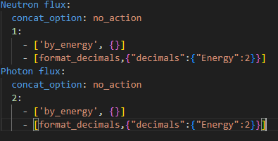
The raw result configuration file
RAW RESULTS CONFIG FILE
Tally 1
Energy | Value | Error
1.1100 | [#/cm2/s] | …
… | … | …
pos1
Tally 2
Energy | Value | Error
0.41 | [#/cm2/s] | …
… | … | …
TUD-W_pos1 Neutron flux.csv
Energy | Value | Error
1.11 | [#/cm2/s/MeV] | …
… | … | …
…
…
pos2

Slide 19
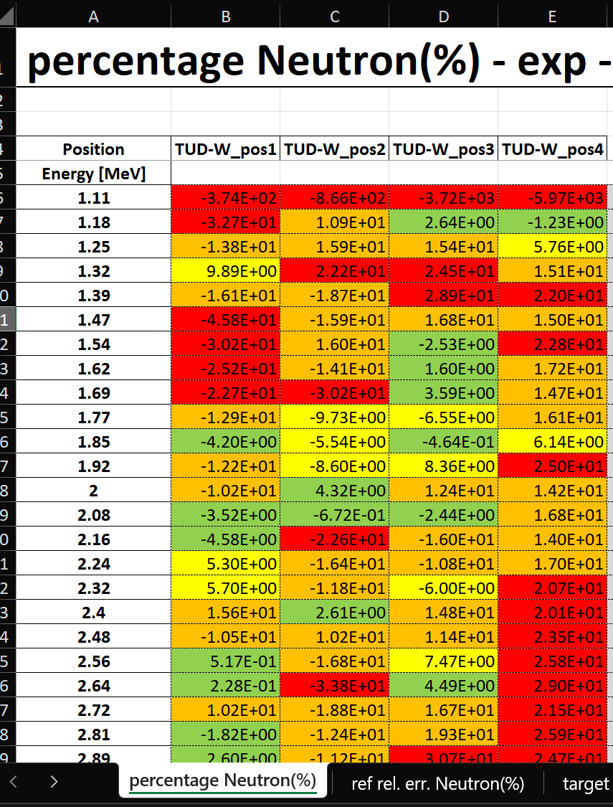
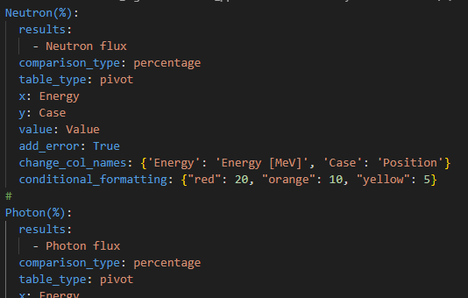
The excel configuration file
A global DataFrame is generated by JADE, Case and Result columns are always added
TUD-W_pos1 Neutron flux.csv
Case | Result | Energy | Value | Error
TUD-W_pos1 | Neutron flux | 1.11 | [#/cm2/s/MeV] | …
… | … | … | … | …
TUD-W_pos1 Photon flux.csv
TUD-W_pos2 Neutron flux.csv
…
EXCEL CONFIG FILE

Slide 20
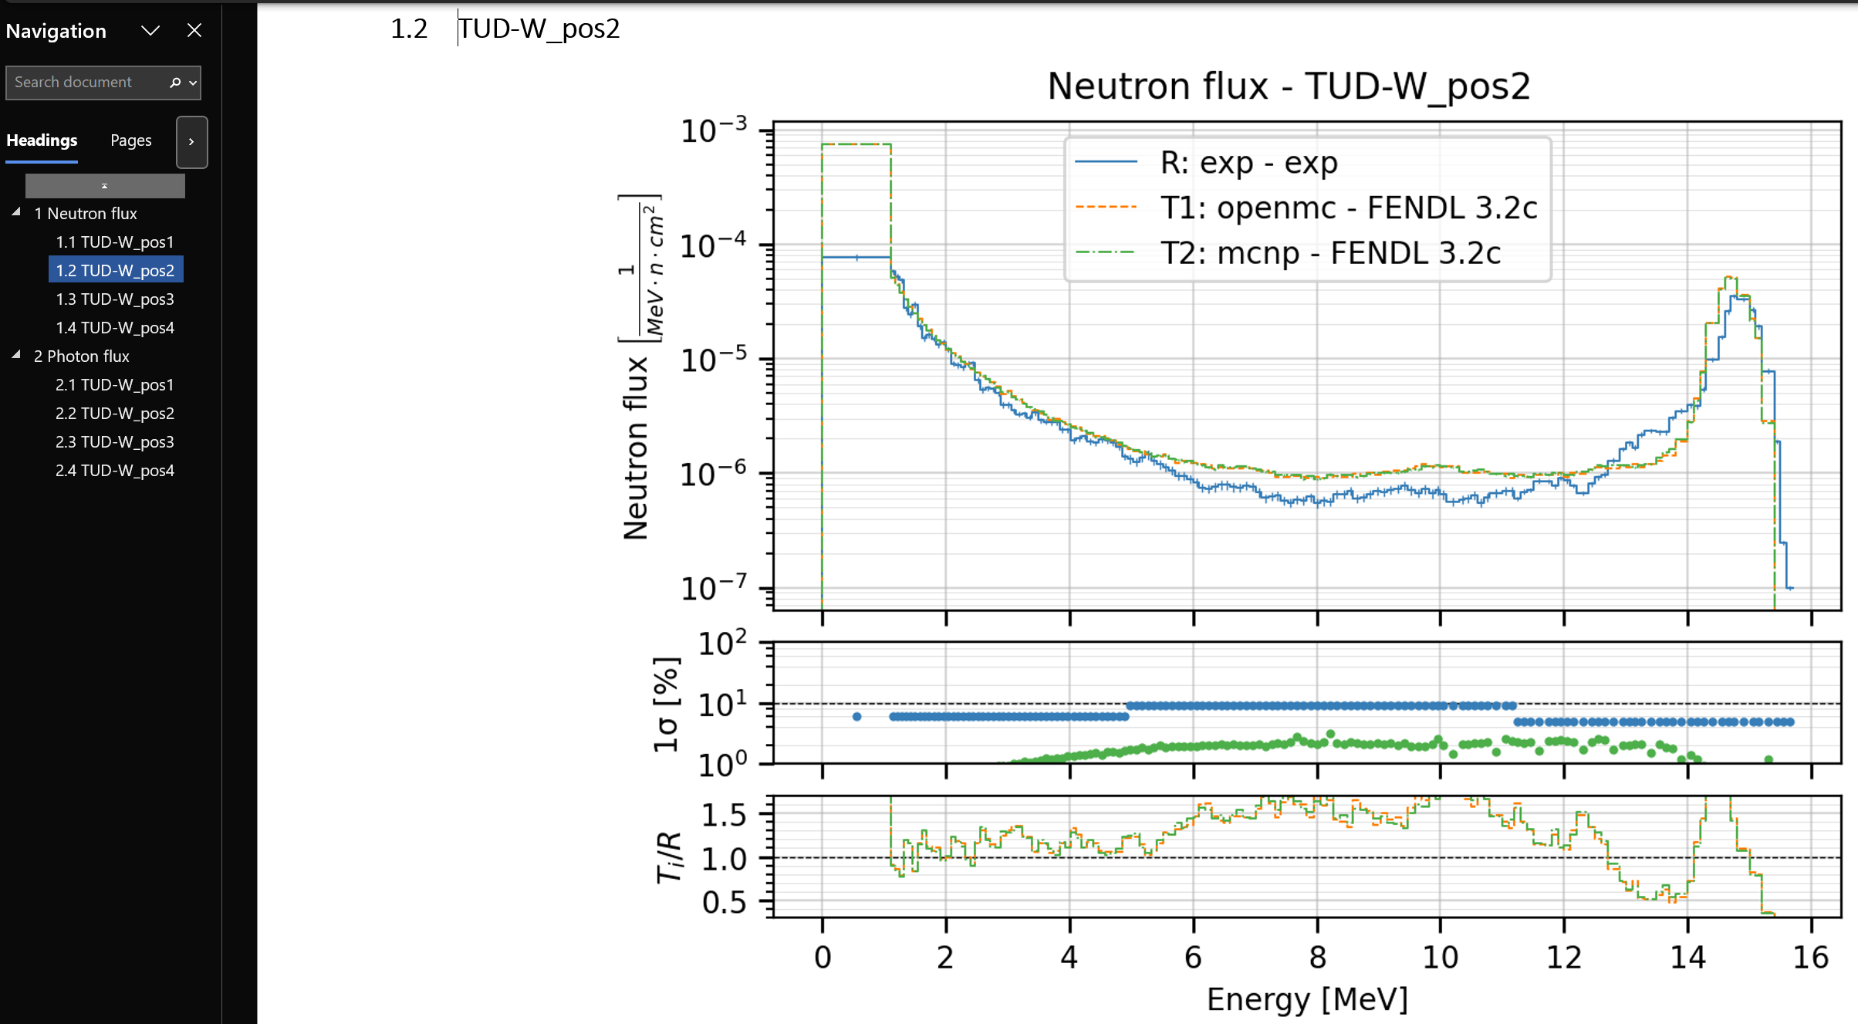
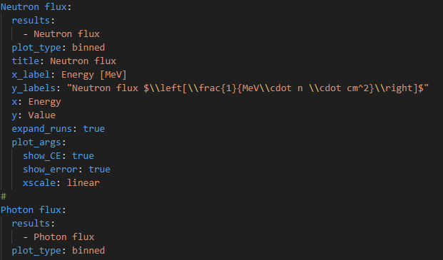
The atlas configuration file
Case | Result | Energy | Value | Error
TUD-W_pos1 | Neutron flux | 1.11 | [#/cm2/s/MeV] | …
… | … | … | … | …
ATLAS CONFIG FILE

Slide 21
Future plans
CONSOLIDATION
Review from experts to point out improvements on plot quality/types but also on methodologies (e.g. more TOF derivation instead of direct energy binning) and input improvements.
Schedule a hackathon to address the major comments that will arise -> v4.2.0
EXPANSION OF FEATURES
Keep implementing new benchmarks.
Gradually implement all available benchmarks also in OpenMC.
Implementation of CHI SQUARE and other KPIs to quantify libraries and/or codes performances.

Slide 22
Conclusions
JADE is an open-source, robust and expandable platform for nuclear data and transport codes V&V.
Starting with JADE v4, OpenMC is fully supported.
Adding a new benchmark to JADE has never been easier.
We believe JADE can be strategic for supporting the adoption of OpenMC in fusion production environments.
Collaboration is always welcome!

Slide 23
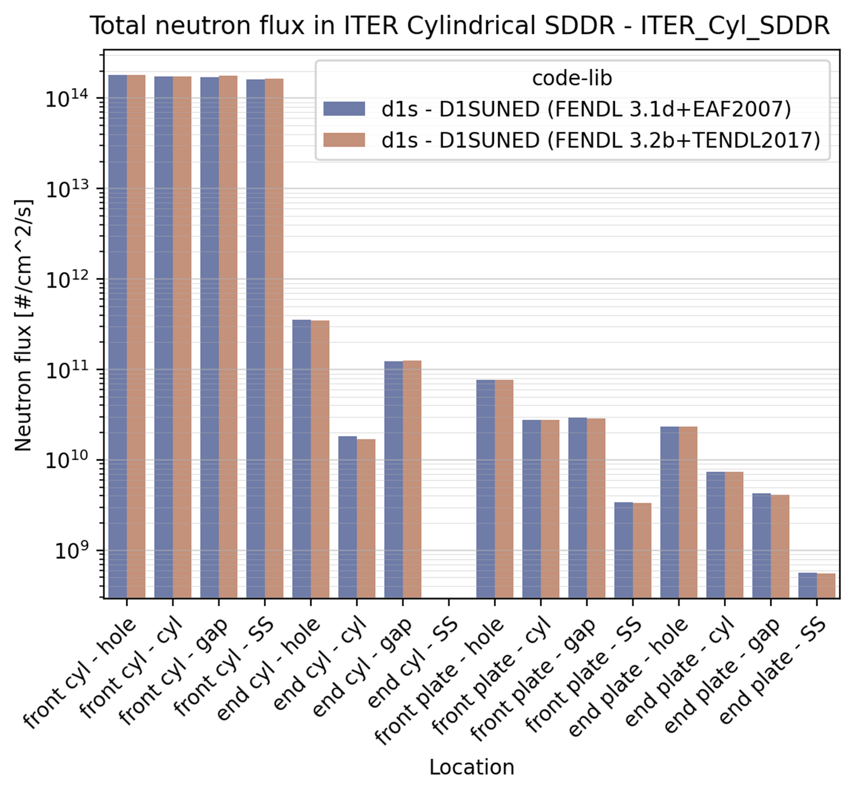
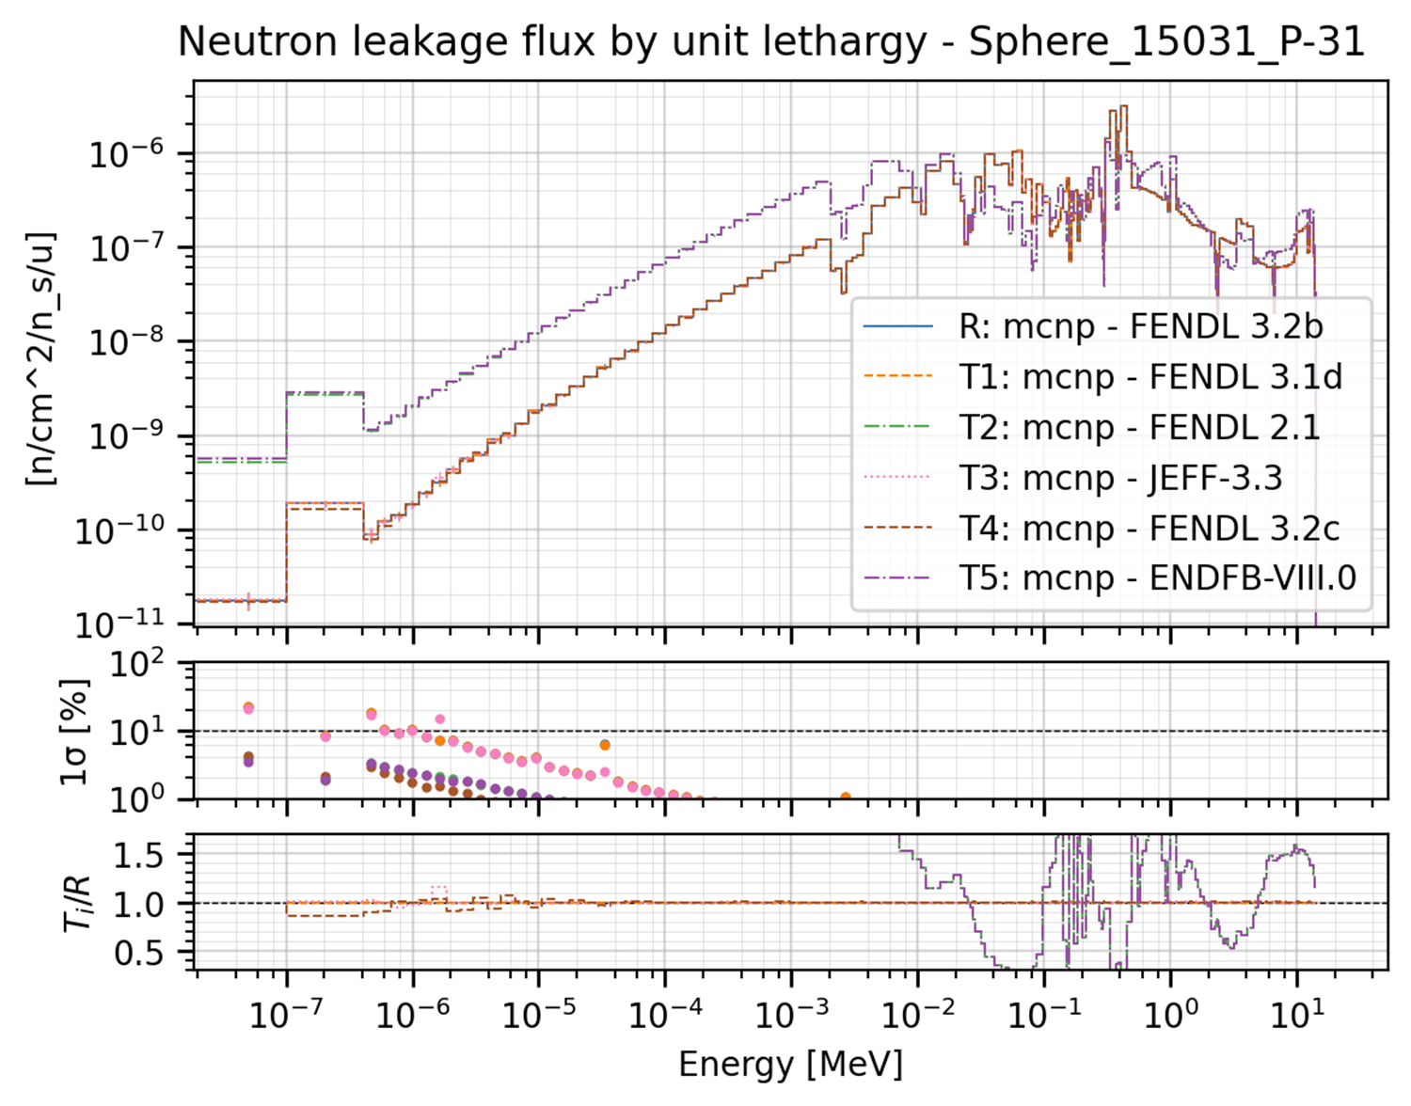
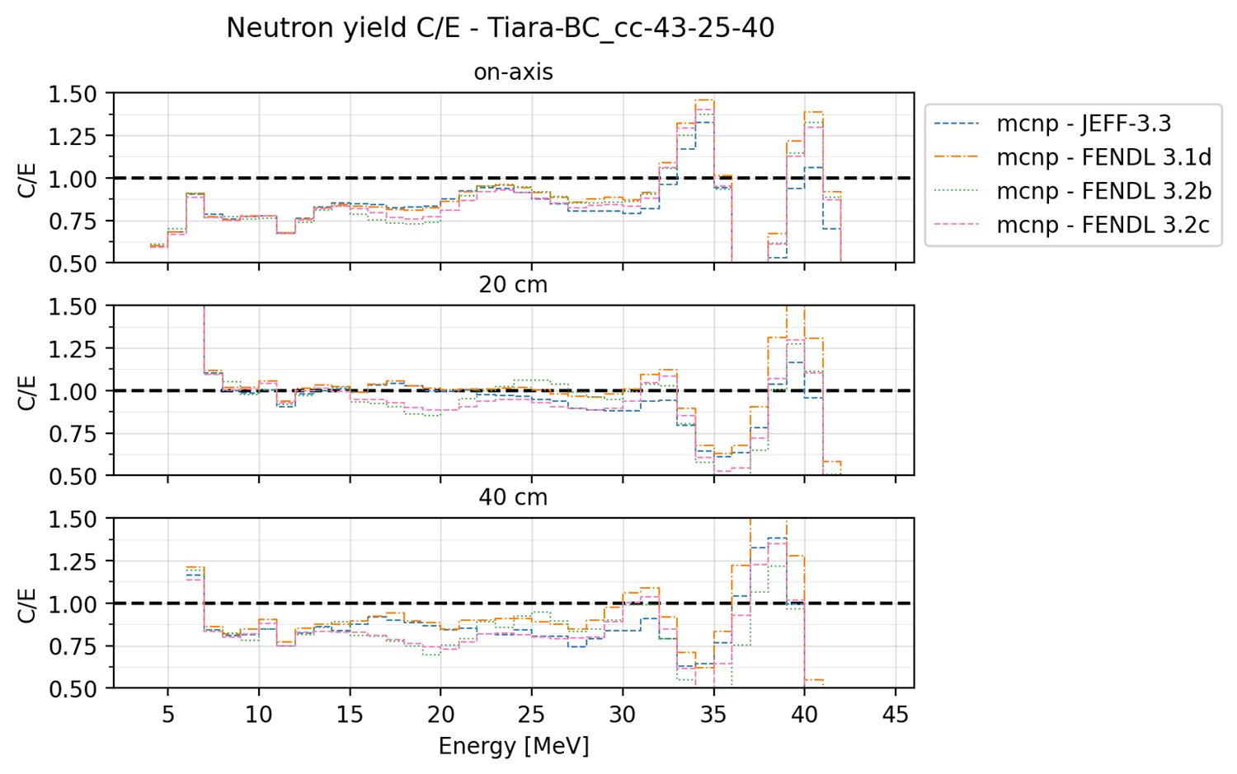
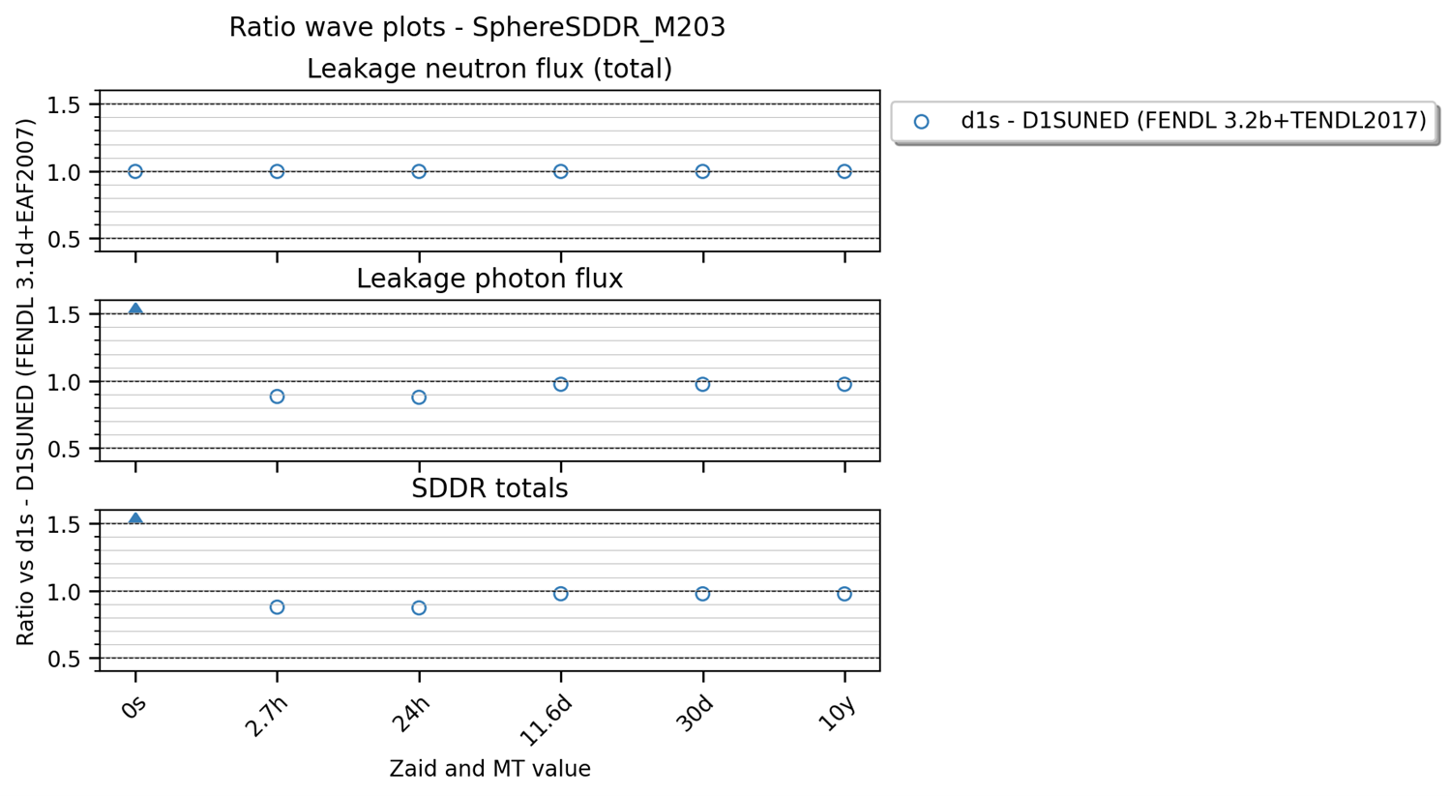
Thanks for you attention

