Slide 1
Neutronics Feasibility of Transmuting Long-lived Fission Products in Fusion Reactors
Cihang Lu and Arantxa Cuadra
05/28/2025

Slide 2
Background
What are long-lived fission products (LLFPs)?
    Fission byproducts with half-lives >10⁵ years
    Examples: Sn-126, Zr-93, I-129, Tc-99
Why are they important?
    Radiologically hazardous over geological timeframes
    Key contributors to long-term radiotoxicity of spent fuel
    Limitations on repository capacity due to long decay periods
Current mitigation strategies
    Geological Disposal: Technically feasible but expensive (~billions USD/site), politically sensitive
    Partitioning & Transmutation (P&T): in fission reactors and accelerator-driven systems (ADS)
  What about transmuting LLFPs in fusion reactors?

Slide 3
Introduction
This study employs neutronics calculations to assess the feasibility and viability of transmuting the six major light-water reactor (LWR) LLFPs, including I-129, Cs-135, Tc-99, Se-79, Zr-93, and Sn-126.
Modeled in the blanket region of fusion reactors.
A typical boiling water reactor (BWR) was used as a basis for comparison.
Neutronics calculations were conducted with Monte Carlo neutronics codes using ENDF/B-VIII.0 nuclear data library.

Slide 4
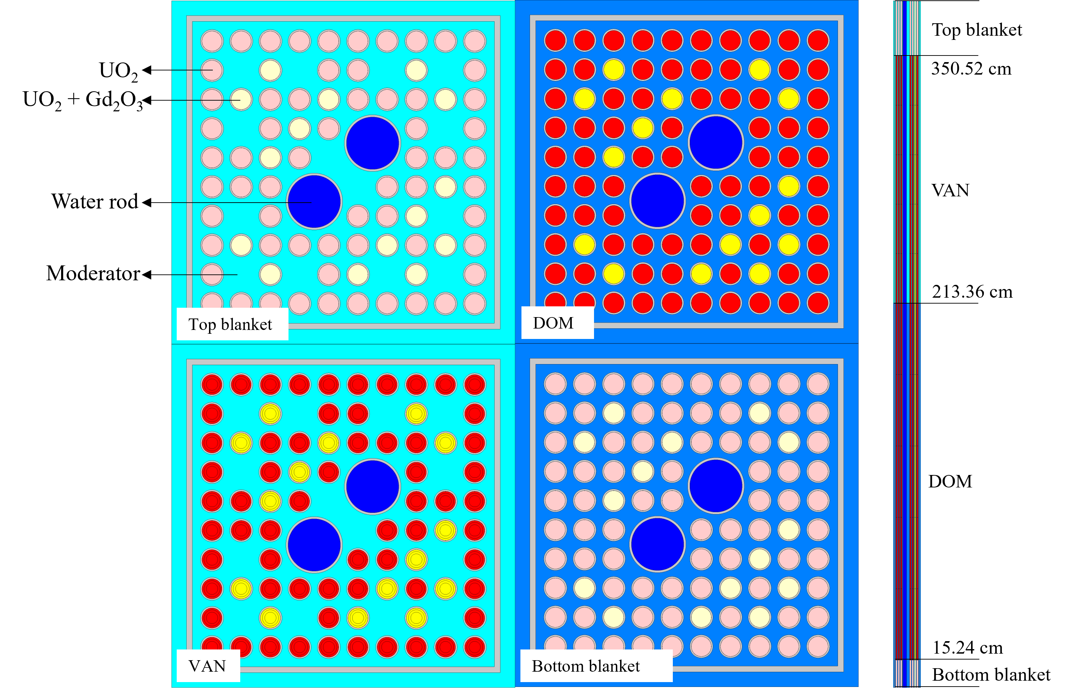
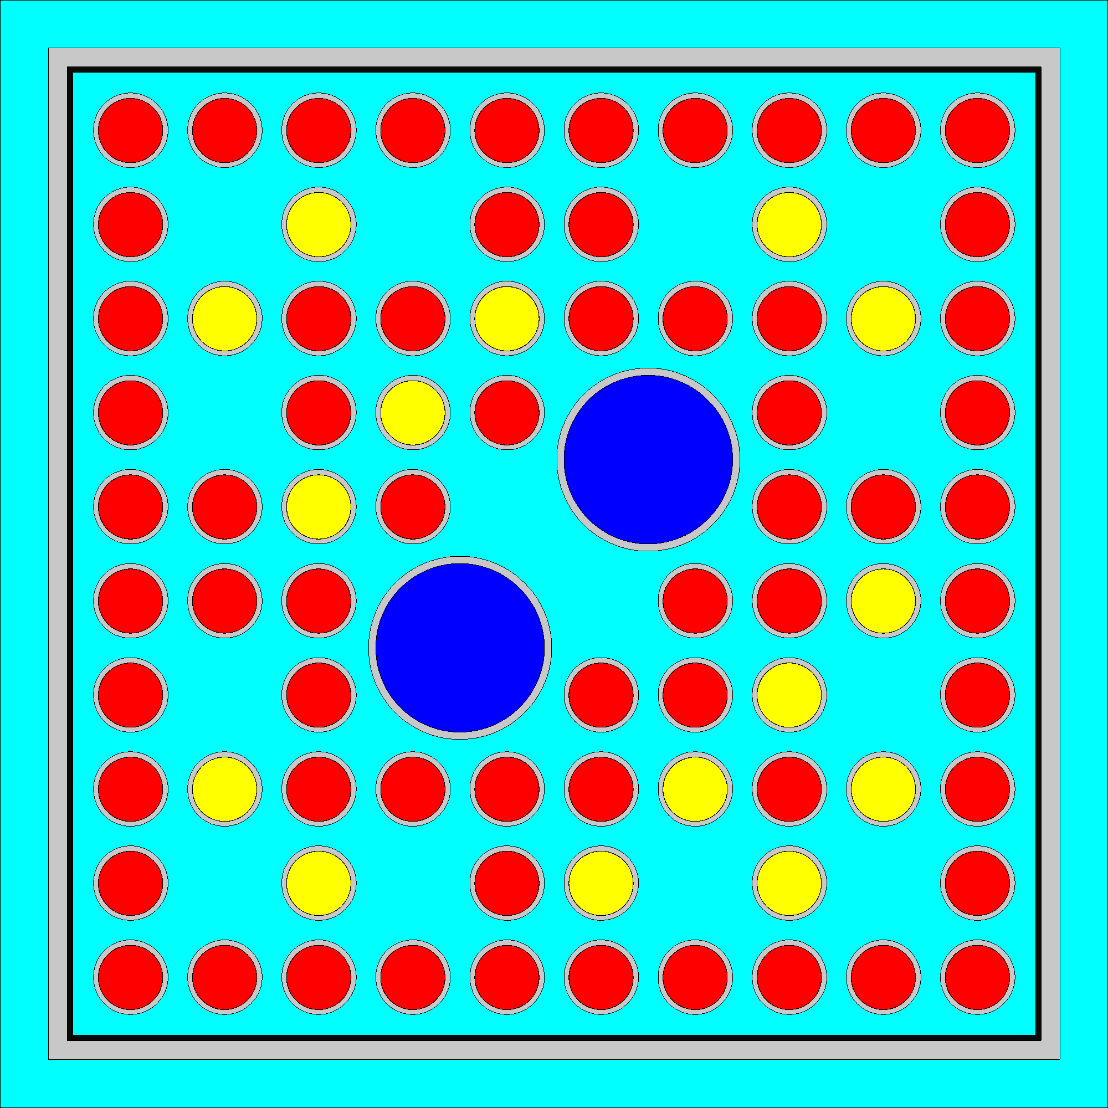
Neutronics model - BWR
LLFP
Single fuel assembly (FA) model for a typical BWR.
The target was shaped as a layer of LLFP coating on the interior side of the FA wall.
The LLFP coating had a thickness of 0.075 cm over the whole length of each FA, resulting in an LLFP specific volume of 52.7 cm³/MWth.
The fuel ²³⁵U enrichment was adjusted to maintain fuel cycle length.
MC code – Serpent 2.2.1

Slide 5



Neutronics model – fusion reactor
plasma
First wall
Be
LLFP
y-z cross-sectional view
x-y cross-sectional view
1st structure
2nd structure
FLiBe channel
FLiBe tank
Simplified model for MIT ARC reactor, with neutron spectrum and tritium breeding ratio (TBR) verified against literature.
The target was shaped as a layer of LLFP coating on the outer side of the 2nd structure.
The LLFP coating had a thickness of 0.013 cm for a specific volume of 52.1 cm³/MWth.
The Be layer thickness can be adjusted to maintain TBR.
MC code – OpenMC 0.15.2

Slide 6
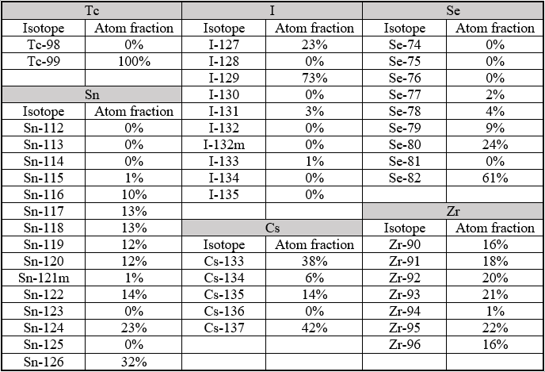
Assumptions
Targets were made of pure elements.
  Reasonable for Tc and Zr due to their high melting points, non-reactivity, and insolubility in water, but not for other elements.
Targets with isotopic compositions from PWR discharge
Targets with isotope separation considered

Slide 7
Results – Group A (Tc-99, I-129, and Se-79)
Element target | Initial LLFP mass (g/MWth) |  | Net LLFP mass transmuted (g/MWth-yr)
Isotope | BWR | ARC | BWR | ARC
Tc-99 | 606 | 599 | 45.8 | 4.8
I-129 | 191 | 189 | 16.9 | 1.0
Se-79 | 21.5 | 21.2 | 3.7 | 0.001
Isotope target | Initial LLFP mass (g/MWth) |  | Net LLFP mass transmuted (g/MWth-yr)
Isotope | BWR | ARC | BWR | ARC
Tc-99 | 606 | 599 | 45.8 | 4.8
I-129 | 260 | 257 | 23.0 | 1.4
Se-79 | 252 | 250 | 39.4 | 1.23

Slide 8
Results – Group B (Zr-93, Sn-126, and Cs-135)
Element target | Net LLFP mass transmuted (g/MWth-yr) |  | LLFP mass transmuted (g/MWth-yr) |  | LLFP mass generated (g/MWth-yr)
Isotope | BWR | ARC | BWR | ARC | BWR | ARC
Zr-93 | -6.7 | 0.03 | 1.1 | 0.03 | 7.7 | 0
Sn-126 | -0.15 | 0.32 | 0.09 | 0.32 | 0.24 | 0
Cs-135 | -8.1 | 0.02 | -3.4 | 0.02 | 4.7 | 0
Isotope target | Net LLFP mass transmuted (g/MWth-yr) |  | LLFP mass transmuted (g/MWth-yr) |  | LLFP mass generated (g/MWth-yr)
Isotope | BWR | ARC | BWR | ARC | BWR | ARC
Zr-93 | -3.6 | 0.97 | 4.1 | 0.97 | 7.8 | 0
Sn-126 | 0.04 | 0.96 | 0.279 | 0.96 | 0.239 | 0
Cs-135 | 2.06 | 0.43 | 6.67 | 0.43 | 4.60 | 0
Fusion reactors can be leveraged to transmute Zr-93 and Sn-126
Fusion reactors can be leveraged to transmute Cs-135 with no isotope separation
Reactor design optimization needed.

Slide 9
Conclusion
Fusion reactors are good for LLFP transmutation as no LLFP were generated.
Fusion reactors have lower neutron flux level and harder spectrum
Fusion reactors are not suitable for transmuting Tc-99, I-129, and Se-79.
Fusion reactors can be leveraged to transmute Zr-93 and Sn-126.
Fusion reactors can be leveraged to transmute Cs-135 with no isotope separation.
Reactor design optimization needed to increase transmutation rate.
Differences experienced with OpenMC vs. Serpent

