Slide 1
An Introduction to the Earth System Grid Federation
Maxwell Grover (Argonne National Laboratory)
CPS Task Force Kick-Off Meeting: Data Intensive Computing Task Force
December 19, 2024

Slide 2
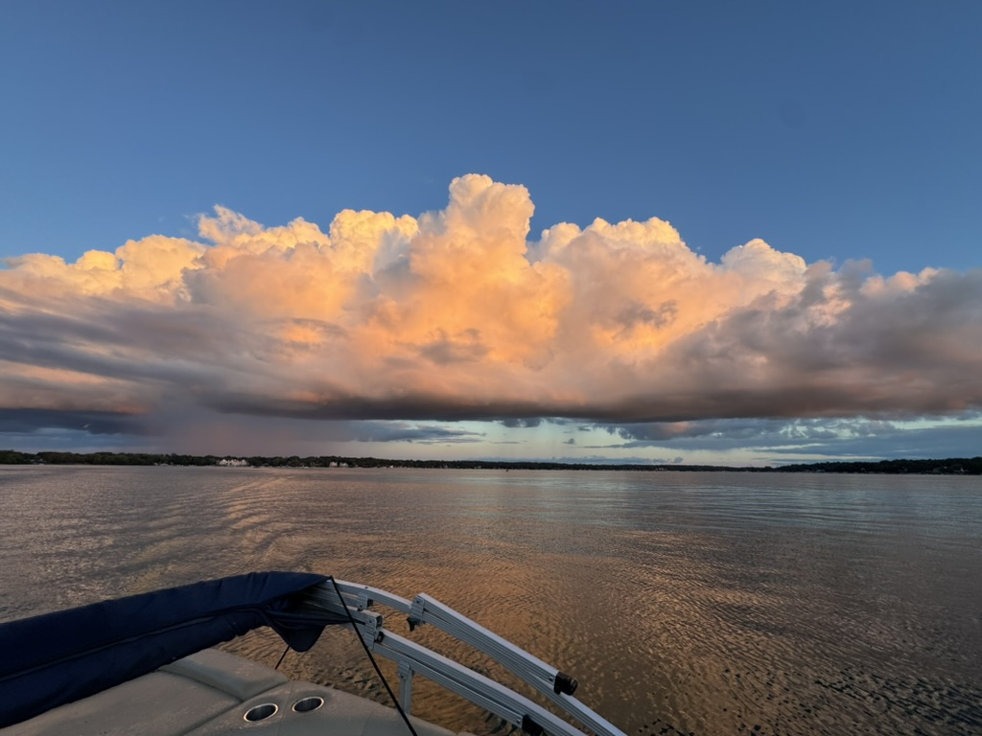
Max Grover, Atmospheric Data Scientist
User Computing and Value Added Products Co-lead for ESGF2-US
~3 years at Argonne (EVS/CELS), 1 year at the National Center for Atmospheric Research
Lead developer for several key open-source packages for atmospheric and climate science (radar obs, model output)
Lead workforce development for the ARM User Facility through open-science summer schools, training events
Key focus: lowering the barrier to working with petabytes of earth system model output/observations
Grow communities of practice around open-science best practices, explore cloud-optimized data formats, pushing for streaming of data instead of downloading/replicating data

Slide 3
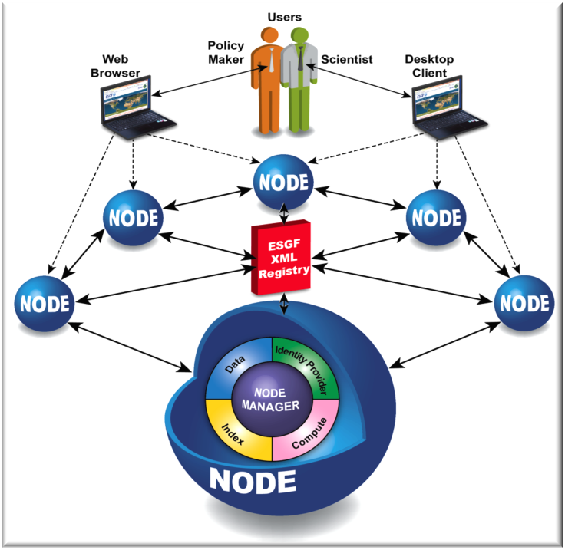
What is the Earth System Grid Federation?
The Earth System Grid Federation (ESGF) is an international consortium and a globally distributed peer-to-peer network of data servers using a common set of protocols and interfaces to archive and distribute climate and Earth system model output and related input, observational, and reanalysis data
These data are used by scientists all over the world to investigate consequences of possible climate change scenarios and the resulting Earth system feedbacks
Logos represent primary international contributors: US Department of Energy, NASA, NOAA, NSF, European IS-ENES Project, and Australian NCI

Slide 4
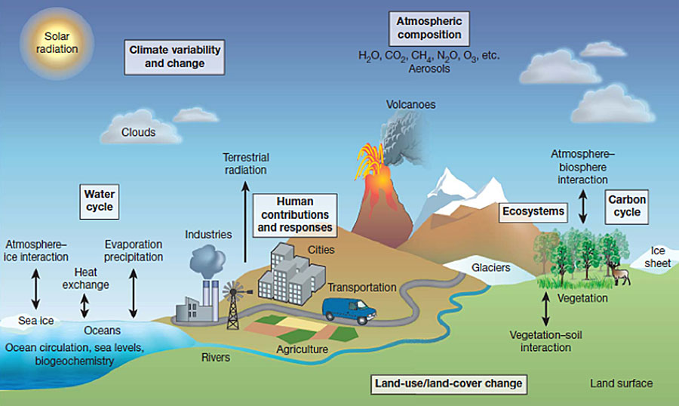
What is Earth System Model Data?
Image from NOAA Geophysical Fluid Dynamics Laboratory

Slide 5
A New Consortium Project in the USA
New team from Oak Ridge National Laboratory, Argonne National Laboratory, and Lawrence Livermore National Laboratory proposed to modernize the data backplane based on the Globus platform (2021)
ESGF2-US proposal was reviewed by panel of 8 scientists in August 2021, and was selected for funding by the US Department of Energy starting in FY2022, and renewed after our triennial review in 2024
In addition, ESGF2-US will continue to develop new data discovery tools and data access interfaces, server-side computing (subsetting & summarizing), and user computing (Kubernetes & JupyterHub) with improved user & system metrics (one of the DOE Integrated-Research-Infrastructure Pilot Projects)
ESGF2-US added a Resource & Project Liaison group and a Science, User & Facility Advisory Board and will offer a help desk/user support

Slide 6
IPCC AR6
The United Nations’ Intergovernmental Panel on Climate Change (IPCC) Sixth Assessment Report from Working Group I was released on Monday, August 9, 2021
All of the climate and Earth system model simulation output underpinning this report was produced by modeling centers participating in the World Climate Research Programme’s (WCRP’s) sixth phase of the Coupled Model Intercomparison Project (CMIP6)
Nearly all of that model output was stored in and distributed to researchers via ESGF
Data are about the future of life on Earth!

Slide 7
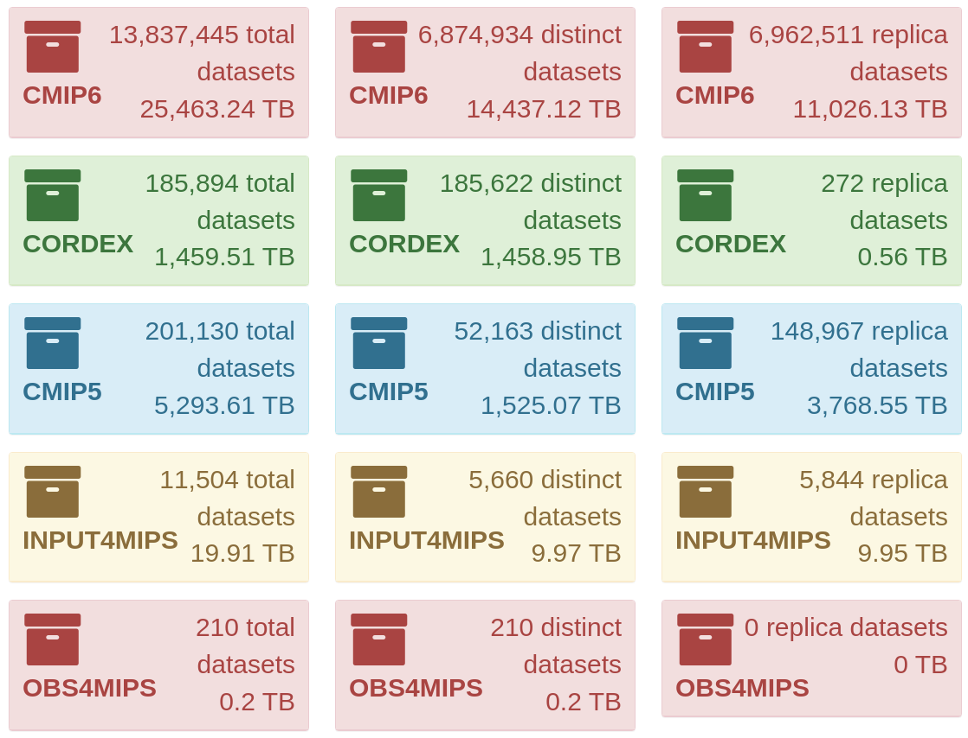
ESGF Holdings are Large and Growing
CMIP5 totals >5 PB (including replicas)
CMIP6 totals >25 PB (including replicas)
CMIP7 is expected to have more high resolution output & ensembles, totaling ~100 PB
ESGF2-US will expand Federation holdings by adding other Earth science data projects for AI/ML, large ensembles, etc.
As of April 11, 2023

Slide 8
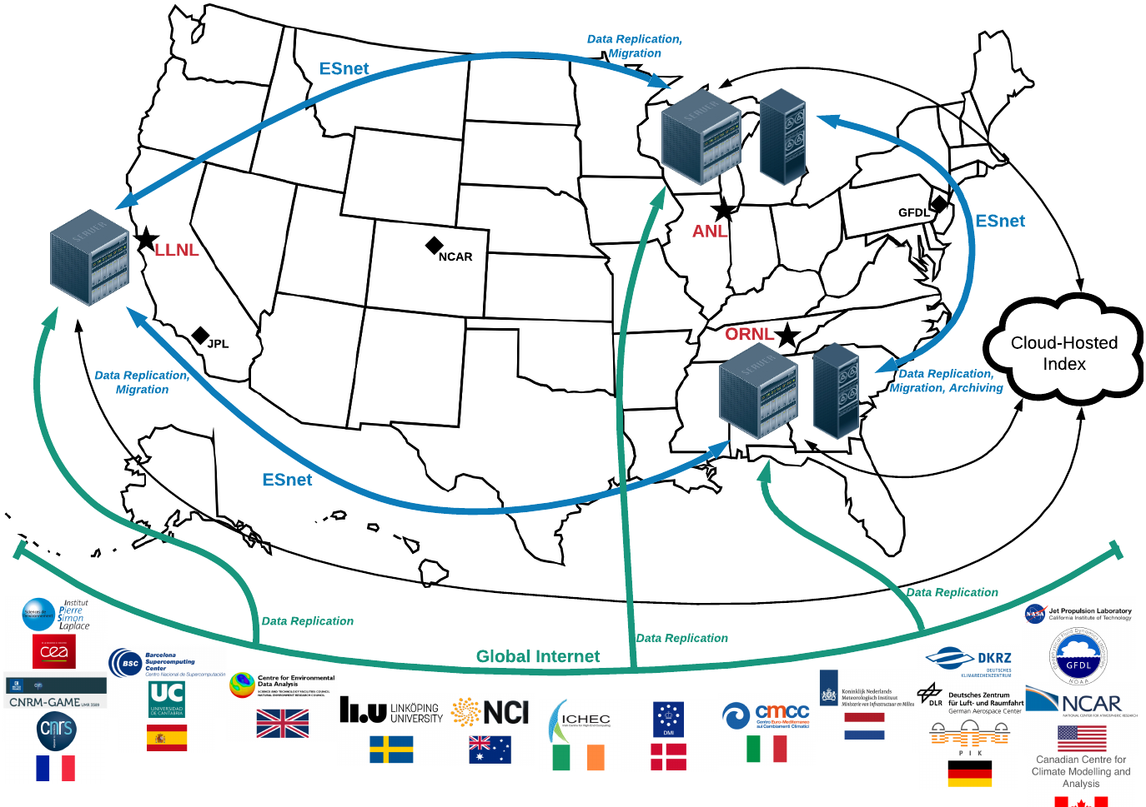
DOE’s Next Generation Earth System Grid Federation
As many as three nodes co-located at DOE’s major computing facilities
Replicating data from the global Federation
Providing cloud indexing and tape archiving

Slide 9
Design and implementation principles
Open architecture and protocols
Enable substitution of alternative implementations
Leverage highly available and scalable central services from Globus
Reduce complexity, increase reliability, provide economies of scale
Use proven, modern security technologies and practices
Integrated access control; protect against attacks and intrusions
Use case approach to design, implementation, and evaluation
Ensure that solutions meet real user needs
Integrated instrumentation
Metrics drive data management, data access features, capability development
Focus on performance to deal with big data
High-speed data transfer, search, server-side processing

Slide 10
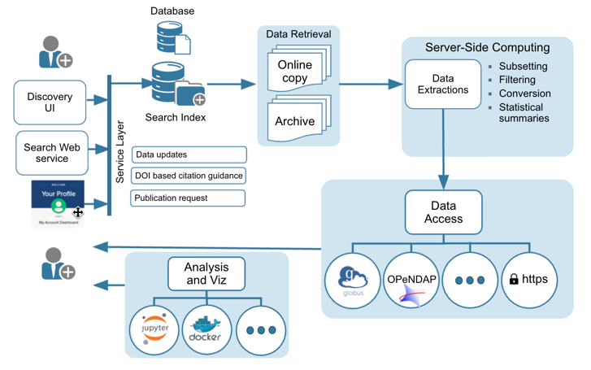
The General ESGF Architecture

Slide 11
What’s Our Goal in Terms of User Access?
Objective: Remove the barriers and accelerate science with ESGF-hosted data
Data access: Develop improved APIs and services to access and analyze data;
Server-side functions: make it easy to run core operators (averaging, selecting, regridding) next to the data;
User computing services: Data proximate computing resources; reproducible/relocatable workflows;
Community development: Don’t reinvent the wheel - use and improve existing solutions, entrain the community;

Slide 12
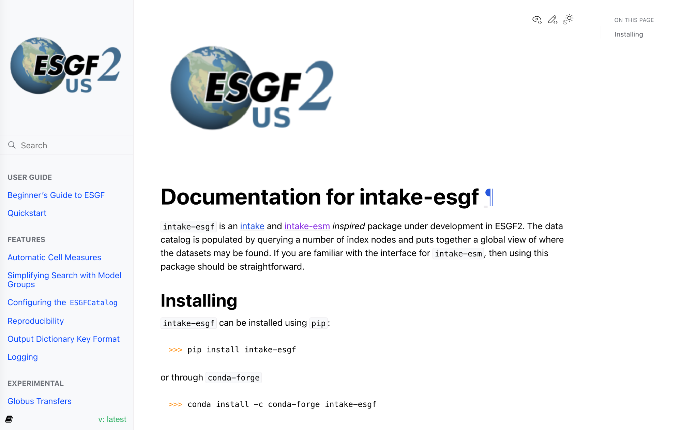
intake-esgf: Programmatic Access to ESGF
Improve the APIs to access data; simplify searching for data programmatically across the federation
Provide STAC-based index query in addition to the existing Solr and Globus indices
Extend the interface to provide capability for data streaming (OPeN-DAP, Kerchunk, Virtual Zarr) as available
Integrate the errata service provided by es-doc into intake-esgf catalogs
Intelligently determines the quickest way to access data (download, Globus Transfer, stream, load locally)
Interfaces directly with both SOLR + Globus indexes
Repository: https://github.com/esgf2-us/intake-esgf
Documentation: https://intake-esgf.readthedocs.io/
Installation: PyPI and Conda-forge

Slide 13
Web Processing Services: Server-Side Compute
Building upon capabilities being developed by federation partners, in coordination with Compute Working Team
WPS service will be optimized for performance and stability
Supported server side operations will be extended to enable multiple variables, models, and observations.
Richer set of scientific analysis functions such as calculation of trends, identification of extreme hot/cold days, ENSO indices, climate sensitivity, climate-carbon cycle feedback metrics etc.
ROOK: Remote Operations On Klimadaten
Rooki Python Client
Multi-Petabyte Store of CMIP Data
Containerized WPS
using Kubernetes (ORNL)
Notebooks in Users’ Environment/Cloud
ROOK/WPS has been deployed at the ORNL node with access to CMIP6, CMIP5 and Obs4MIP data collections. Supports spatio-temporal subsetting, averaging and regridding.
https://github.com/roocs

Slide 14
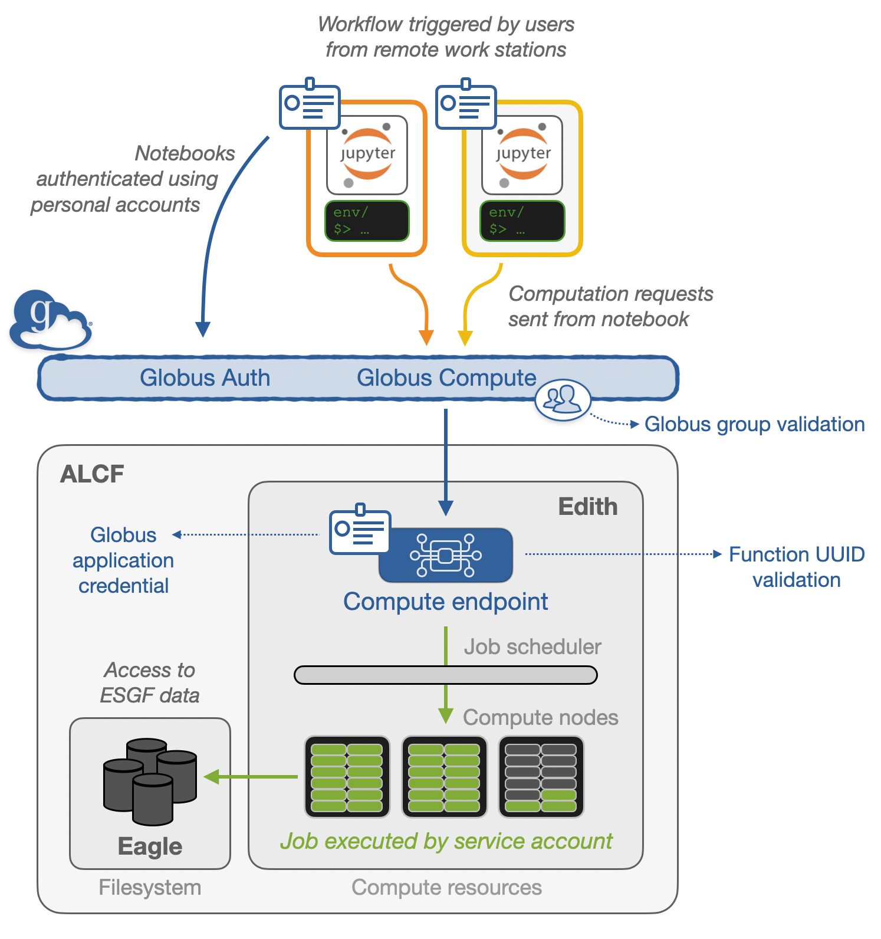
Server-side computing using Globus Compute
Custom, Vetted Compute Functions
Leverages existing tools from ROOK
Enables custom functions (e.g., ENSO)
Users do not need HPC access (controlled at the GLOBUS group level)
Documentation for running your own function

Slide 15
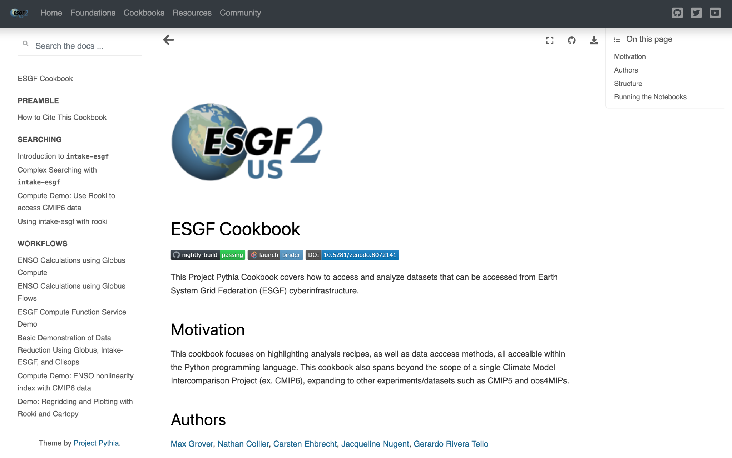
Learning resources & collaboration with open source community
Continue to develop illustrative ESGF cookbooks that demonstrate the use of search and access interfaces and analysis tools
Provide users the tools + example analysis recipes based on use-cases
Leverage tools developed by the community (Pangeo, Project Pythia) and co-develop new tools to work with ESGF data
Engage with user community via tutorials and workshops, and seek feedback for new tools
6 contributors, 10 notebooks
100 registered users can run this on ESGF-supported Jupyterhub (Nimbus)
https://projectpythia.org/esgf-cookbook

Slide 16
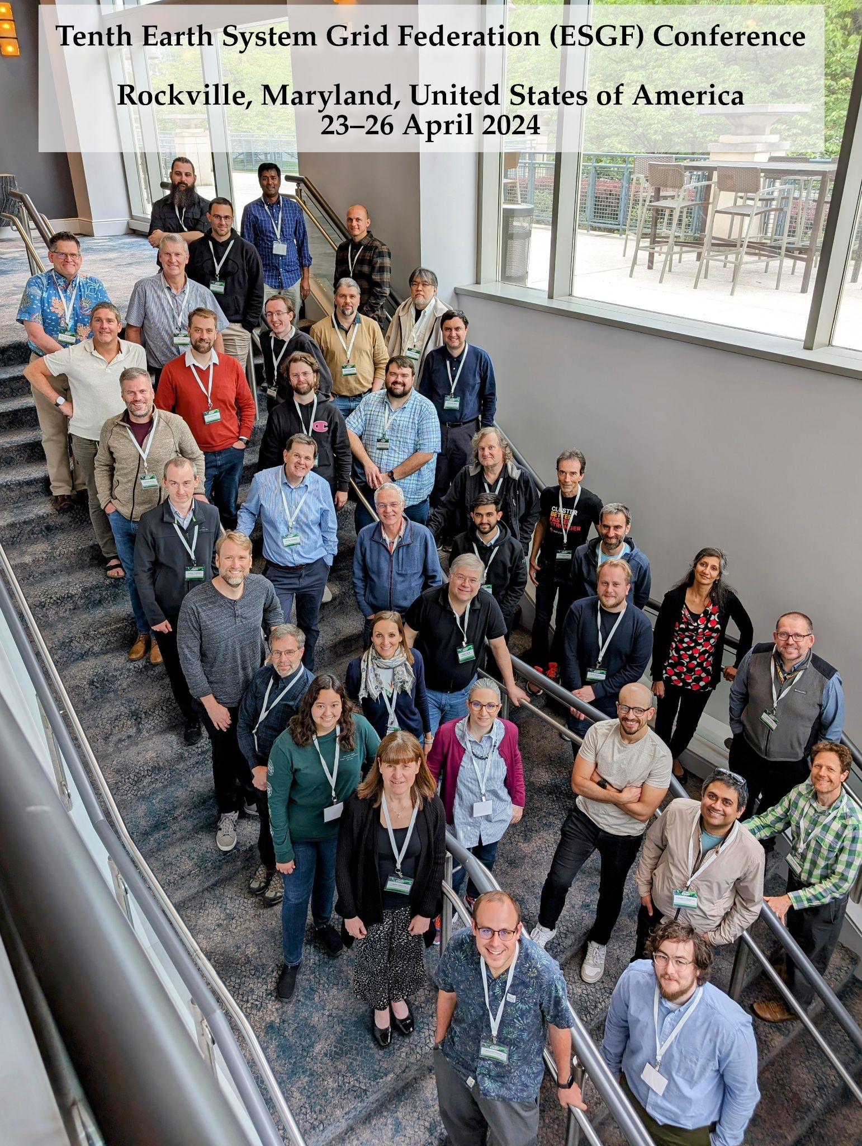
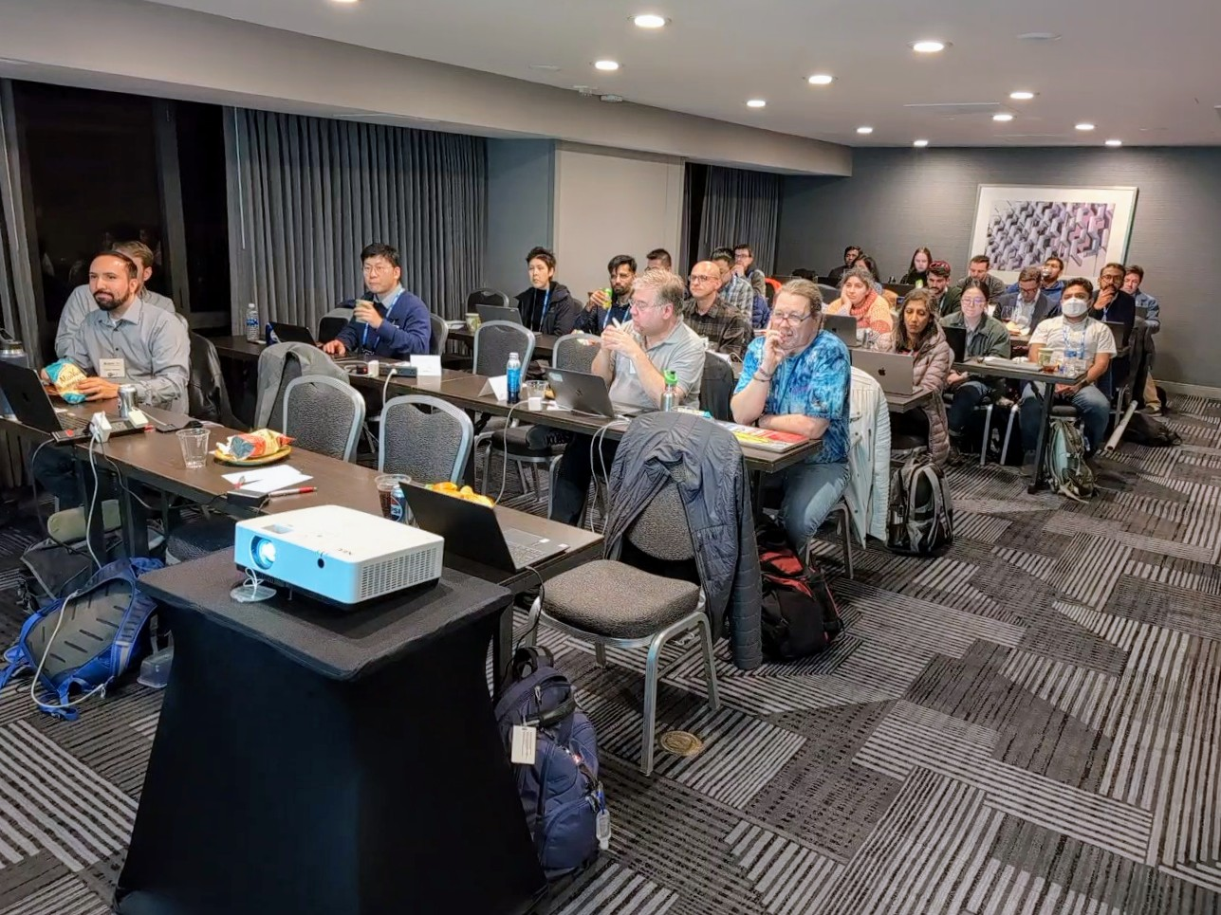
Outreach Activities
Organize Webinars, Tutorials, and Bootcamps
Data management lessons learned
Ingest best practices
Data discovery and access
➜ ESGF Webinar series playlist at https://www.youtube.com/@esgf2432
Hackathons and Workshops
Data standards
Data node deployment and user compute resources
Hold at large relevant conferences, e.g., AGU Fall Meeting, EGU, and AMS Annual Meeting
Organize and host annual ESGF Developer and User Conferences
ESGF Workshop & Tutorial at the 2023 AGU Fall Meeting in San Francisco

Slide 17
Summary
The next generation Earth System Grid Federation (ESGF2-US)
Will be designed for an order of magnitude increase in data sizes
Will be highly available, scalable, and fast
Will automatically migrate data as needed
Will have improved data discovery and sharing tools
Will offer server-side computing for derived data
Will offer user computing capabilities (e.g., JupyterHub/JupyterLab) near the data
All new ESGF development is being performed collaboratively with Federation partners all over the world
ESGF2-US aims to add new data projects to support large-scale AI/ML data, multi-agency model intercomparisons, and model benchmarking
User computing approaches initiated in the commercial cloud and deployed through on-premise cloud infrastructure will likely facilitate more research

Slide 18
ESGF-US Failsafe Data Replication
In the US, LLNL operates the primary ESGF node, which replicates much of the CMIP6 and related model output from around the globe
Since the data at LLNL are contained only on spinning disk, we decided to replicate the entire ~7.5 PB collection of data to Argonne National Laboratory (ANL) and Oak Ridge National Laboratory (ORNL)
Solution: Use Globus to transfer all the data over ESnet
We used custom Globus scripting (thanks to Lukasz Lacinski), ESnet network monitoring and diagnostics (thanks to Eli Dart), DTN and GPFS optimized configurations (thanks to Cameron Harr and others), and debugging and problem-solving (thanks to Sasha Ames, Lee Liming, and others)

Slide 19
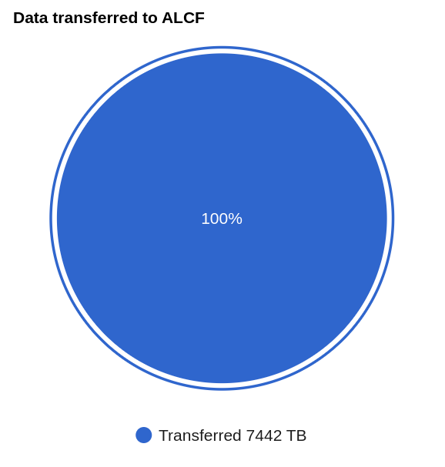
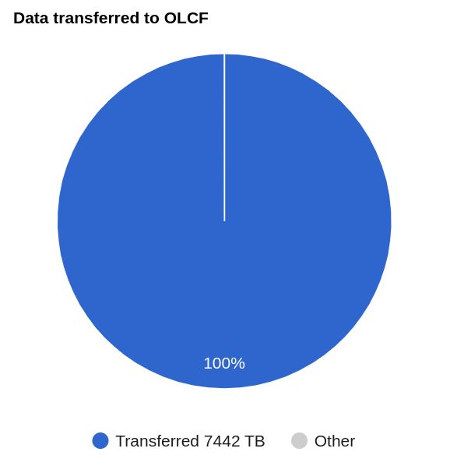
4 to 6 GB/s
1.5 GB/s
7.5 PB transferred between mid-Feb and May 4 2022
17,347,671 directories and 28,907,532 files
https://dashboard.globus.org/esgf
As of May 4, 2022

Slide 20
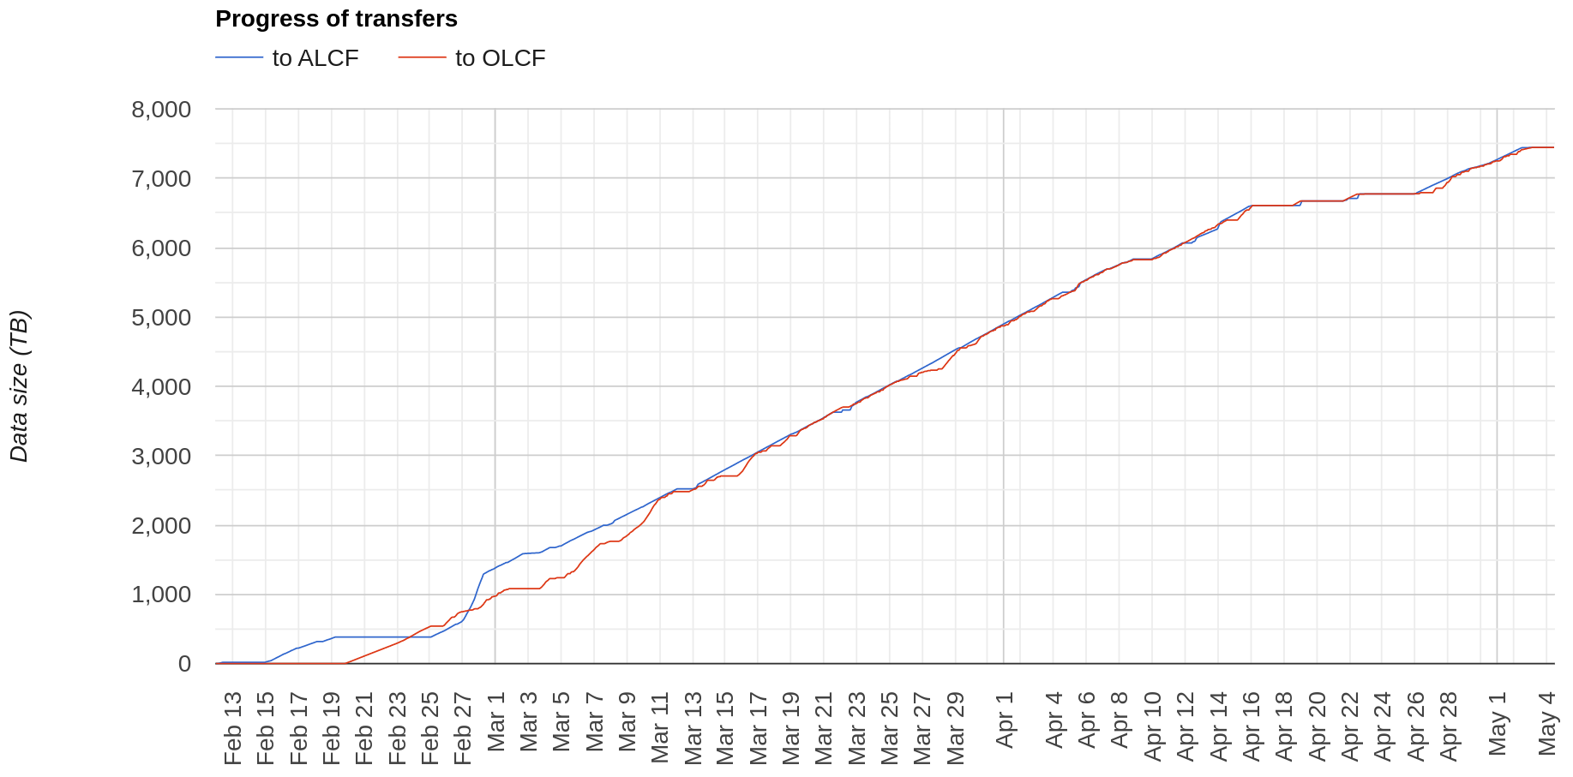
Cumulative Data Transferred Over Time
CMIP5
GPFS Reconfigured
GPFS Errors & Unreadable Files
Small files
CMIP6
Big files

Slide 21
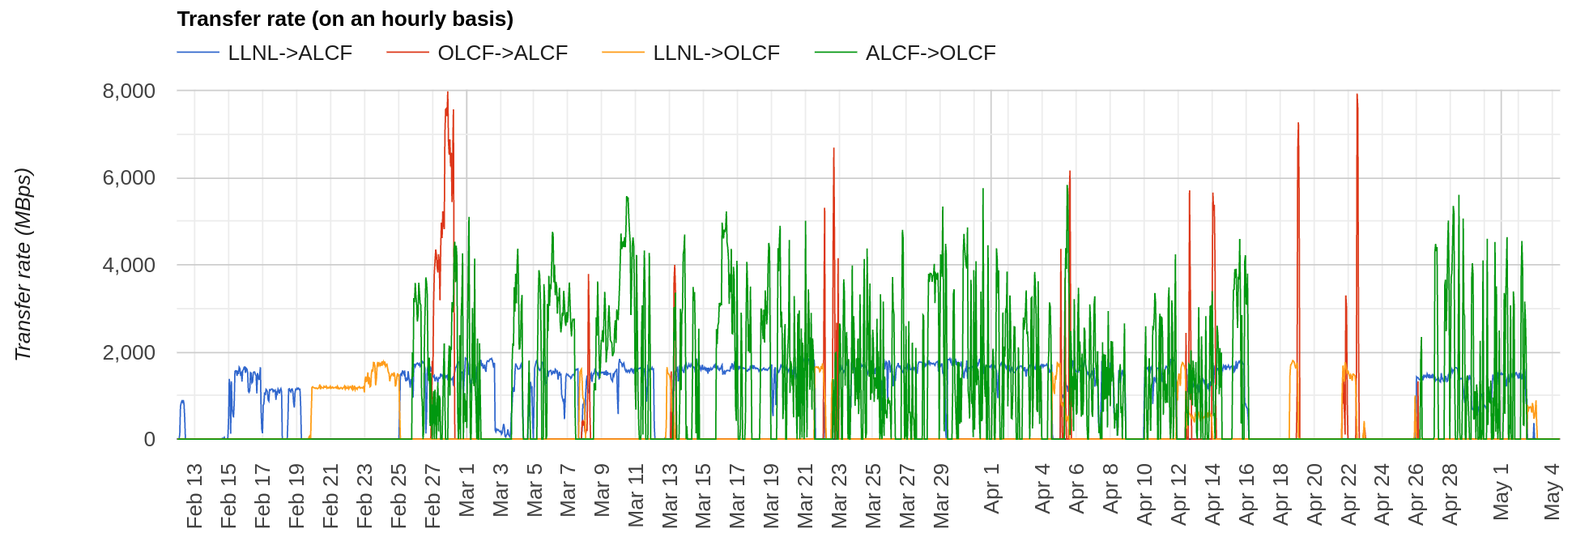
Transfer Rates Over Time
>7.5 GB/s OLCF ➔ ALCF

