Slide 1
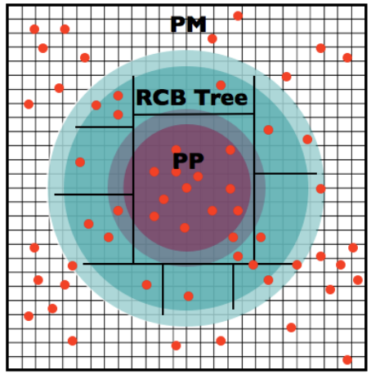
Preparing the HACC Benchmark for ALCF-4: Porting OpenMP Target to SYCL
The HACC framework has been designed with great flexibility in mind – it is easily portable between different high-performance computing platforms. HACC has three distinct phases in the computation - their relative ratios to total run time strongly depend on the parameters of the simulation. The short force evaluation kernel is compute-intensive with regular stride one memory accesses. This kernel can be fully vectorized and/or threaded. The tree walk phase has essentially irregular indirect memory accesses and has very high number of branching and integer operations. The 3D FFT phase is implemented with point-to-point communication operations and is executed only every long-time step; thus, significantly reducing the overall communication complexity of the code.
https://asc.llnl.gov/coral-2-benchmarks
Challenge
The HACC benchmark for the Aurora SOW is based on the CORAL benchmark, with the short force evaluation kernel offloaded to the PVC GPU using OpenMP Target. The code is optimized to use SIMD loop vectorization and Intel extensions to the OpenMP runtime library.
To act as an ALCF-4 benchmark it is desirable to have a standard compliant (no extensions) portable implementation of the benchmark in OpenMP and/or SYCL.
Porting to SYCL is a manual process due to the lack of automated migration tools, e.g., SYCLomatic for CUDA., LLMs not very good either…yet.
Informal representation of the HACC force evaluation hierarchy – 1) long/medium-range contributions from a high-order grid-based, spectrally filtered particle-mesh (PM) solver, 2) medium/short-range contributions using a (rank-local) recursive coordinate bisection (RCB) tree algorithm (green region), 3) close-range contributions using direct particle-particle (PP) interactions (magenta).
Habib, Salman, et al. "The universe at extreme scale: multi-petaflop sky simulation on the BG/Q." SC'12: Proceedings of the International Conference on High Performance Computing, Networking, Storage and Analysis. IEEE, 2012.
Collaborating Institutions: Argonne/Intel
Funding Source: ALCF

Slide 2
Preparing the HACC Benchmark for ALCF-4: Porting OpenMP Target to SYCL
Accomplishment
Implemented an OpenMP standard compliant (no Intel extensions) HACC benchmark based on Aurora SOW. Credit: Adrian Pope.
Utilized OpenMP interop features to incrementally develop and verify SYCL kernels for the benchmark.
Fully ported remaining SYCL functions for memory management to achieve comparable application performance on Sunspot/Aurora.
Discovered optimization differences with default compiler settings between OpenMP and SYCL.
Found a few bugs related to Intel’s OpenMP/SYCL interop support.
Impact
The resulting code is a standards compliant implementation of the Aurora SOW codebase that can be used as an ALCF-4 benchmark, having improved portability. With two programming paradigms: SIMD and SPMD, cross-platform compatibility is also improved. Follow on activities are to confirm scalability on Aurora and compare results on NVIDIA and AMD GPU architectures.
Results are obtained from running the benchmark on Sunspot using SDK version: oneapi/eng-compiler/2024.04.15.002. The Aurora SOW configuration is used with 96 ranks on 1 node of the system mapping 2 MPI ranks to each CCS. The simulation has 912³ particles in a 690.53³ h⁽⁻¹⁾Mpc volume. Kernel timing from iprof.
Collaborators: Adrian Pope (ANL), Vitali Morozov (ANL), John Pennycook (Intel), Ye Luo (ANL), Thomas Applencourt (ANL)
Collaborating Institutions: Argonne/Intel
Funding Source: ALCF
Awesome CPS logo created with AI image generator

