Slide 1
Quantum Computing in CELS/PSE (No-Hardware)
April 17, 2024
Alessandro Lovato
Physicist
PHY DIVISION

Slide 2
Alessandro Lovato
Background and Interest on QIS
I am a Theoretical Nuclear Physics working in the PHY Division.
Understanding self-emerging properties of nuclei and neutron-star matter from individual interactions among protons and neutrons.
Expertise in “conventional” continuum quantum Monte Carlo methods (variational and diffusion Monte Carlo).
Introduced neural-network quantum states to nuclear theory.

Slide 3
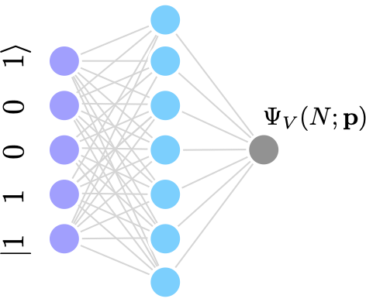
Alessandro Lovato
Current Work
Recently involved in the development of neural-network quantum states.
Applied to nuclear-physics, condensed-matter, and quantum chemistry problems.

Slide 4
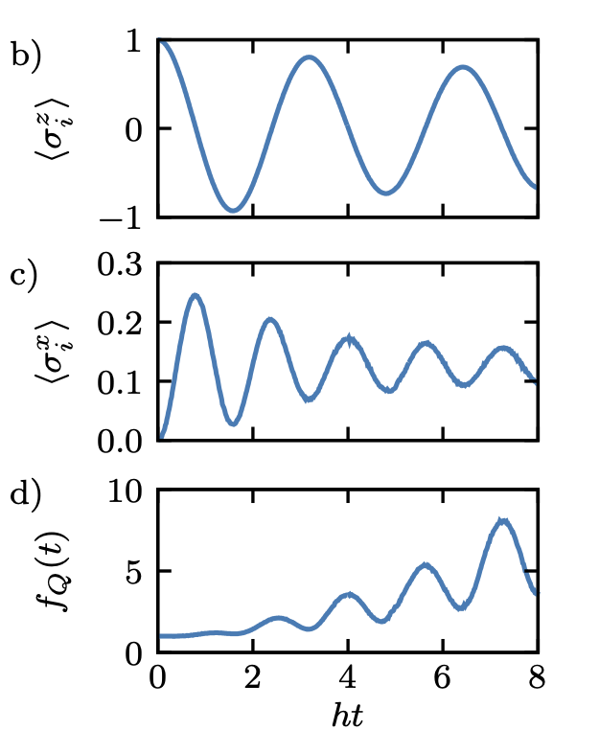
Alessandro Lovato
Collaboration Interests
Not currently working in QIS, but see potential overlap with neural-network quantum states.
Real-time dynamics already encoded in neural-network quantum states; possible development of (favorably scaling) quantum simulators.

