Slide 1
Quantum information science directions
Stephen K. Gray, NST
• Open quantum systems theory and simulations -- qubit or emitter/cavity
interactions including dissipation for quantum sensing
Saleem, Shaji, Gray, Optimal time for sensing in open quantum systems, PRA 108, 022413 (2023).
ANL Collaborator: Z. Saleem
• Quantum algorithms development for molecular and materials simulations, e.g.,
Otten et al., Localized quantum chemistry on quantum computers, J. Chem. Theor. Comput. 18, 7205 (2022).
ANL Collaborator: Y. Alexeev; UChicago: L. Gagliardi; UW: M. Otten
• Use of machine learning to accelerate actual quantum optics and
networking experiments, and also quantum machine learning, e.g.
Cortes et al., Sample-efficient adaptive calibration of quantum networks using Bayesian optimization, Physical Review Applied 17, 034067 (2022).
ANL Collaborators: X. Ma, X. Han; QC Ware: C. Cortes

Slide 2
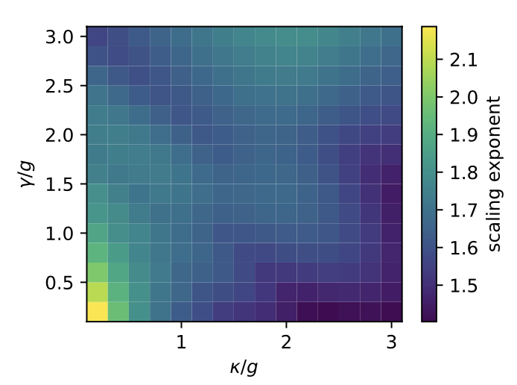
Open quantum systems theory and simulations -- qubit or emitter/cavity
interactions including dissipation
• Recent result: possibility of Heisenberg scaling in the presence of noise, utility of Dicke vs othr types of entangled states
Z. Saleem (MCS), A. SM. Perlin (Infleqtion), A. Shaji (IISER-TVM), Q. Langfitt (NW)
Fisher information can scale as N² (Heisenberg limit) for certain entangled states and in particular coupling regimes, e.g. the strong coupling regime

Slide 3
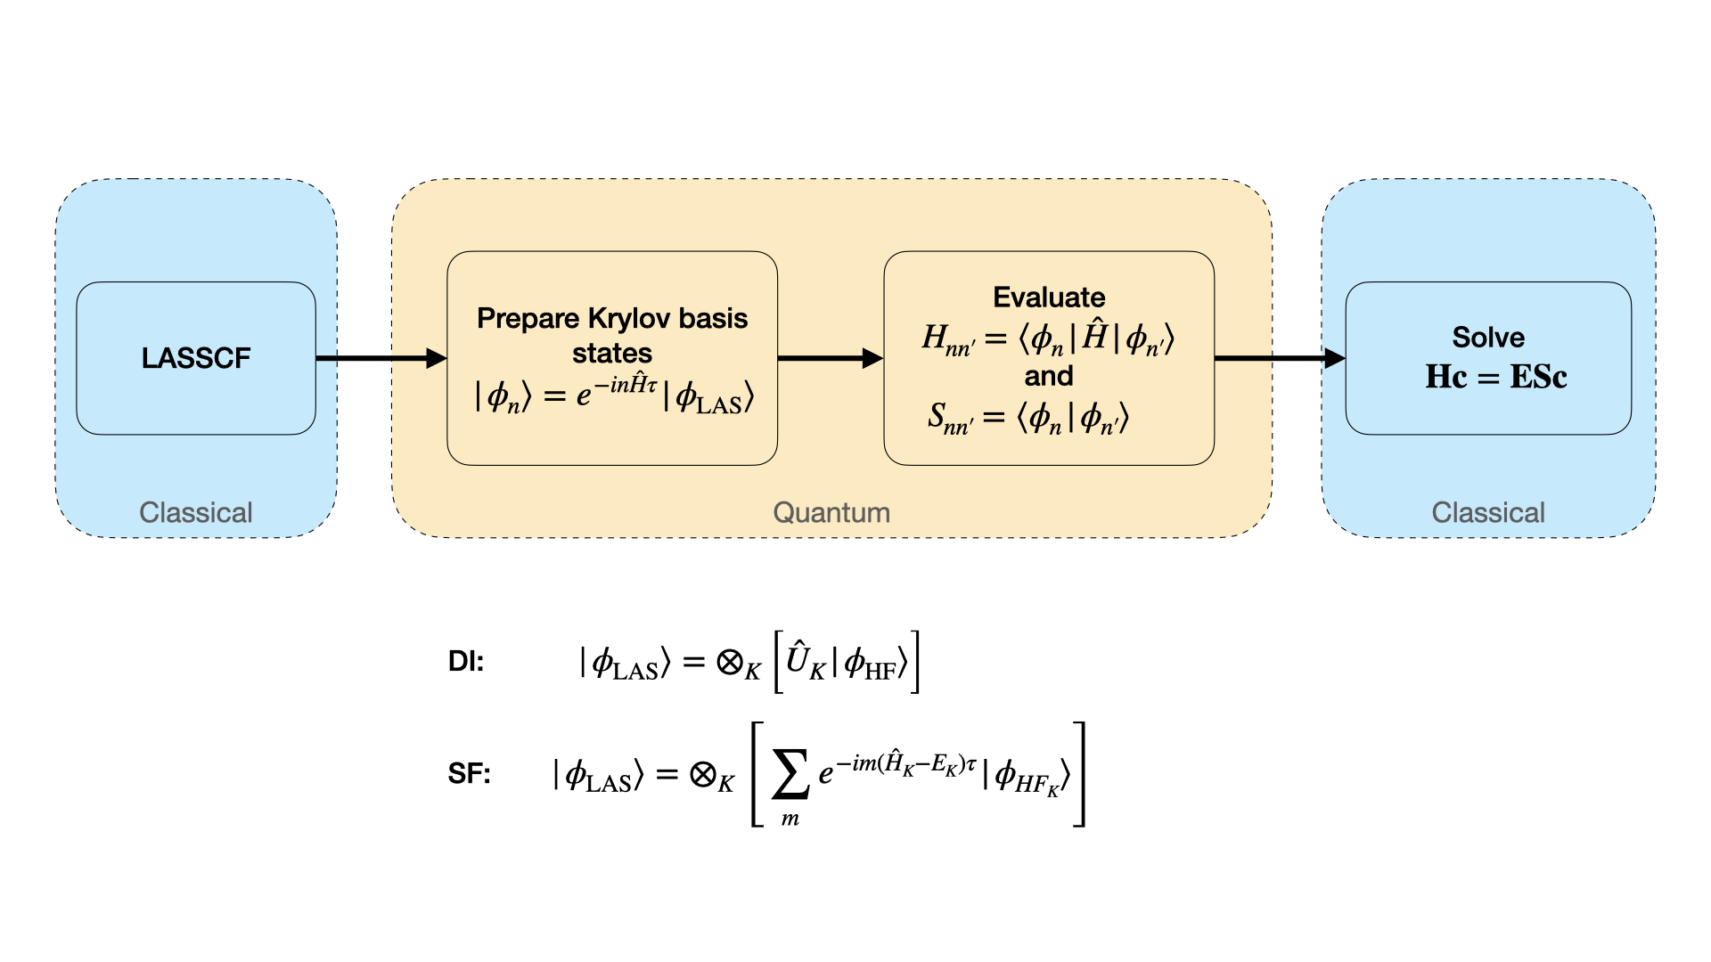
Quantum algorithms development for molecular and materials simulations
Recent result: Use of quantum Krylov subspace diagonalization methods in lieu of QPE and within fragmentation-based quantum chemistry algorithms
R. D’Cunha and L. Gagliardi (Uchicago); C. Cortes (QC Ware)

Slide 4
Some other ongoing/future directions:
Distributed quantum sensing with quantum networks – effects of noisy state preparations
Z. Saleem, R. Kettimuthu and Team
Use of “quantum light”, e.g. single and two-mode squeezed light in place of ordinary light in plasmonics and imaging experiments – enhancing entanglement production, swapping
N. Scherer, G. Wiederrecht
Molecular qubits and environmental effects
Y. Alexeev, S. Galania, B. Peng, N. Govind

