Slide 1
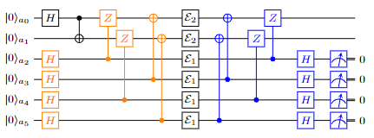
Quantum Computing in CELS/PSE (No-Hardware)
April 17, 2024
Alvin gonzales
Postdoctoral Appointee
Advisor: Zain Saleem

Slide 2
Alvin gonzales
Background and Interest on QIS
Master and PhD in Computer Science with dissertation in quantum information theory.
Quantum error mitigation and correction.
Pauli Check Sandwiching (PCS).
Constraints on the correction of non completely positive maps.
Distributed quantum computing
Instantaneous nonlocal quantum computation.

Slide 3
Alvin gonzales
Current Work
State preparation via Quantum Walks
Error Mitigation

Slide 4
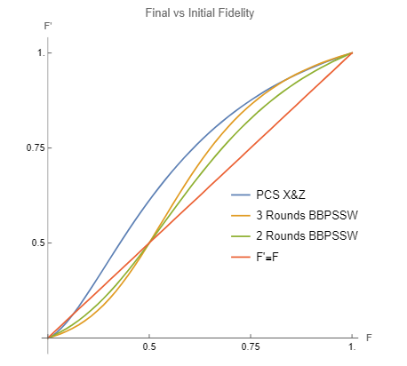
Alvin gonzales
Current Work
Error Mitigation

Slide 5
Alvin Gonzales
Collaboration Interests
Quantum sensing.
Accurate representation of open quantum system evolution.
Initial correlations between the system and environment is problematic.

