Slide 1
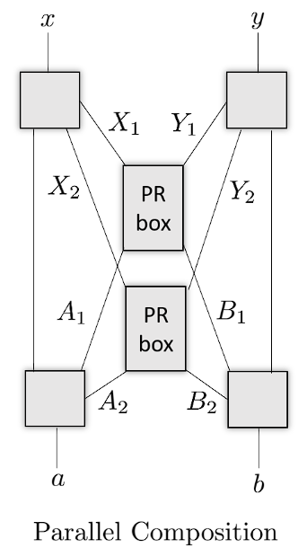
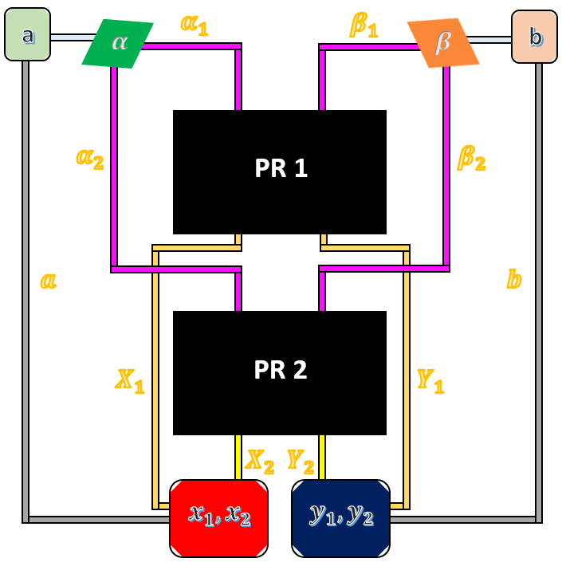
QIS research overview
April 17, 2024
Daniel Dilley
Jeffrey Larson
Zain Saleem
MCS Division
Postdoc
Advisor
Advisor

Slide 2
Daniel Dilley
CHSH Experiment
Background and Interest on QIS
Demonstrating Bell nonlocal correlations in various experimental set-ups
Quantum networks imitate classical systems when correlations are local
Detector inefficiencies may cause correlations to be local for maximally entangled states, but not for weaker entangled states
Quantum error correction (QEC) in open quantum systems
Initial correlations between a system and its environment may cause state evolutions that are not completely positive (NCP)
There are a different set of error correcting conditions for these evolutions
Quantum state manipulation
Explicit construction of local unitaries that can control correlations between two qubits.
Use weak measurements to model open system evolution as a product state
Standard QEC protocols can then be used for NCP evolutions

Slide 3
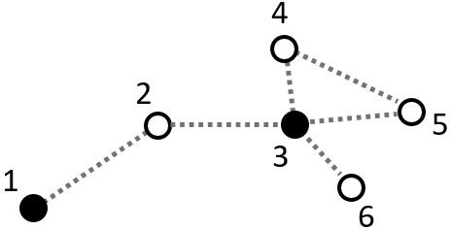
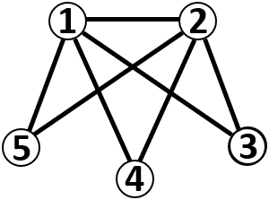
Daniel Dilley
Current Work
Geometric Measure of Entanglement (GME)
Closest separable state to the state prepared in the lab
Related to maximum output purity of quantum channels
Alice can send information with higher fidelity to Bob when the GME is higher
Entanglement purification protocols with restricted architectures
More copies of the state $ρ$ get purified into less copies of the more entangled state $σ$
Understand how correlations are distributed b/w systems to optimize entanglement
Use quantum walks during state preparation and constrained optimization
Use the minimal number of walks to prepare a given initial state
Determine an optimal way of constraining the walks to only feasible states

Slide 4
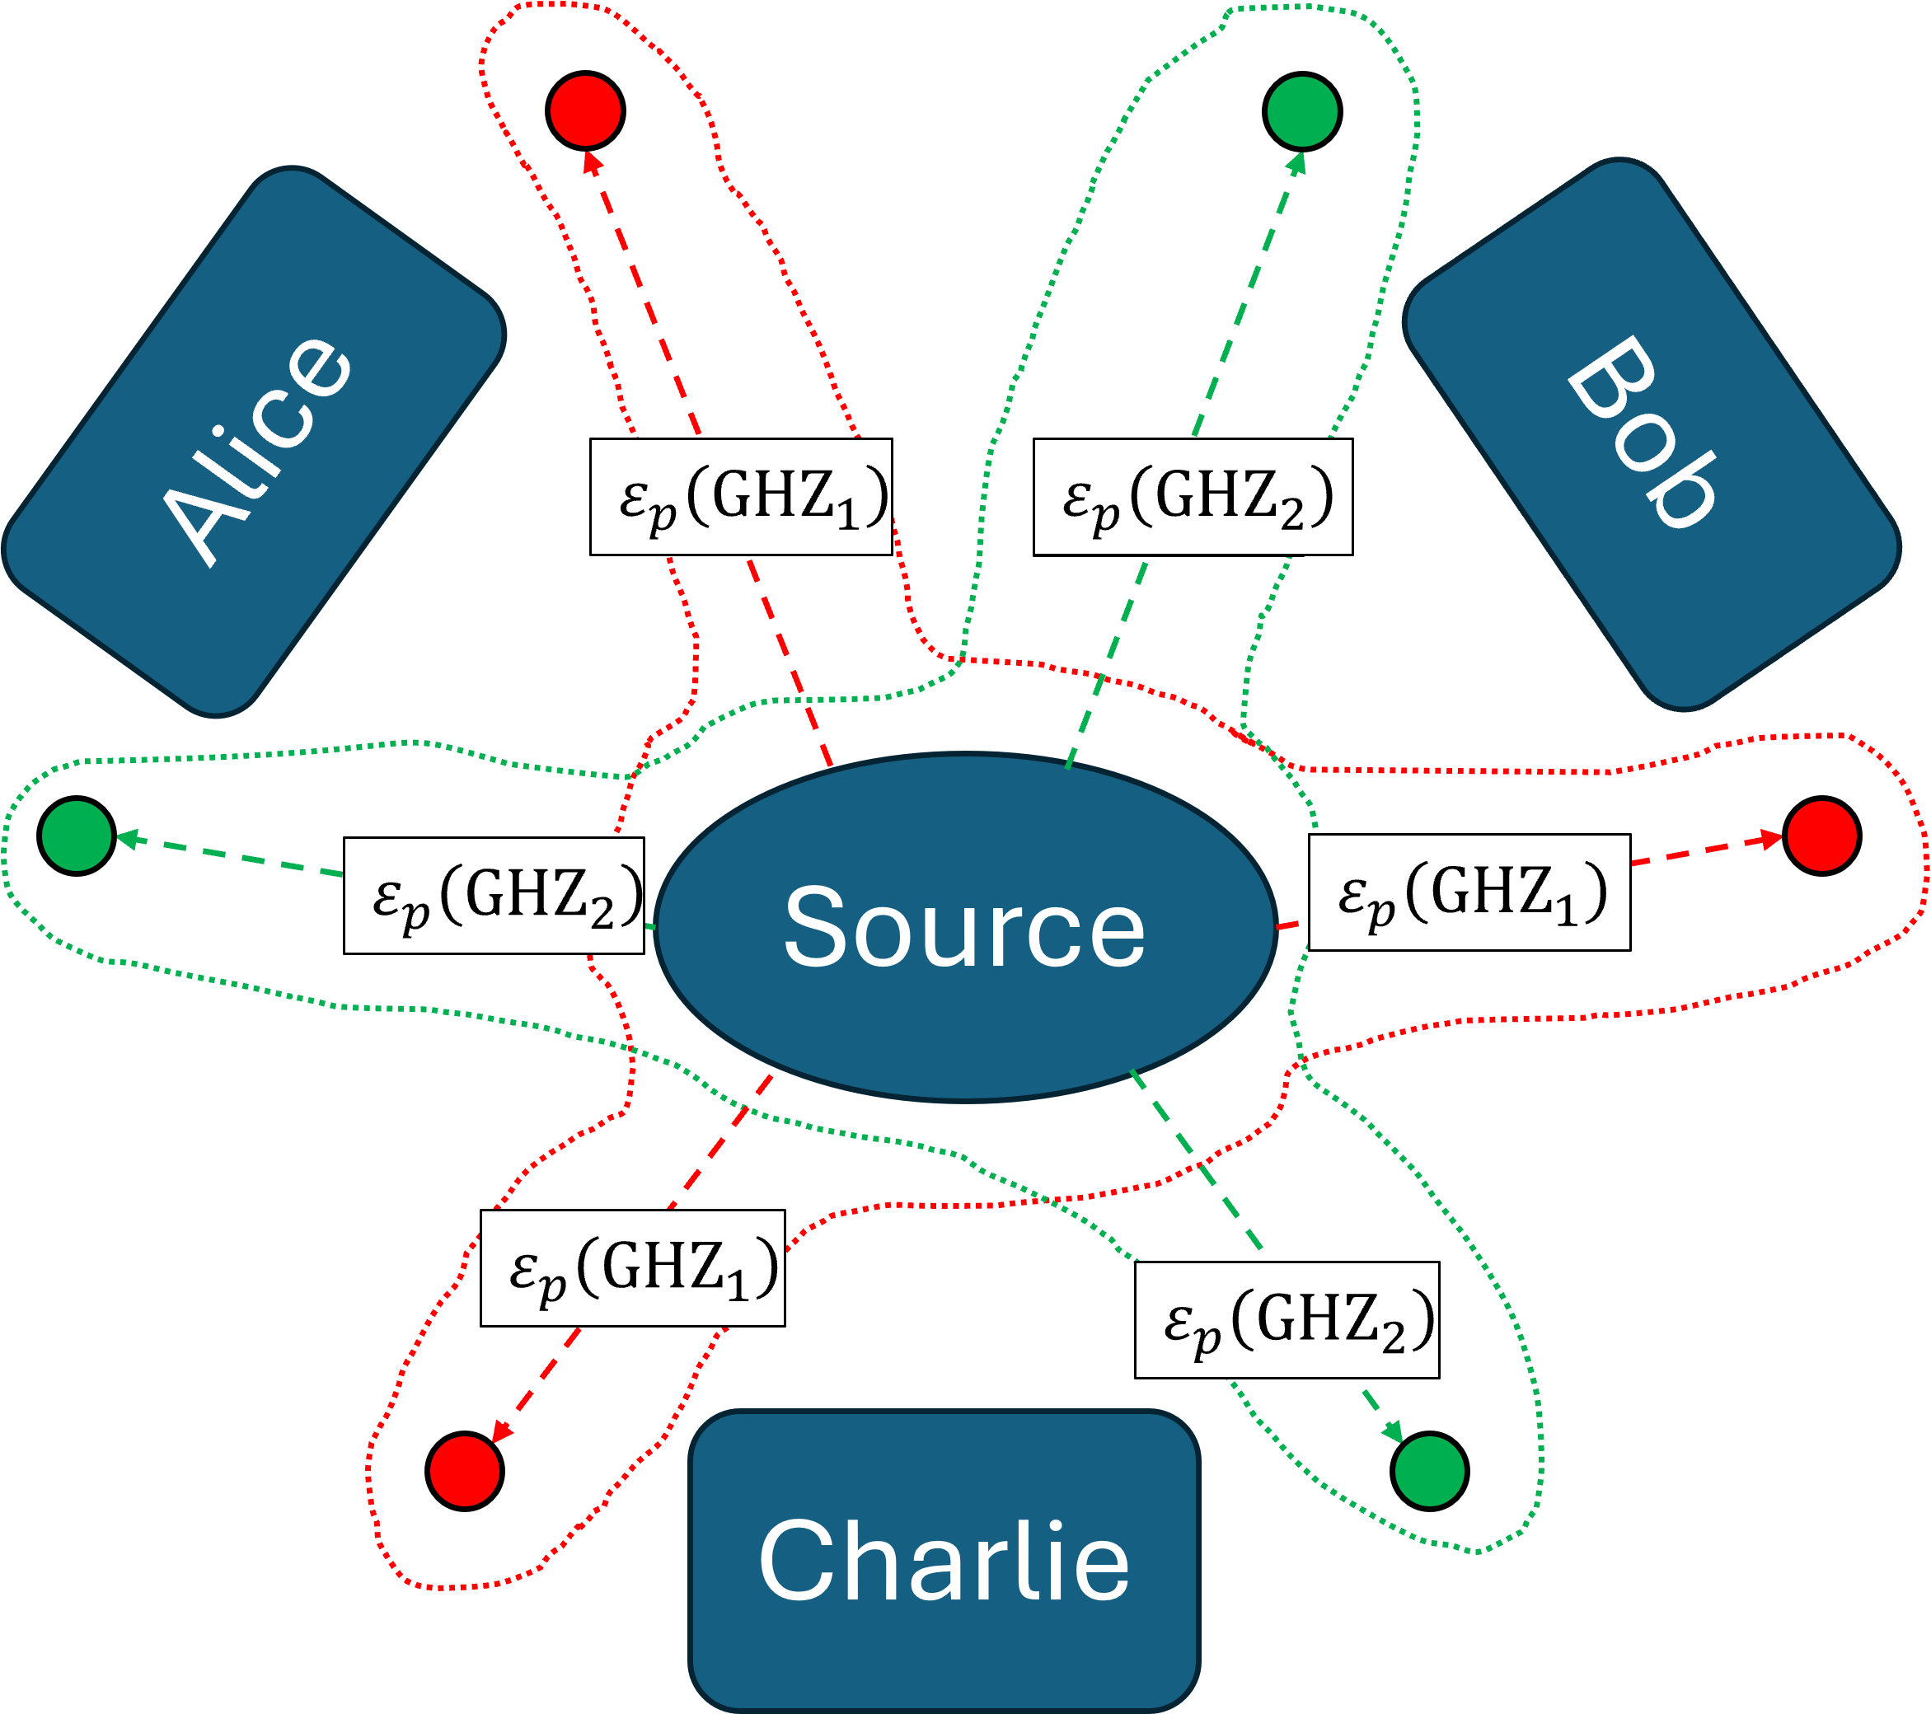
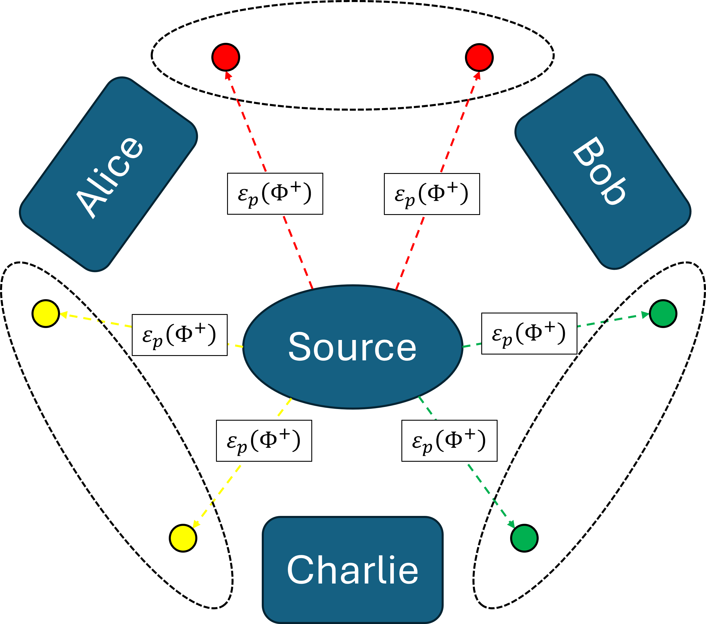
Daniel Dilley
Collaboration Interests
Distribution of entanglement and nonlocal resources in quantum networks
Find simple methods for generating non-classical correlations
How does manipulating global (local) states alter the correlations of the local (global) states
Distributed quantum sensing
Quantum sensors should enable non-classical measurement precision
The standard quantum limit (SQL) tells us that N independent sensors may improve the measurement sensitivity by $1/\sqrt{N}$
The SQL can be surpassed using entanglement or squeezed light
Determine how quantum correlations can be utilized to improve measurement precision
Time-optimal unitaries in quantum control of qubits
Implement Cartan decompositions to make quantum circuits more efficient

