Slide 1
Quantum Computing in CELS/PSE (No-Hardware)
April 17, 2024

Slide 2
Joaquin Chung (DSL)
Background and Interest on QIS
Background
Classical networking expertise on industry and systems research
Working on quantum networking since 2019, primarily focusing on classical control plane and architecture
Co-leading the development of SeQUeNCe simulator with Raj Kettimuthu
Interest on QIS
Demonstrations of quantum networks as systems that can operate (semi)autonomously
Architecture and protocols for scalable quantum networks

Slide 3
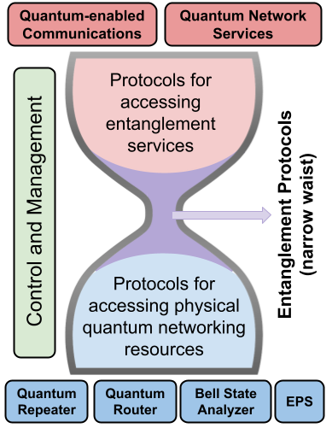
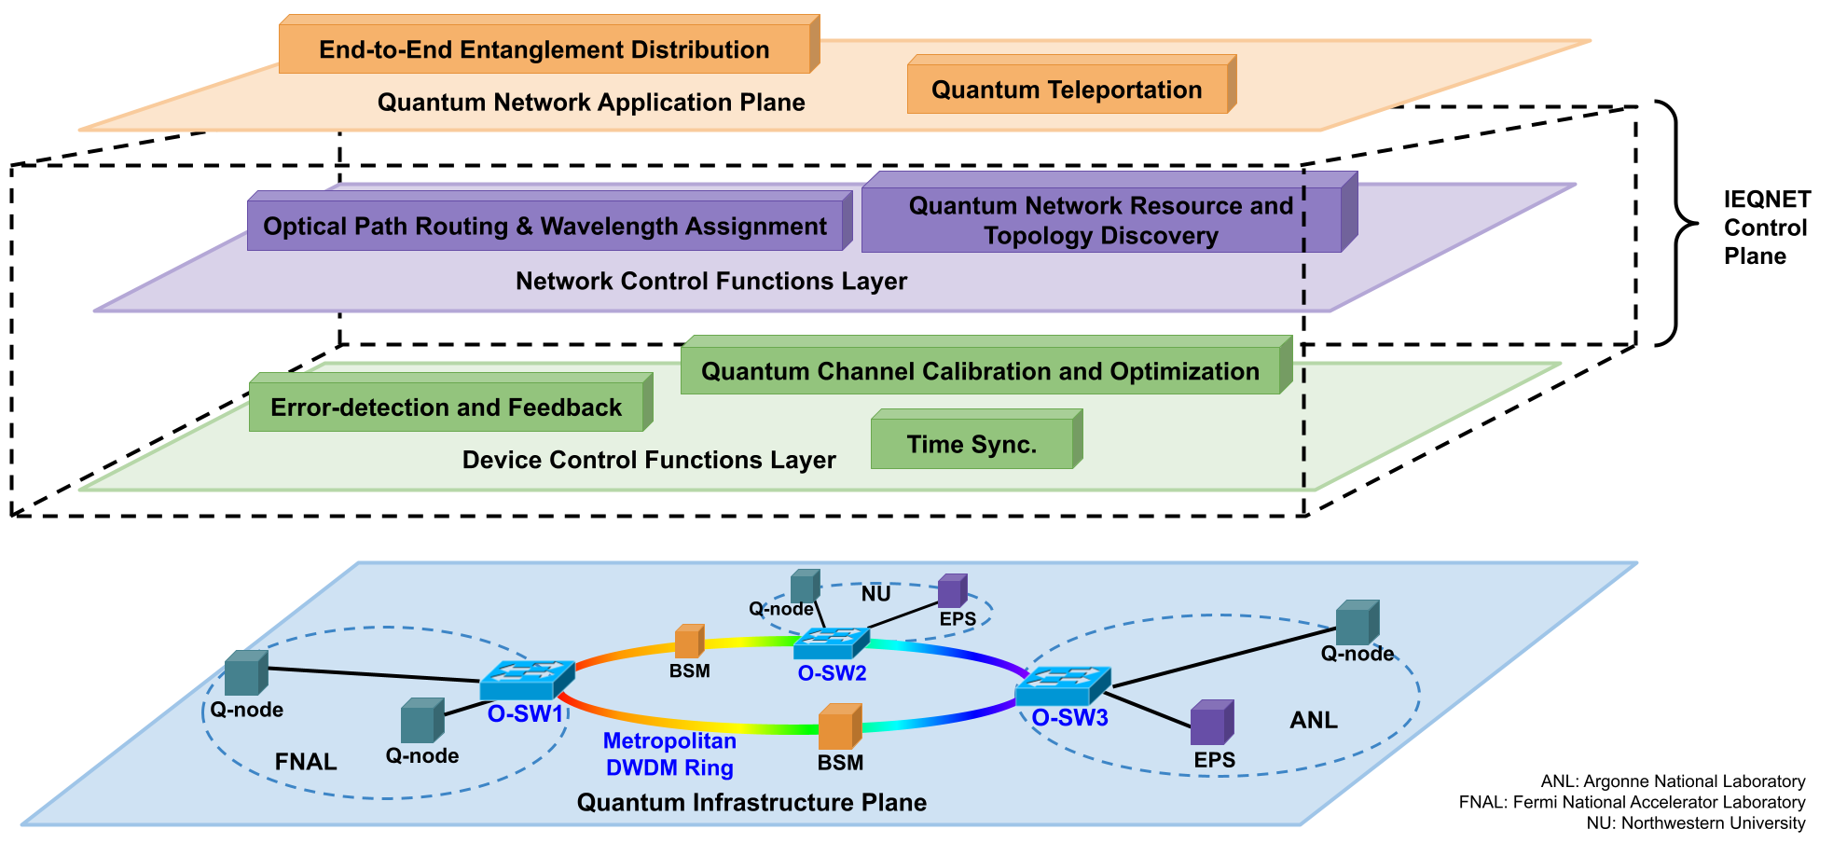
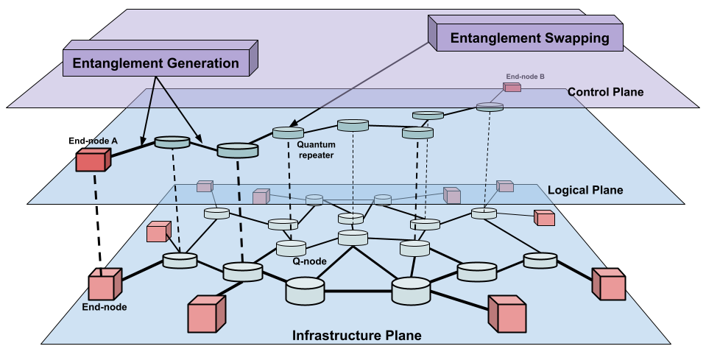
Joaquin Chung
Current Work
Classical control plane, abstractions, and APIs for near-term quantum networks
Architecture and protocols for scalable quantum networks

Slide 4
Joaquin Chung
Collaboration Interests
"Networked" quantum applications such as distributed quantum computing and distributed quantum sensing
Benchmarks for quantum computing

