Slide 1
quantum krylov subspace algorithms for ground and excited state energy estimation
Cristian Cortes and Stephen Gray
Center for Nanoscale Materials
Argonne National Laboratory

Slide 2
This project is one component of the LDRD-funded project,
Quantum-computer-based simulation of strongly correlated photocatalytic materials
L. Gagliardi (UChicago, CSE)
Y. Alexeev (CPS), M. Suchara (MCS)
D. Fedorov (CPS), C. Cortes (NST), S. Gray (NST)
M. Otten (HRL – external, unfunded collaborator)

Slide 3
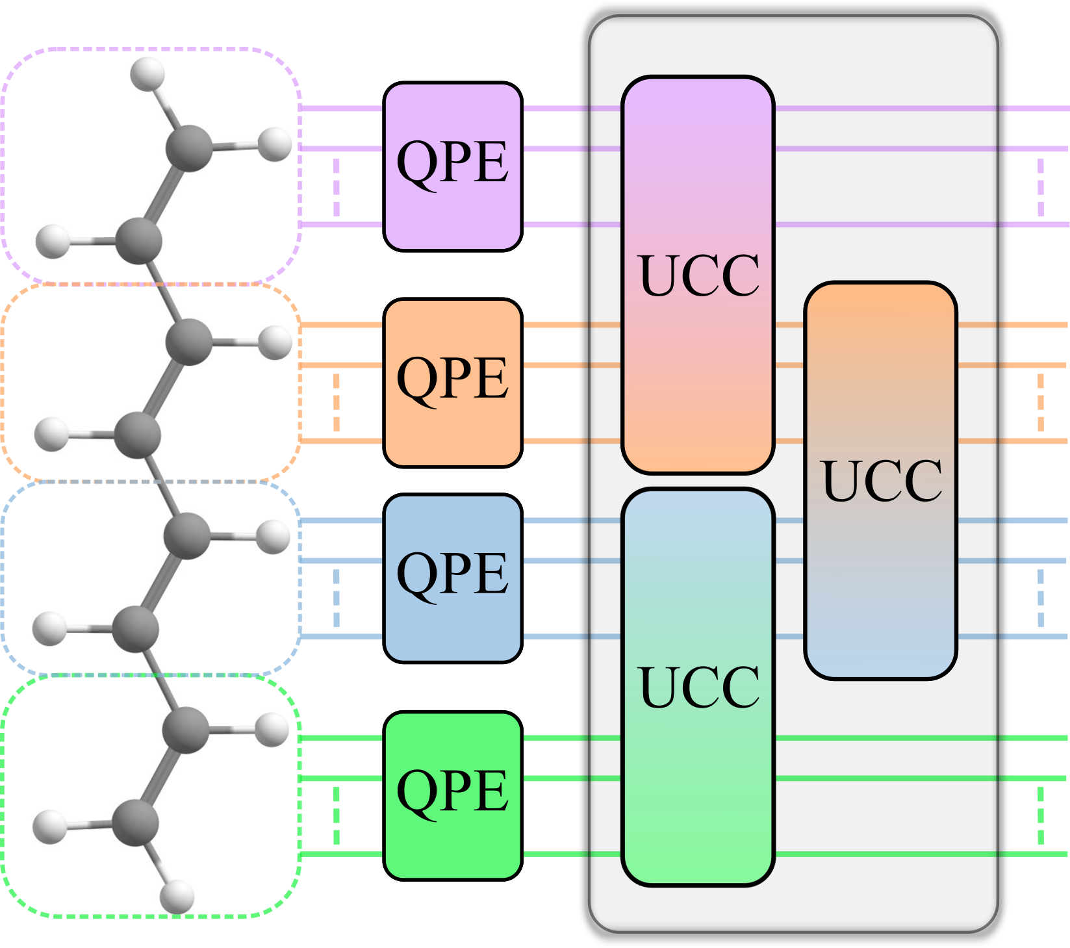
In this project, the idea is that large, complex chemical systems will be broken up into chemically-motivated fragments, “exact” (Quantum Phase Estimation or QPE) calculations on a quantum computer are performed on the fragments which are then coupled to obtain the energy in a variational quantum algorithm (VQE) circuit:
Our Krylov approach can be thought of as an efficient variation on the QPE aspects above.

Slide 4
Outline
Goal and Perspective
Approach
Quantum Chemistry Examples
Conclusions

Slide 5
Goal and perspective
To develop quantum algorithms for solving difficult eigenvalue/eigenvector problems like the electronic Schrödinger equation for molecular systems.
Variational Quantum Eigensolver (VQE) – a unitary-gate implementable ansatz is defined and an approximate solution is obtained by minimizing the energy.
Quantum Phase Estimation (QPE) can provide the “full CI” energy. Roughly speaking, QPE involves time-stepping exp(-iHτ) on an initial state that has some good overlap with the desired state and Fourier analysis to obtain the “full CI” energy. It can involve on the order of 1/ε = 1000 or more time steps and thus requires deep circuits.
More clever approaches to the Fourier analysis or to effectively doing the Fourier analysis in QPE can be developed that can reduce the effort. Here we will use Krylov subspace methods. See some important, related papers:
  Parrish and McMahon, arXiv:1909.08925 (2019)
  Stair, Huang & Evangelista, JCTC 16, 2236. (2020)
  Klymko et al., arXiv:2103.08563 (2021)

Slide 6
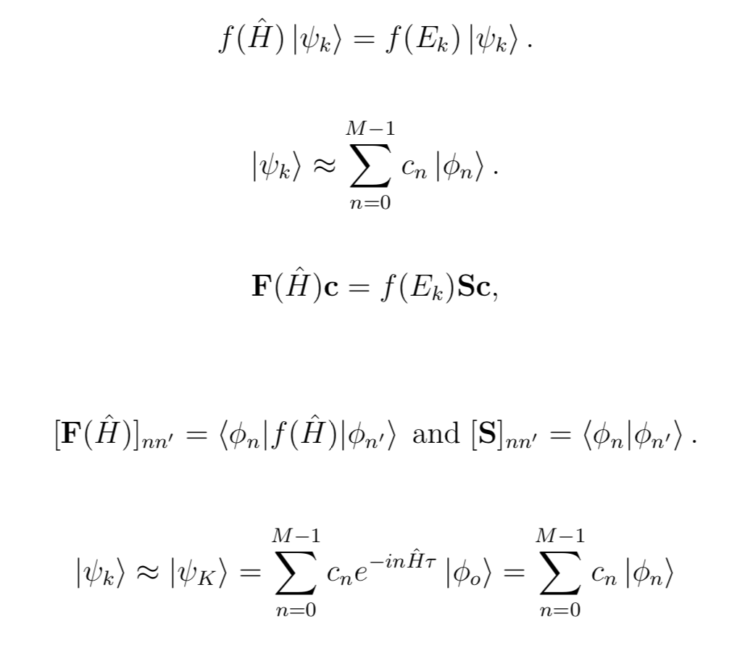
Generalized eigenvalue problem and use of Krylov iterates based on M-1 time steps:

Slide 7
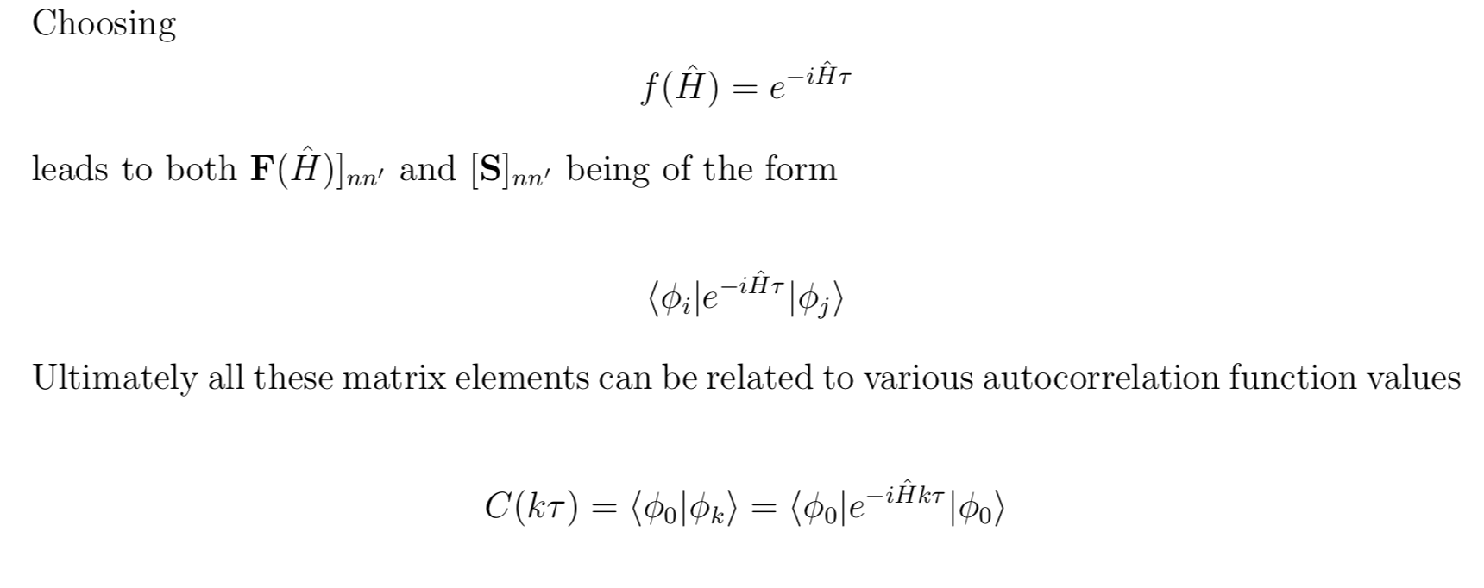
Choice of f(H): f(H) = H, of course, is one possibility. However, a much more computationally efficient choice is: f(H)= exp(-iHτ). This is also motivated by a signal-processing approach arising from the chemistry literature called “Filter Diagonalization”:
  Wall and Neuhauser, J. Chem. Phys. 102, 8011 (1995)
  Mandelshtan and Taylor, J. Chem. Phys. 107, 6756 (1997)

Slide 8
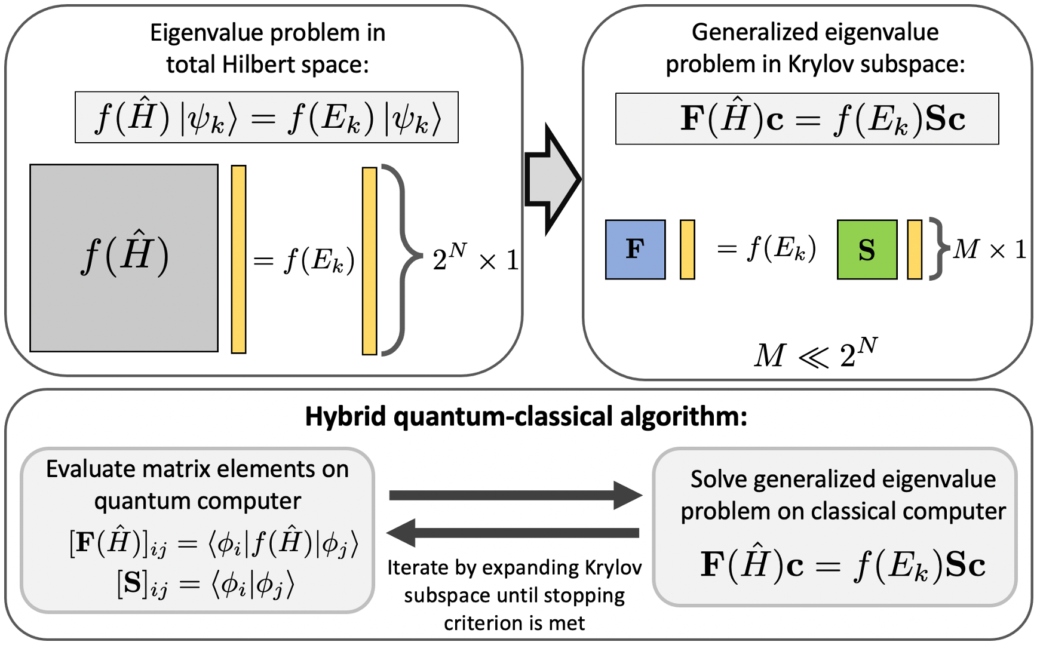
Plan is to use the quantum computer to take the time steps, and to either use an ancillary qubit and the Hadamard test to evaluate the overlaps or to use a new fidelity-based procedure we devised that avoids the need of an ancillary qubit.
A classical computer is used to solve the generalized eigenvalue problem.

Slide 9
Quantum chemistry examples
Taking just 5-10 time steps can lead to chemically accurate energies:
An issue can arise with condition numbers and numerical problems can occur in the solution of the generalized eigenvalue problem when many more time steps are taken – we developed a procedure based on defining new basis functions as Fourier transforms of the original ones that is closer to the spirit of original Filter Diagonaliztion that ameliorates this problem.

Slide 10
Excited states can also be obtained
Excited singlet states of water.

Slide 11
conclusions
Our approach may be useful in the NISQ era, as well as the early fault tolerant era.
We plan to incorporate it into the fragmentation approaches we are working on with Gagliardi and co-workers
We also plan to develop “fast forwarding” methods, i.e. methods that predict time-dependent properties beyond the coherence limit of a quantum computer, using these ideas.
Submissions:
  The quantum fragmentation method: Otten et al., 10.33774/chemrxiv-2021-0nmwt
  The Krylov work: Cortes & Gray, arXiv:2109.06868

Slide 12
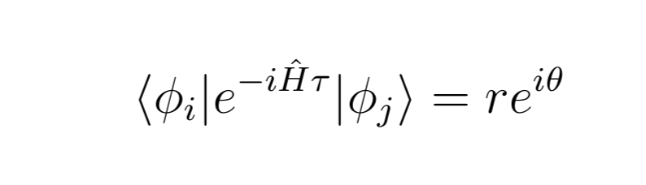
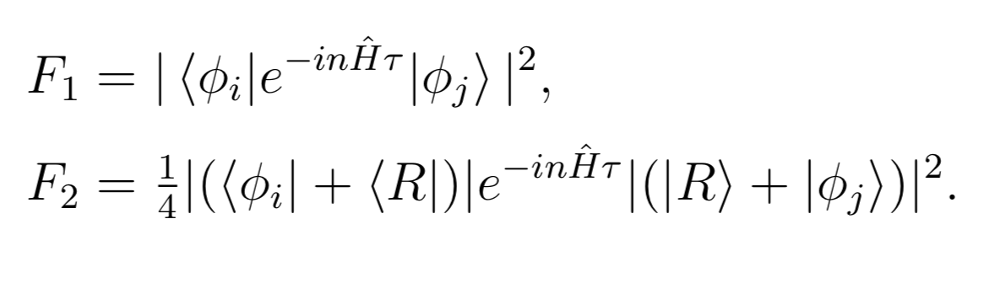
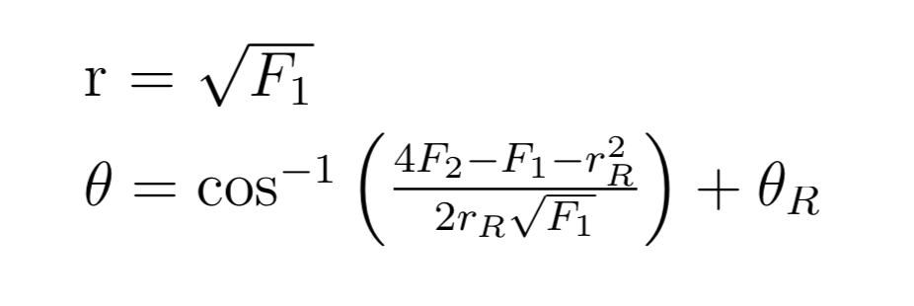
Appendix: evaluating the overlaps
Need to evaluate the complex amplitudes:
Can do so by evaluating the two fidelities,
which can be related to the polar decomposition of the amplitude via
The choice of the reference state being the vacuum (e.g., no electrons) is especially convenient:

