Slide 1
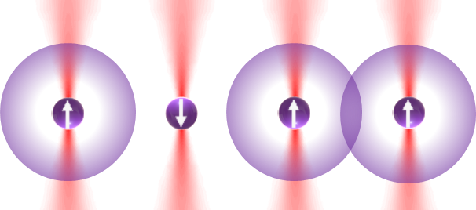
Neutral atom quantum simulations for nuclear physics
erhtjhtyhy
Michael Bishof
Assistant Physicist
Physics Division
Medium Energy Physics
TRACER
Monday, Nov. 22, 2021

Slide 2
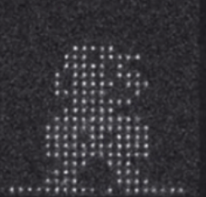
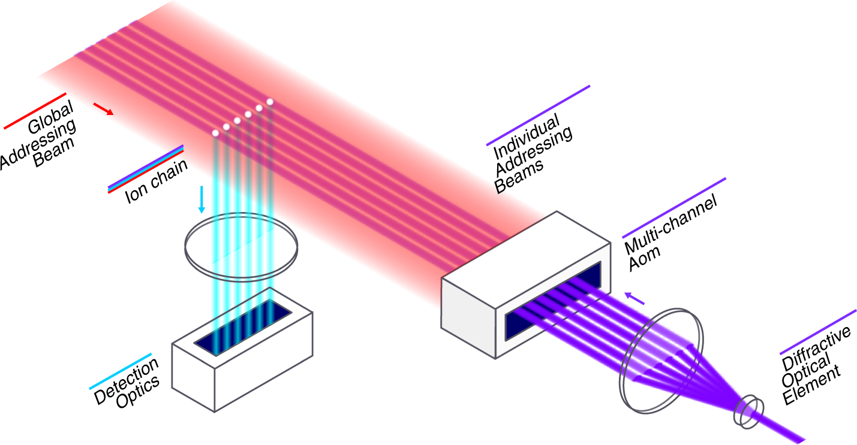
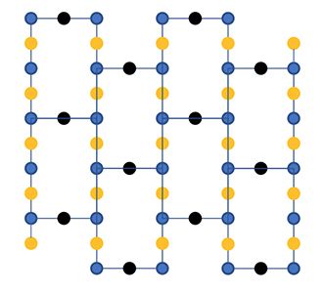
Quantum capabilities as I see it
Qubit Technology | Best entangling fidelity | Average 2-qubit fidelity | Connectivity | Scalability
Superconducting | 0.999 | 0.99->0.98 | Heavy Hex | Meh
Trapped Ion | 0.999 | 0.97 | All to all* | Even worse
Neutral Atoms | 0.99 | 0.97 | NN or NNN | 🚀🚀🚀
*Demonstrated for systems up to 11 qubits
Neutral atoms in their most useful form.
Heavy hex connectivity.
Trapped ion chain.
Image credit: IBM
Wright, K., Beck, K.M., Debnath, S. et al. Benchmarking an 11-qubit quantum computer. Nat Commun 10, 5464 (2019).
Image credit: QuEra

Slide 3
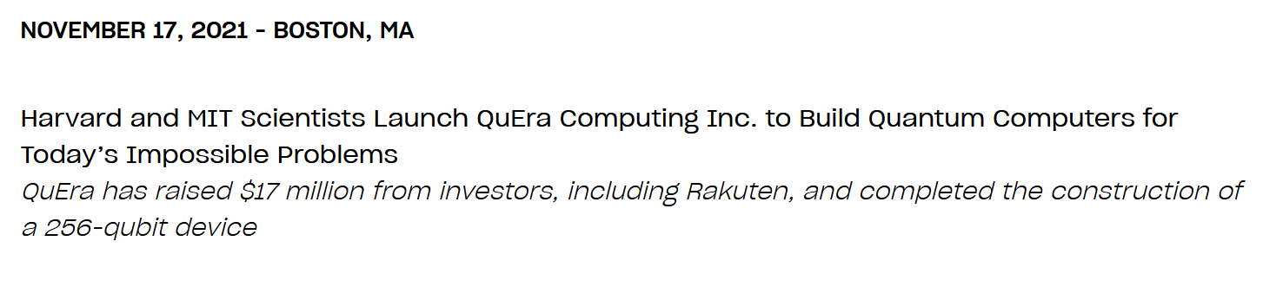

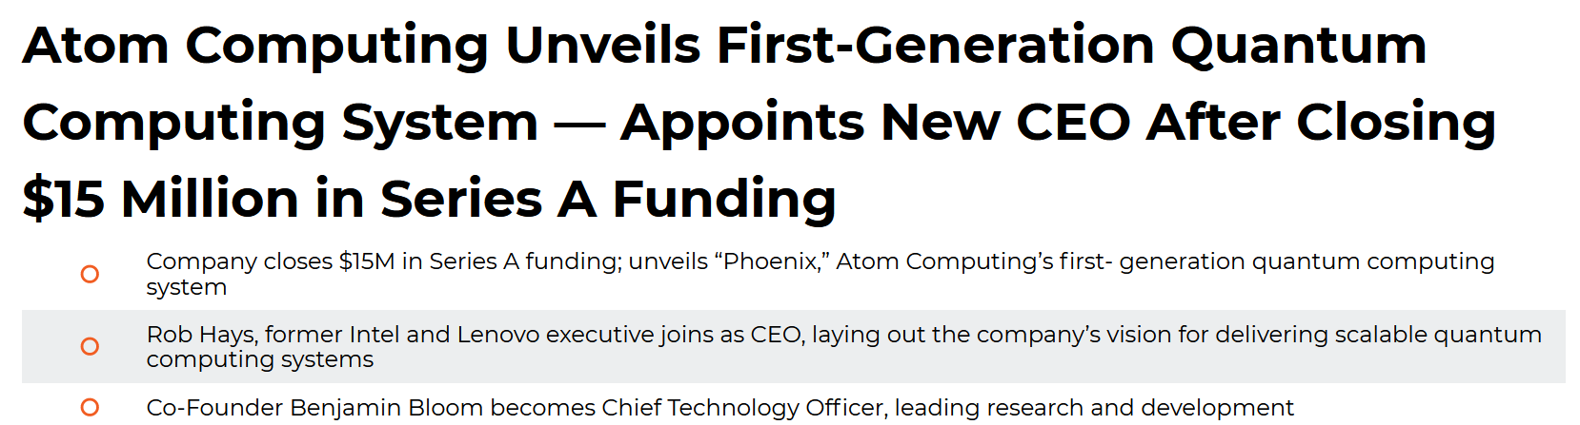

Are we entering the neutral atom quantum computing golden age?

Slide 4
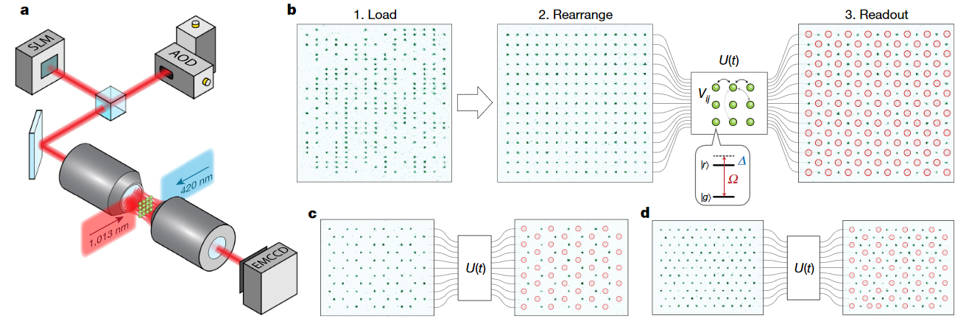
Neutral atoms and quantum simulation
Recent publication with 256 qubit simulation
  Ebadi, S., Wang, T.T., Levine, H. et al. Quantum phases of matter on a 256-atom programmable quantum simulator. Nature 595, 227–232 (2021).
Perform global operations on larger groups of qubits
  Observe global behavior but with fine grain qubit state information
Scalable individual qubit control also possible.

Slide 5
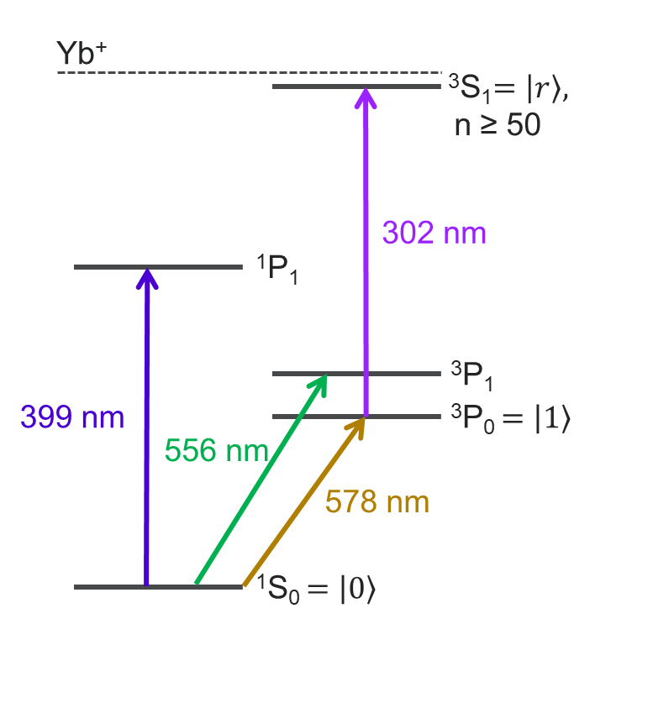
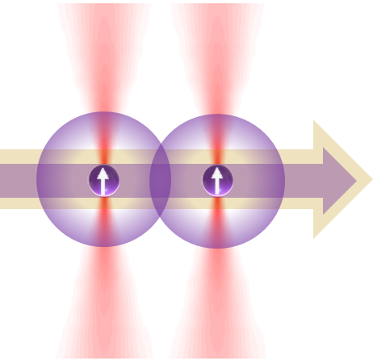
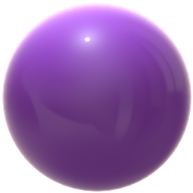
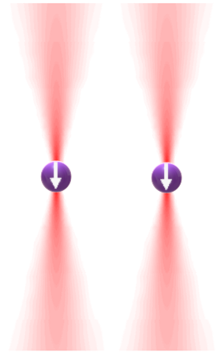
Netutral Yb atoms: even better
Excitation to “clock” metastable state to select atoms for interaction
Second excitation to Rydberg state to turn on an off interactions as desired
Atomic state can couple to telecom wavelengths to achieve long distance entanglement between systems for clock networks or distributed quantum sensors
³D₁
1.4 μm
= 1.16 μm ÷ 2

Slide 6
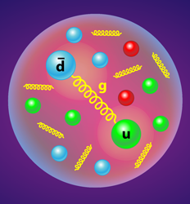
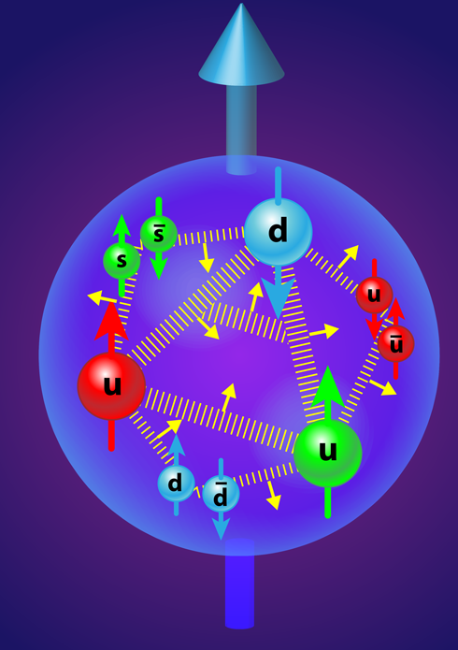

Investigate how the properties of nucleons and nuclei emerge from fundamental interactions of quarks and gluons
Well… they’re kind of like quarks
Discrete space
Gluons are too difficult
1 flavor
1 color
Images: APS/Alan Stonebraker
Now I just need a cocktail napkin.
>1+1D is difficult
Encode in atomic state

Slide 7
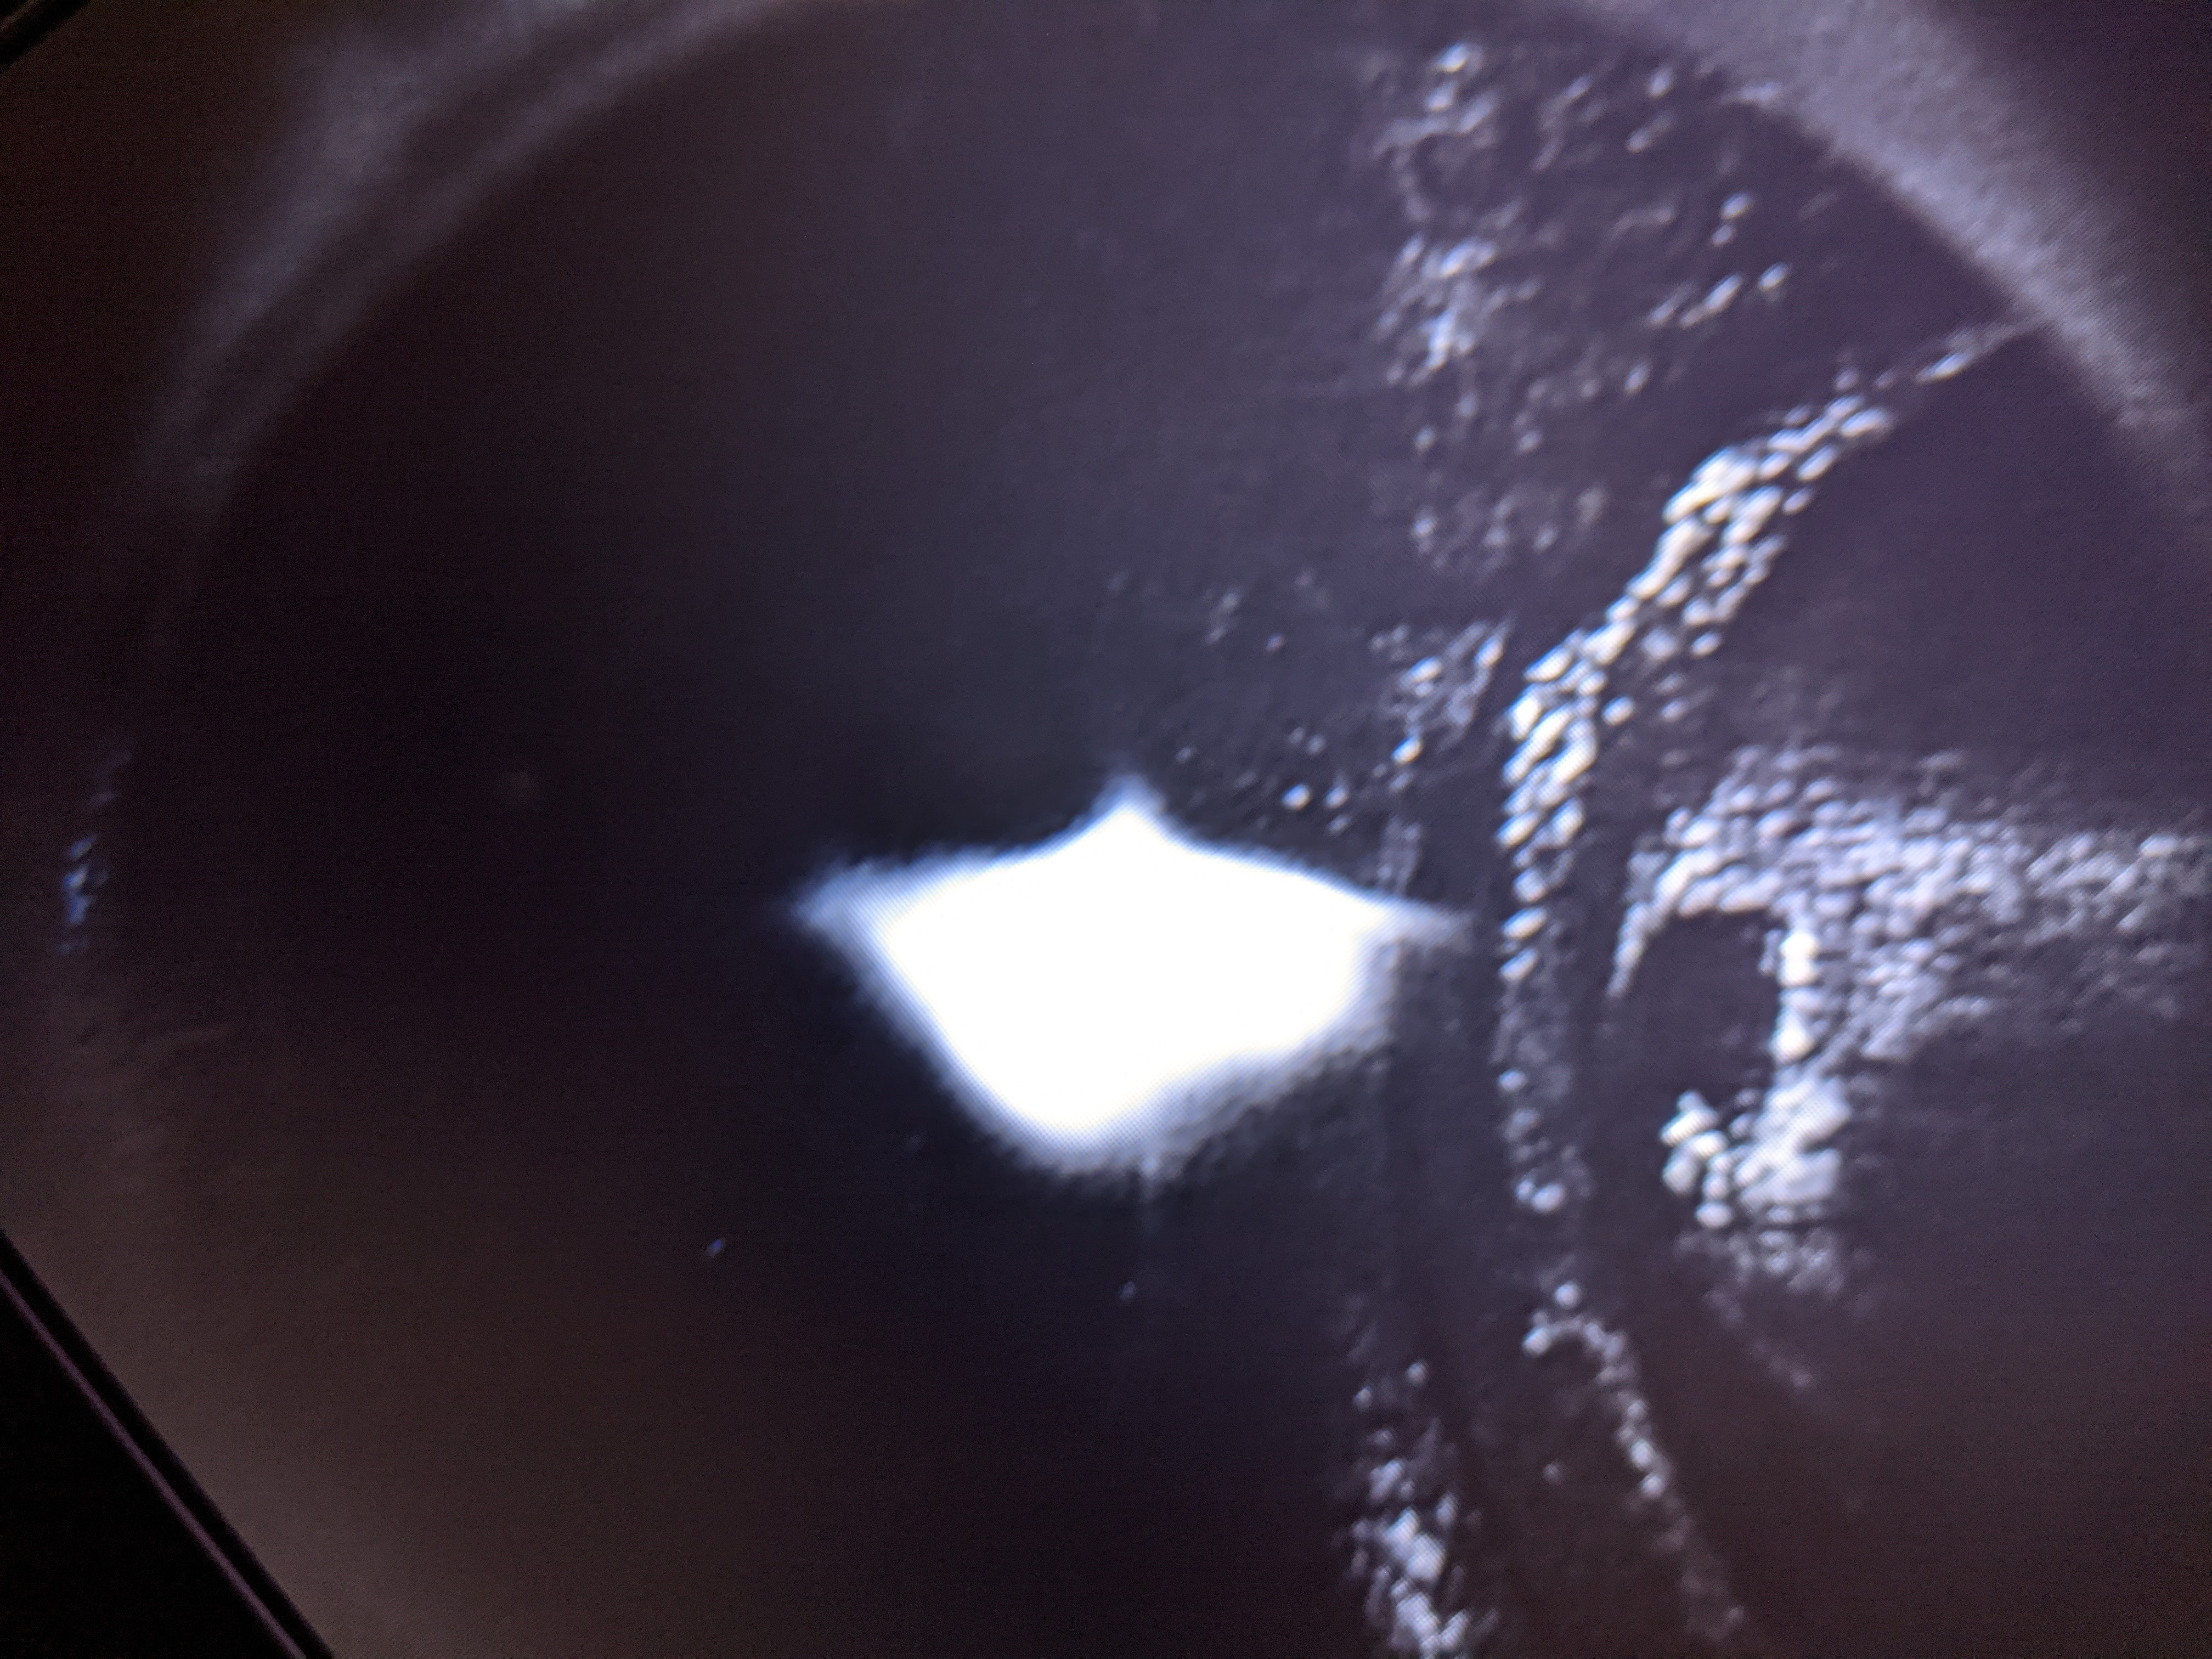
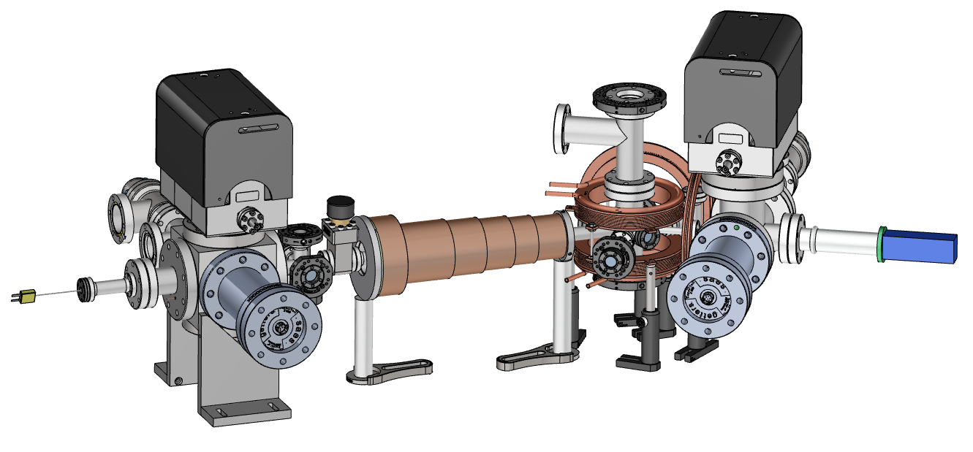
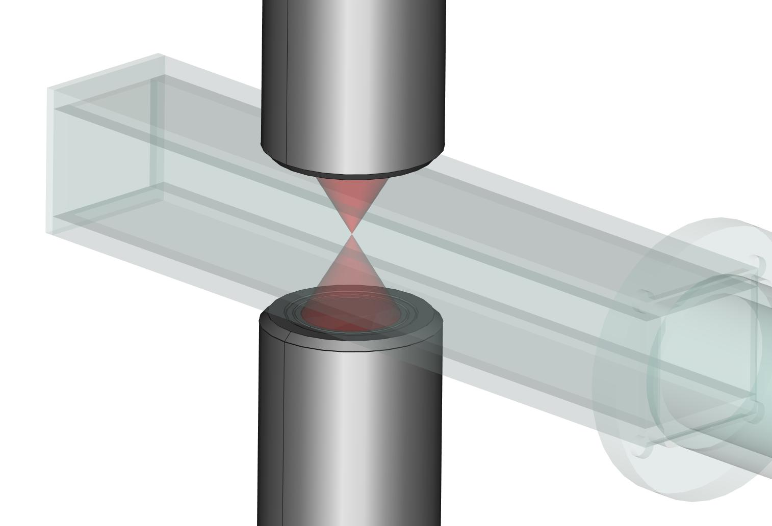
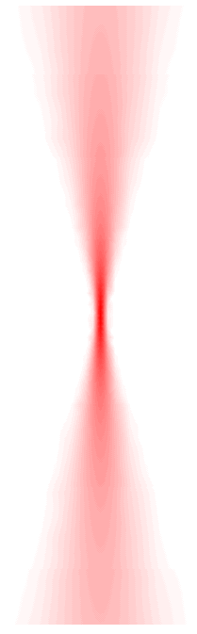
Argonne’s Analog quantum apparatus (AQuA)
Roadmap and Progress
FY2021 | FY2022 | FY2023 | FY2024 | FY2025
System design and construction | Tweezer trapping | Clock state manipulation | Rydberg excitation | Scale to 2D
MOT Trapping | Atom arrangement | Single qubit control | 1D Simulation | 2D simulations
Lots of Yb atoms in a MOT!
~1 m

Slide 8
A pathfinder for nuclear physics quantum simulation
I. Cloët
P. Ramirez
R. Côté, Uconn
J. Osborne
“A neutral atom quantum simulator for nuclear physics”
2020 ECRP
Unified NP-QIS funded project at ANL
Funding began in FY20
“Pathfinder” began FY21
Strong, interdisciplinary team representing the many strengths of ANL
  PHY, CSD, CNM, university collaborators
M. Bishof
F. Granato
K. Bailey
T. O’Connor
M. Dietrich
P. Mueller
S. Gray
C. Cortes
J. Osborne
M. Saffman, UWM C. Cortes
S. Gray

