Slide 1
Writing a specific aims page
January 9, 2021

Slide 2
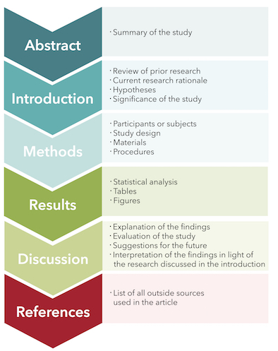
Scientific Article Format
ORDER
Abstract
Introduction
Skim Methods/Results
Discussion
Read Methods/Results
Notes:
Rely on mentors previously in program to explain expectations

Slide 3
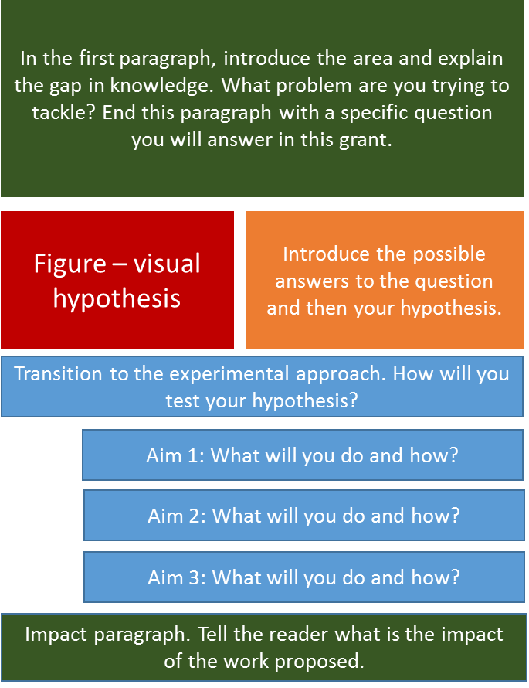

Slide 4
Why start with a specific aims page
A specific aims page is THE MOST CRITICAL part of any scientific project. It is a combination of persuasive writing and science married together in one page. A specific aims page does the following:
Demonstrates a problem, a gap in current knowledge, and suggests a solution
Aims that work toward a defended solution and reveal the impact of the proposal on the problem, the field, and future research
Creates easily understood rationale and methodology in laymen’s terms

Slide 5
Background
The gut microbiome has been commonly linked to chronic diseases such as obesity, diabetes, systemic immune and inflammatory response, which is often driven by the host’s lifestyle such as exercise. Within the gut microbiome, short-chain fatty acid producers (termed the “sBiome”) largely influence host systems and their metabolic pathways. Recent literature has demonstrated that sBiome proportions within the gut microbiome are strongly correlated to exercise activity and host fitness. One plausible theory is that the sBiome counteracts inflammatory expression in the gastrointestinal tract resulting in continued gut homeostasis during exercise. However, the mechanism that governs host-microbe interactions and the increase of the sBiome during/following exercise is poorly defined. Here, we will test the extent to which the sBiome mitigates exercise-induced inflammation across varying levels of physical fitness and the magnitude to which the sBiome can improve exercise capacity when transplanted into another host.
IMPACT STATEMENT
TARGETED BACKGROUND
THEORY/LINK
HYPOTHESIS

Slide 6
SIGNIFICANCE
Our previous research demonstrated that exercise induces compositional and functional changes in the sBiome, and that these changes are dependent on the initial state of body composition and contingent on sustained exercise (1). Furthermore, sBiome proportions are directly correlated to changes in energy expenditure via exercise prior to a detectable change in body composition (2). This preliminary data highlights the importance of defining the manner in which gut microbiome modulate cardiorespiratory fitness, body composition, and host metabolism – all of which are influenced by energy expenditure. Our working postulate is that biomarkers of anti- and pro-inflammation in the gut, i.e. IL-6 and IL-10, are the causal link between the sBiome and exercise. For example, increases in exercise are directly correlated to increases in gut anti-inflammatory biomarkers thereby decreasing immune activation and increasing protein synthesis, which could consequently improve muscle strength, training adaptations, and cardiorespiratory fitness. Based on our preliminary data and literature, we hypothesize that the sBiome is directly responsible for increased protein synthesis, energy availability, and anti-inflammatory consequences of physical fitness.
JUSTIFICATION
APPROACH

Slide 7
APPROACH
We will examine whether sBiome and their metabolic products (acetate, propionate, and butyrate) differ at varying cardiorespiratory fitness. Based on preliminary data, sBiome are differentially abundant in highly fit (athletes) individuals vs. the general population (non-athletes). We will utilize metagenomic sequencing and substrate phenotype arrays (Biolog plates) to identify microbial taxa, their functional/metabolic capacities, and substrate production/turnover between groups. Biolog plates will also be employed to analyze host inflammatory and immune responses. We anticipate that highly-fit individuals will show genes enriched within SCFA pathway, as well as increased SCFA rates of utilization. Also, we expect host pro-inflammatory and immune responses to be significantly lower in highly-fit individuals.
APPROACH
EXPECTATIONS

